Slide 1
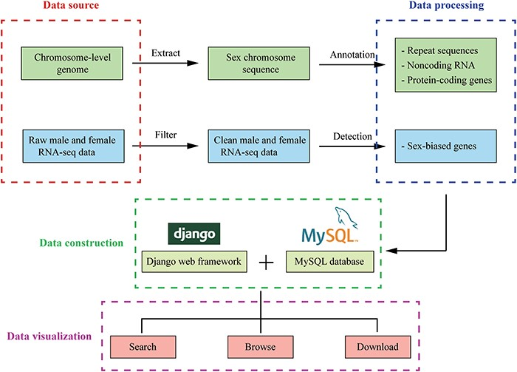
Figure 2. The overview of InSexBase. Genomes and sex-related RNA-seq data were collected from public databases. Sex ...
Notes:
Figure 2. The overview of InSexBase. Genomes and sex-related RNA-seq data were collected from public databases. Sex chromosome sequences were extracted from those genome data. Repeat sequences, non-coding RNAs and protein-coding genes were annotated from sex chromosome. Sex-biased genes were detected from male and female RNA-seq clean data. Finally, these data were deposited in InSexBase built with Django 3.0.5 web framework and all data were stored in a MySQL 5.7.17 database. Users can use browse, search and download functions to explore the database.
Unless provided in the caption above, the following copyright applies to the content of this slide: © The Author(s) 2021. Published by Oxford University Press.This is an Open Access article distributed under the terms of the Creative Commons Attribution License (http://creativecommons.org/licenses/by/4.0/), which permits unrestricted reuse, distribution, and reproduction in any medium, provided the original work is properly cited.

