Slide 1
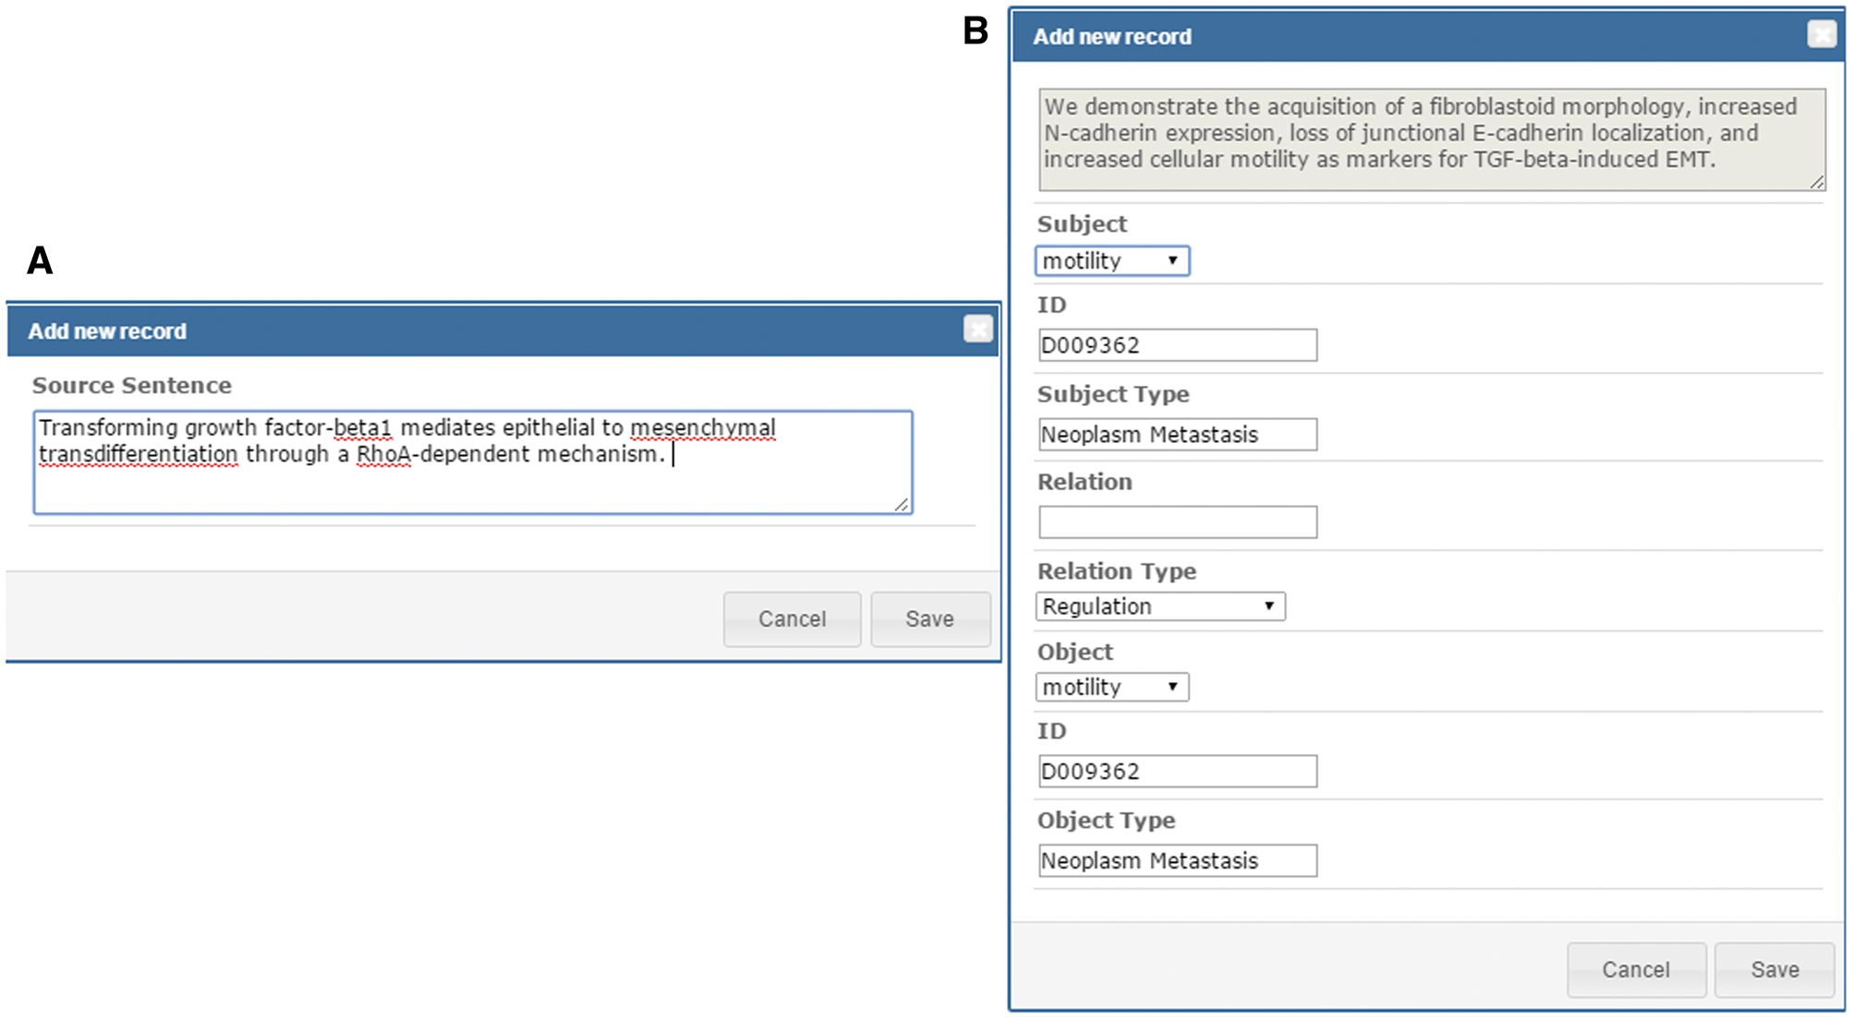
Figure 4. Curation interface for adding source sentences and relations.
Notes:
Figure 4. Curation interface for adding source sentences and relations.
Unless provided in the caption above, the following copyright applies to the content of this slide: © The Author(s) 2016. Published by Oxford University Press. This is an Open Access article distributed under the terms of the Creative Commons Attribution License ( http://creativecommons.org/licenses/by/4.0/ ), which permits unrestricted reuse, distribution, and reproduction in any medium, provided the original work is properly cited.

