Slide 1
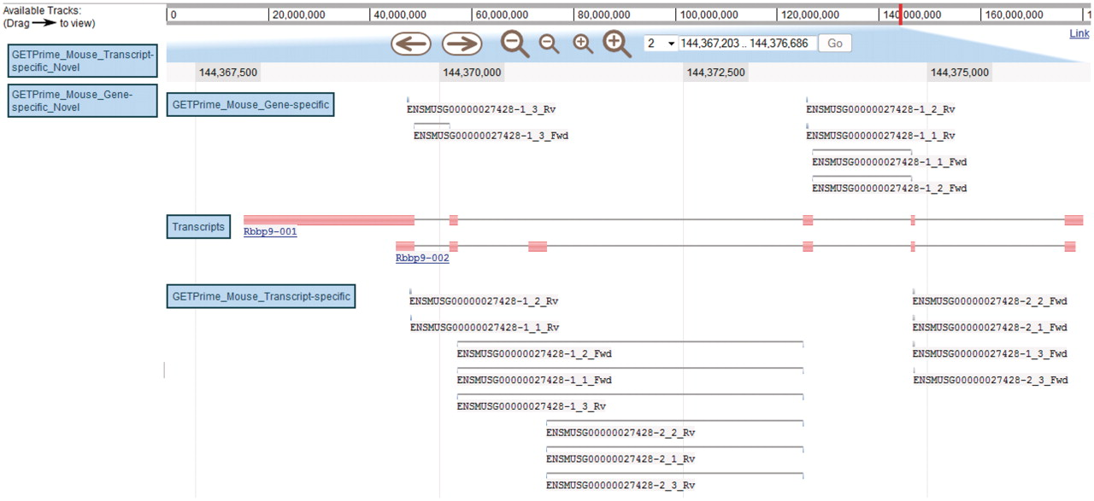
Figure 5. JBrowse-based graphical view of GETPrime primer pairs targeting the Rbbp9 mouse gene. The blue boxes on the ...
Notes:
Figure 5. JBrowse-based graphical view of GETPrime primer pairs targeting the Rbbp9 mouse gene. The blue boxes on the left are the available tracks that can be dragged in the JBrowse genome view (23). In this example, the transcripts, the gene-specific primers (covering the majority of splice variants if possible) and the transcript-specific primers (covering a single splice variant, when possible) have been dragged into the browser. The upper part of the figure shows tools to zoom, to move to up- or downstream of the genome location, and to enter another chromosome, another position on the chromosome or also an Ensembl ID. Each primer is annotated by its Ensembl ID, its iteration in GETPrime (e.g. −1), its ranking (e.g. _3) and its primer type (forward and reverse primers are abbreviated Fwd and Rv, respectively). The blue box for each primer represents the respective alignment to the transcripts and sometimes a thin line between two blue boxes is used to bridge an intron region for primers spanning two exons. The primer pairs in the gene-specific track cover both transcripts. The primer pairs from the first iteration (‘−1’) and the second iteration (‘−2’) in the transcript-specific track are specific to the largest transcript Rbbp9-001 and the shortest transcript Rbbp9-002, respectively.
Unless provided in the caption above, the following copyright applies to the content of this slide: © The Author(s) 2011. Published by Oxford University Press.This is Open Access article distributed under the terms of the Creative Commons Attribution Non-Commercial License (http://creativecommons.org/licenses/by-nc/2.5), which permits unrestricted non-commercial use, distribution, and reproduction in any medium, provided the original work is properly cited.

