Slide 1
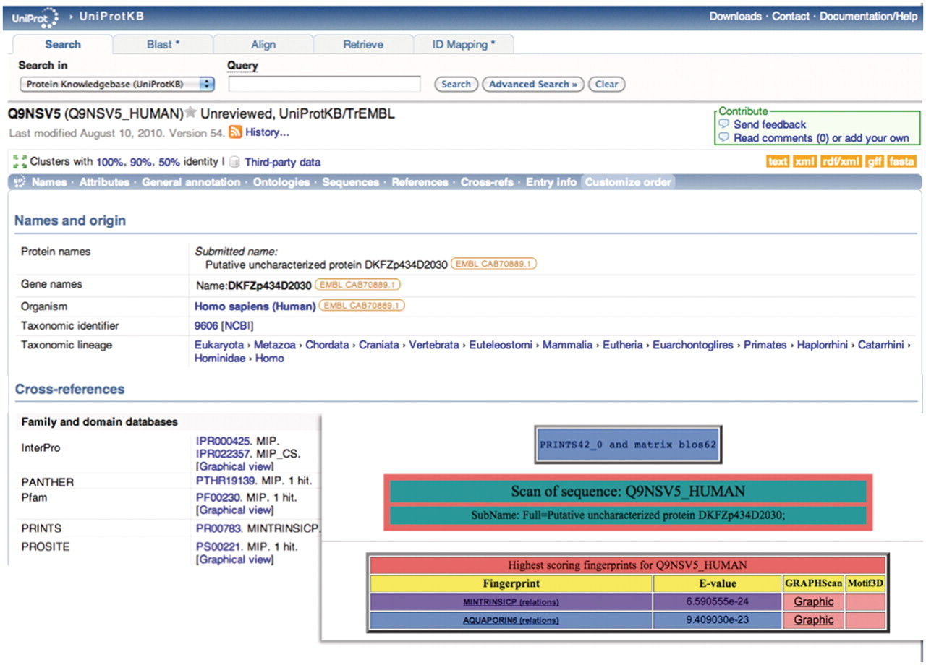
Figure 1. Illustration of a hierarchical PRINTS diagnosis. The UniProtKB/TrEMBL entry Q9NSV5_HUMAN was annotated as ...
Notes:
Figure 1. Illustration of a hierarchical PRINTS diagnosis. The UniProtKB/TrEMBL entry Q9NSV5_HUMAN was annotated as putative uncharacterized protein DKFZp434D2030; the family- and domain-database cross-references suggested membership of the major intrinsic protein (MIP) superfamily, but provided no specific family affiliation. The FingerPRINTScan result (inset) diagnoses the sequence both as a member of the MIP superfamily and as an aquaporin 6 subtype.
Unless provided in the caption above, the following copyright applies to the content of this slide: © The Author(s) 2012. Published by Oxford University Press.This is an Open Access article distributed under the terms of the Creative Commons Attribution Non-Commercial License (http://creativecommons.org/licenses/by-nc/3.0), which permits unrestricted non-commercial use, distribution, and reproduction in any medium, provided the original work is properly cited.

Slide 2
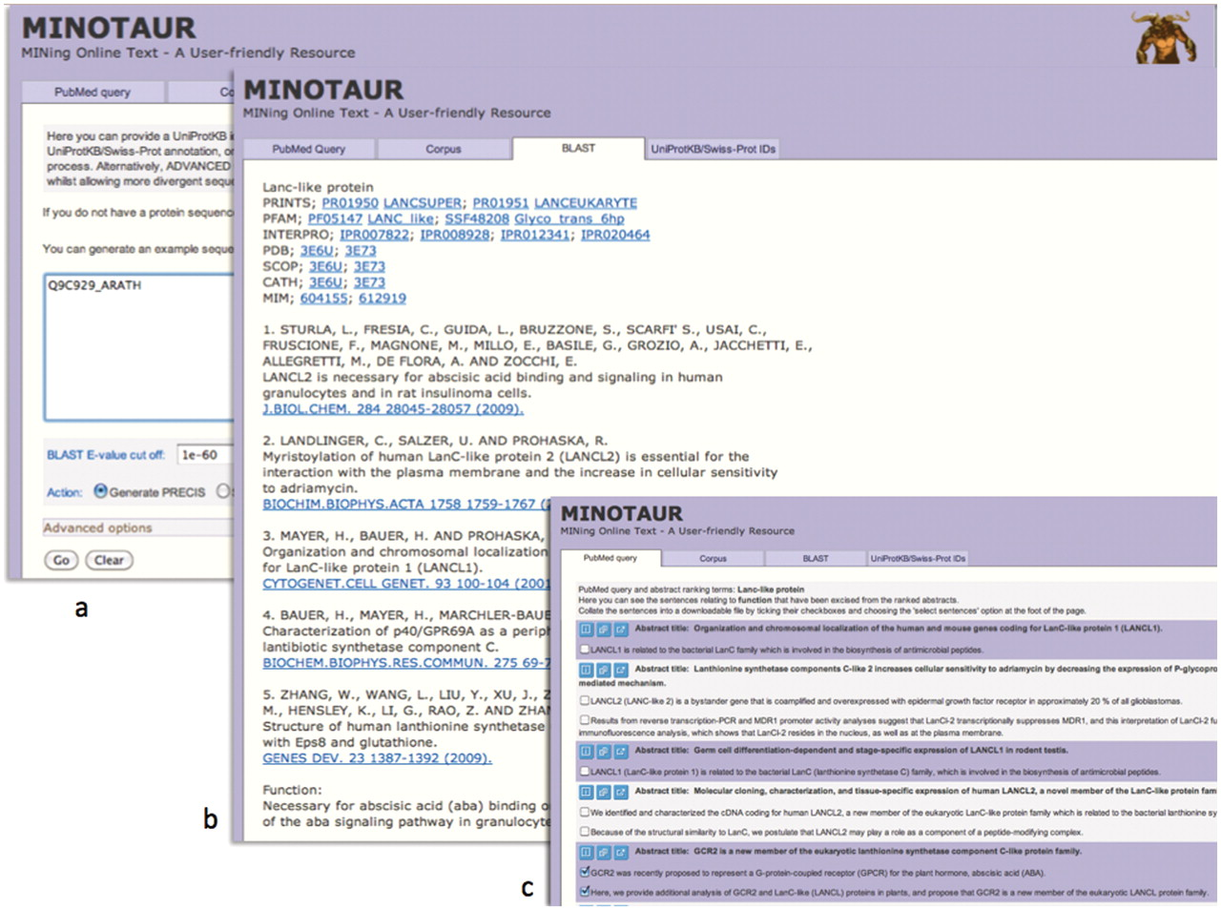
Figure 2. Using the MINOTAUR curator-assistant tool to generate a protein report and extract structure-related ...
Notes:
Figure 2. Using the MINOTAUR curator-assistant tool to generate a protein report and extract structure-related sentences from the literature: (a) shows the BLAST-PRECIS input option, with putative G-protein-coupled receptor, Q9C929_ARATH, as the query sequence; (b) shows the returned PRECIS report from the top 7 BLAST hits, which suggests the sequence really belongs to the LanC-like protein family; (c) selection of relevant sentences from the PubMed query results, confirming that the sequence is unlikely to be a GPCR.
Unless provided in the caption above, the following copyright applies to the content of this slide: © The Author(s) 2012. Published by Oxford University Press.This is an Open Access article distributed under the terms of the Creative Commons Attribution Non-Commercial License (http://creativecommons.org/licenses/by-nc/3.0), which permits unrestricted non-commercial use, distribution, and reproduction in any medium, provided the original work is properly cited.

Slide 3
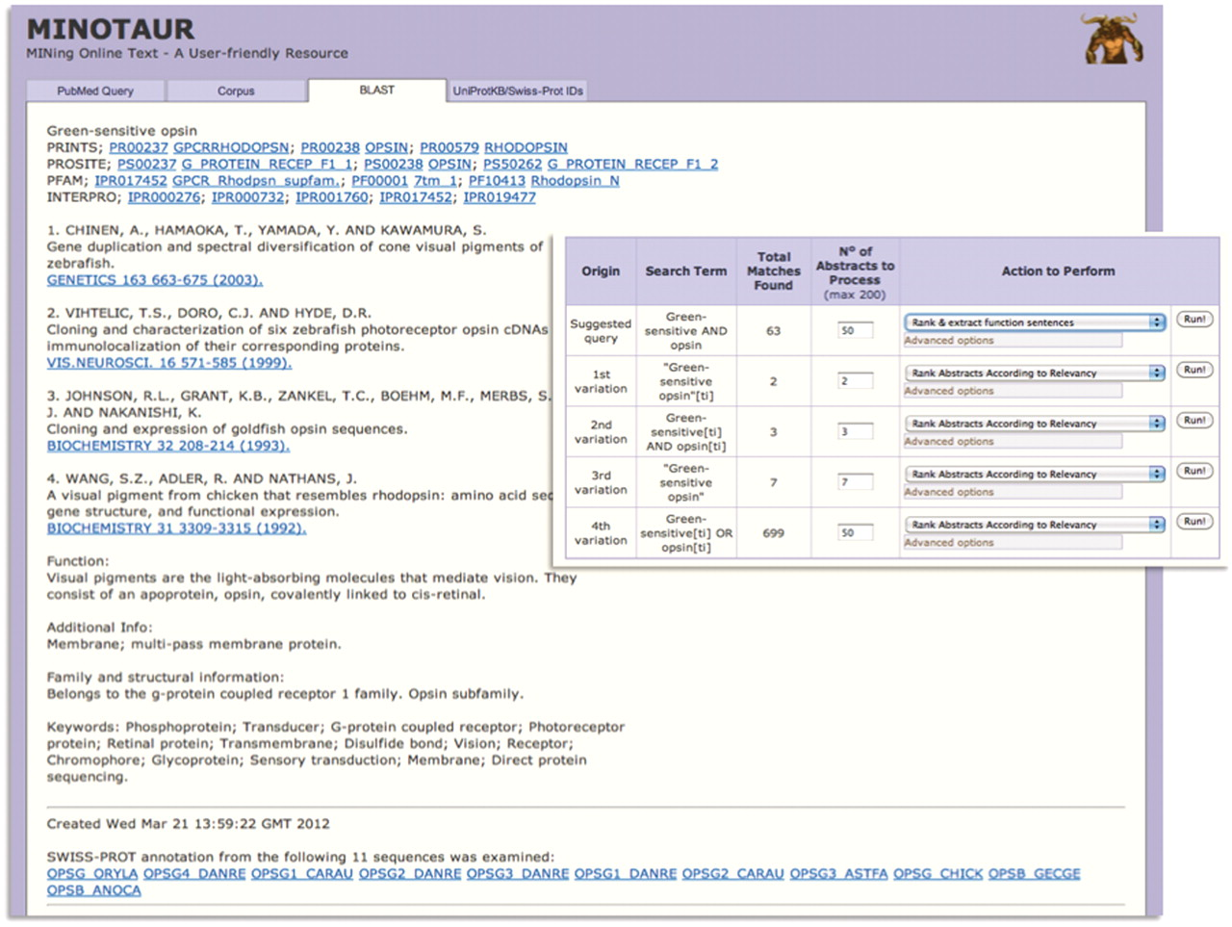
Figure 3. Using MINOTAUR to generate a PRECIS report for query sequence, Q30HW6_9CICH. The report, culled from the top ...
Notes:
Figure 3. Using MINOTAUR to generate a PRECIS report for query sequence, Q30HW6_9CICH. The report, culled from the top 11 BLAST hits, suggests the sequence is a green-sensitive opsin—accordingly, the annotation extracted from UniProtKB/Swiss-Prot relates to the function of opsins. However, the hierarchical PRINTS diagnosis suggests that the sequence is a rhodopsin. To shed light on the discrepancy, the sequence can be used to generate possible PubMed queries—the inset shows that the recommended query is ‘Green-sensitive AND opsin’, and the SVM-based ‘rank and extract function sentences’ qualifier has been selected to extract sentences from the 63 retrieved abstracts.
Unless provided in the caption above, the following copyright applies to the content of this slide: © The Author(s) 2012. Published by Oxford University Press.This is an Open Access article distributed under the terms of the Creative Commons Attribution Non-Commercial License (http://creativecommons.org/licenses/by-nc/3.0), which permits unrestricted non-commercial use, distribution, and reproduction in any medium, provided the original work is properly cited.

Slide 4
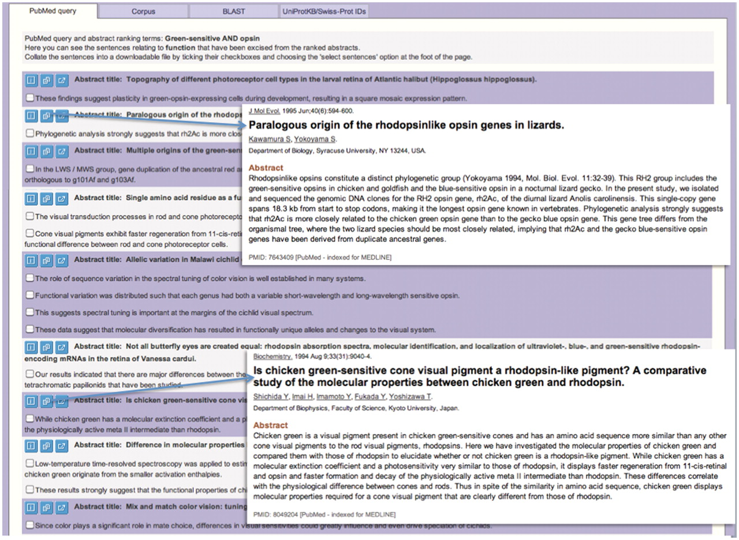
Figure 4. Using MINOTAUR to select function-related sentences relevant to query sequence, Q30HW6_9CICH. The top ...
Notes:
Figure 4. Using MINOTAUR to select function-related sentences relevant to query sequence, Q30HW6_9CICH. The top sentences are shown, following use of the search options illustrated in Figure 3. The parent abstracts for each group of sentences may be quickly viewed by clicking on the appropriate icon (inset). In the examples highlighted, a set of green-sensitive opsins is noted to belong to a distinct ‘rhodopsin-like’ phylogenetic group, being more similar to rhodopsins than they are to other green pigments. This helps to resolve the apparent ambiguity in the PRINTS cross-reference to rhodopsins rather than to green-sensitive opsins: sequences in this group clearly have a rhodopsin-like sequence signature and not a ‘green’ one.
Unless provided in the caption above, the following copyright applies to the content of this slide: © The Author(s) 2012. Published by Oxford University Press.This is an Open Access article distributed under the terms of the Creative Commons Attribution Non-Commercial License (http://creativecommons.org/licenses/by-nc/3.0), which permits unrestricted non-commercial use, distribution, and reproduction in any medium, provided the original work is properly cited.

Slide 5
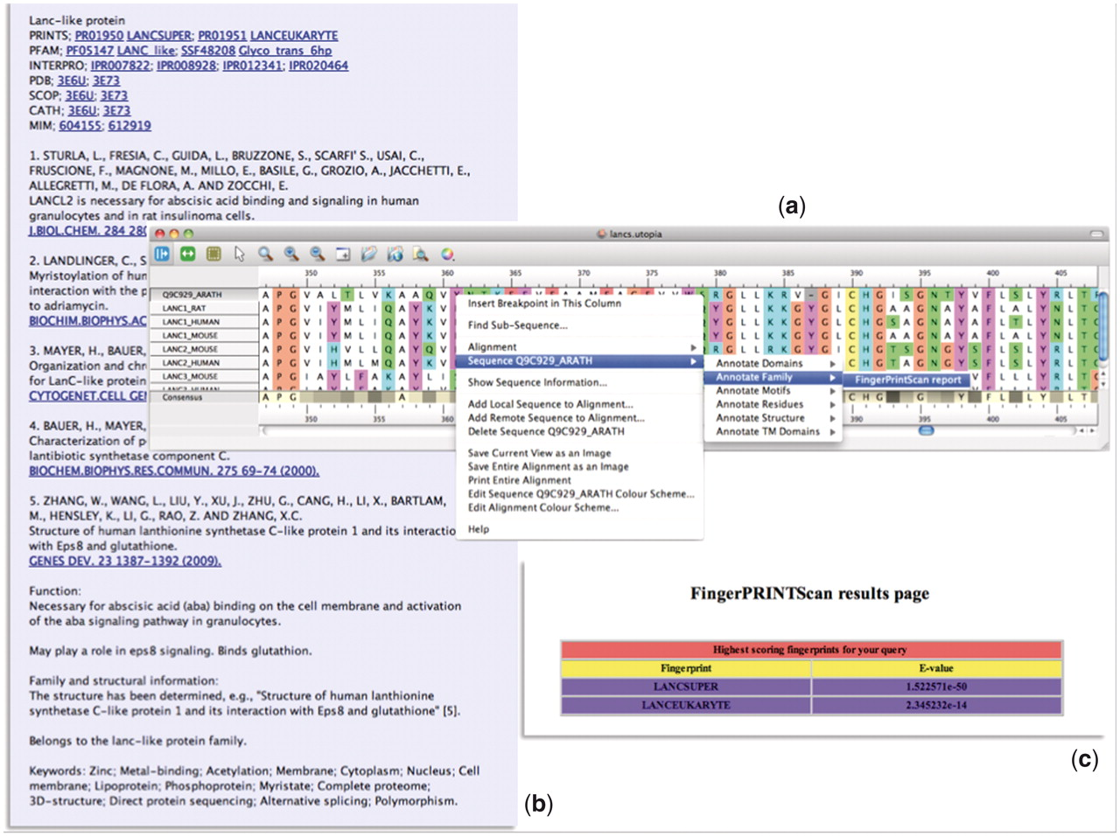
Figure 5. Illustration of the PRECIS and FingerPRINTScan Web-service plugins integrated within Utopia’s CINEMA ...
Notes:
Figure 5. Illustration of the PRECIS and FingerPRINTScan Web-service plugins integrated within Utopia’s CINEMA alignment editor: (a) shows an alignment of sequence Q9C929_ARATH with LanC-like proteins, with the context-sensitive menu invoking a Web-service plugin; (b) shows the report generated for this group of sequences by the PRECIS plugin; and (c) shows the FingerPRINTScan-plugin result for a PRINTS search with Q9C929_ARATH, which diagnoses the sequence as a eurkaryotic LanC-like protein belonging to the LanC-like superfamily.
Unless provided in the caption above, the following copyright applies to the content of this slide: © The Author(s) 2012. Published by Oxford University Press.This is an Open Access article distributed under the terms of the Creative Commons Attribution Non-Commercial License (http://creativecommons.org/licenses/by-nc/3.0), which permits unrestricted non-commercial use, distribution, and reproduction in any medium, provided the original work is properly cited.

