Slide 1
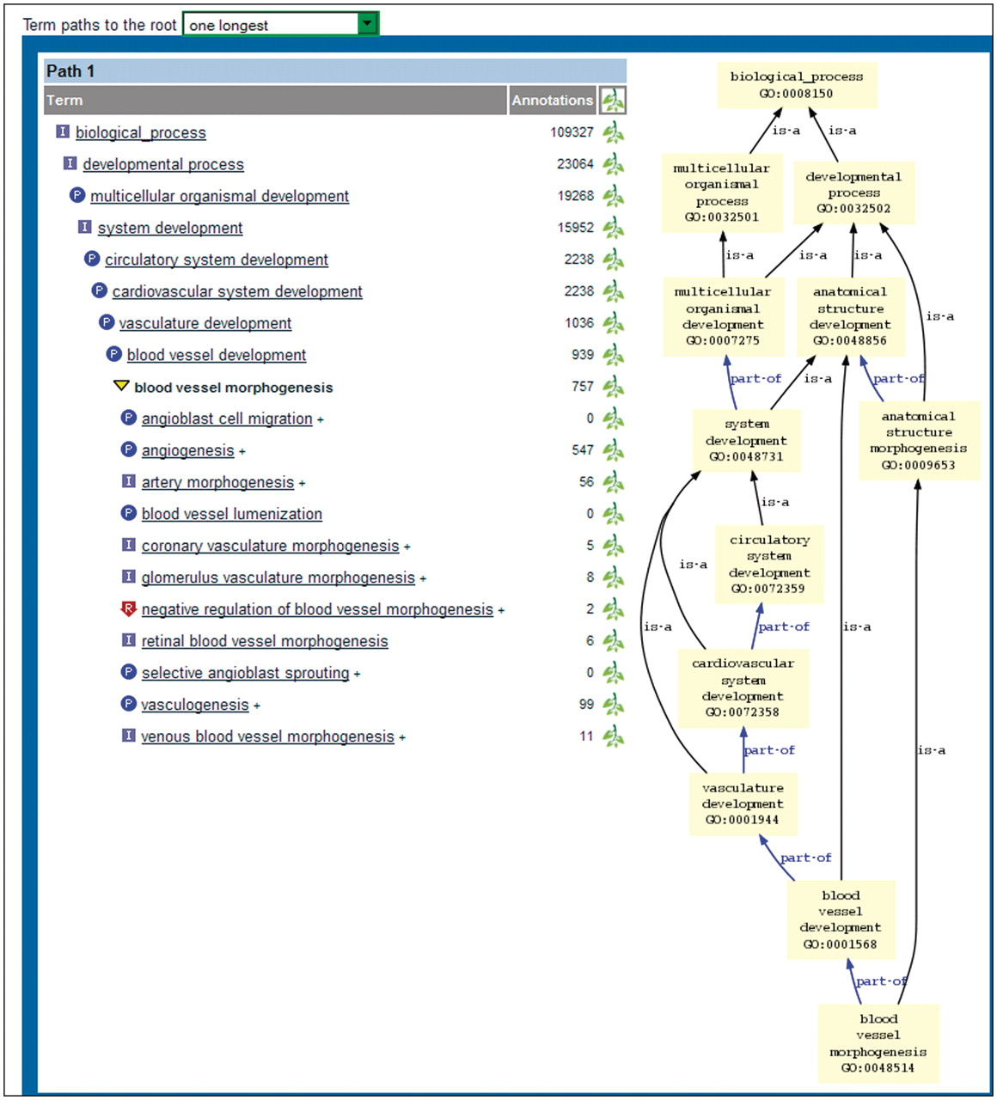
Figure 7. Bottom portion of new ontology report page. The tree view on the left shows the selected term in boldface. ...
Notes:
Figure 7. Bottom portion of new ontology report page. The tree view on the left shows the selected term in boldface. The parent and child terms are shown above and below the selected term, respectively. A single path (the longest one) is displayed because ‘one longest’ has been chosen in the dropdown menu above the display. The graph view on the right shows all paths from the selected term to the root node.
Unless provided in the caption above, the following copyright applies to the content of this slide: © The Author(s) 2012. Published by Oxford University Press.This is an Open Access article distributed under the terms of the Creative Commons Attribution Non-Commercial License (http://creativecommons.org/licenses/by-nc/3.0), which permits unrestricted non-commercial use, distribution, and reproduction in any medium, provided the original work is properly cited.

