Slide 1
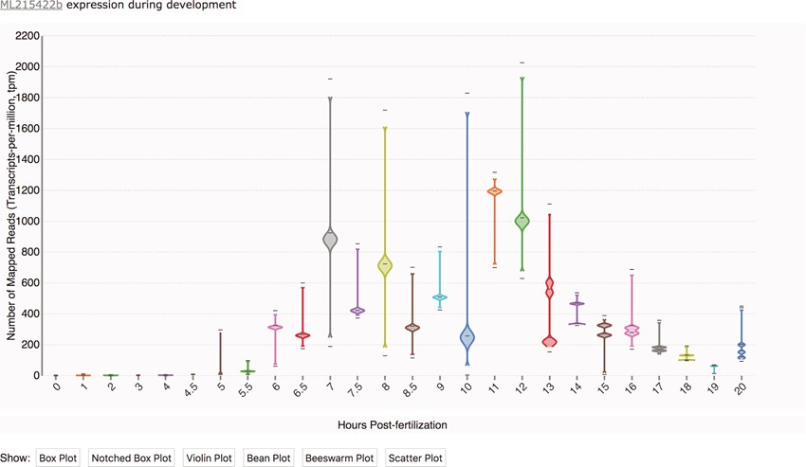
Figure 1 Transcriptomic data displayed as a time-course distribution plot for gene ML215422b. Time-course distribution ...
Notes:
Figure 1 Transcriptomic data displayed as a time-course distribution plot for gene ML215422b. Time-course distribution plots can be accessed through the ‘Temporal Developmental Expression Profile’ link on the MGP Portal home page. The expression profiles can be rendered in a variety of formats by clicking on the buttons immediately below the plot. Here, the profile is visualized as a bean plot.
Unless provided in the caption above, the following copyright applies to the content of this slide: Published by Oxford University Press 2020.This work is written by US Government employees and is in the public domain in the US.

