Slide 1
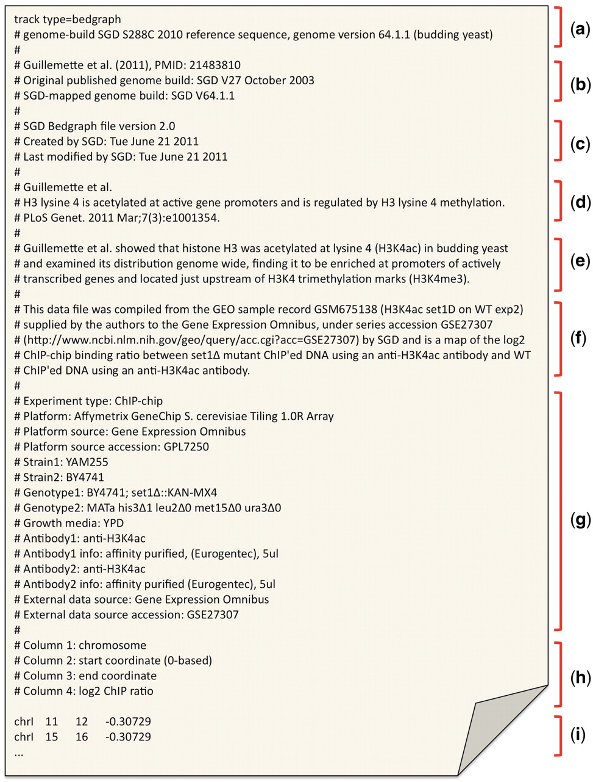
Figure 2. An example file header from a bedGraph file, containing the associated metadata collected from Guillemette et ...
Notes:
Figure 2. An example file header from a bedGraph file, containing the associated metadata collected from Guillemette et al. (28). The header is consistent across different standardized file types and generally contains the following sections: (a) track header (bed, wiggle and bedGraph) or GFF3 directives; (b) abbreviated publication reference and genome version information; (c) file version and modification dates; (d) publication citation from which the enclosed data is collected; (e) brief summary of the publication goal and/or findings; (f) brief summary of origin of enclosed data; (g) reserved ‘tag=value’ pairs containing experimental metadata details; (h) column descriptors for the enclosed standardized formatted data (bedGraph, in this example); and (i) bedGraph-formatted data values.
Unless provided in the caption above, the following copyright applies to the content of this slide: © The Author(s) 2012. Published by Oxford University Press.This is an Open Access article distributed under the terms of the Creative Commons Attribution Non-Commercial License (http://creativecommons.org/licenses/by-nc/3.0), which permits unrestricted non-commercial use, distribution, and reproduction in any medium, provided the original work is properly cited.

