Slide 1
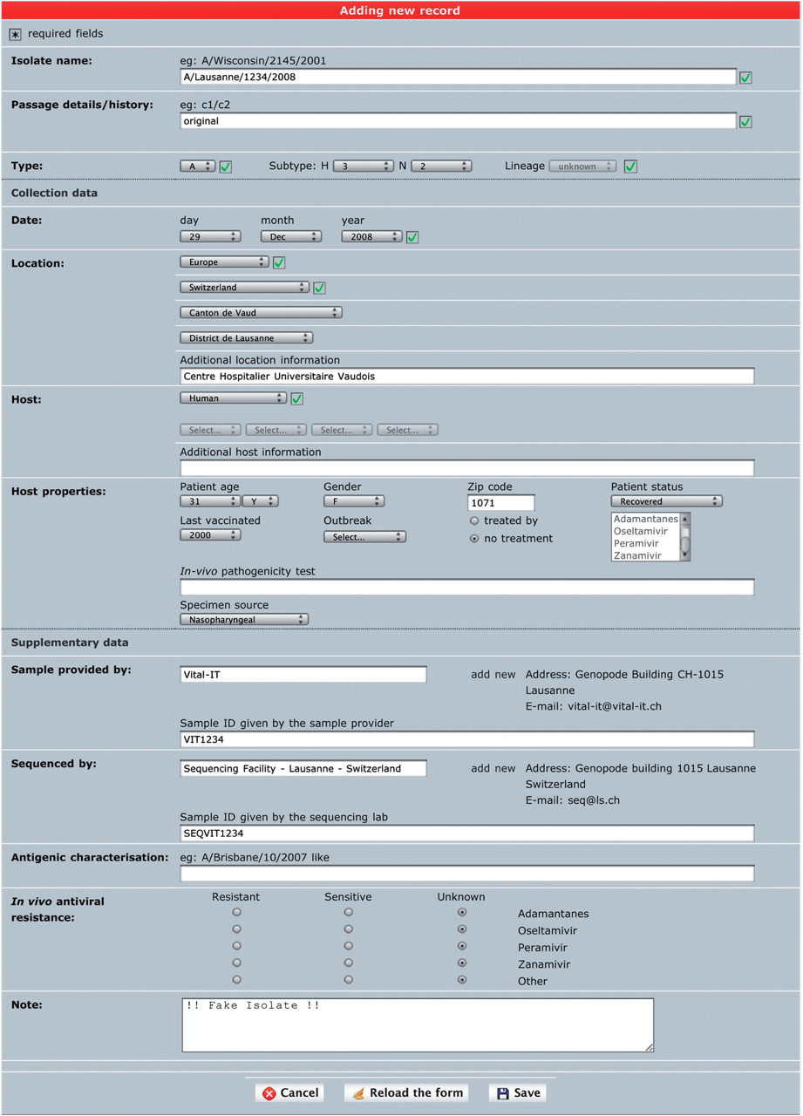
Figure 1. ‘Single isolate upload’ interface. The web form is split into three parts. The top one contains fields to ...
Notes:
Figure 1. ‘Single isolate upload’ interface. The web form is split into three parts. The top one contains fields to specify isolate name, isolate type and passage history. The syntax of the isolate name is verified against sample collection year and standard influenza nomenclature (except for laboratory-derived strains). The middle part contains sample data including host and sample collection date and geographical location. The bottom part contains additional data including sample provider laboratory, sequencer laboratory, in vivo tested antiviral resistance and user note.
Unless provided in the caption above, the following copyright applies to the content of this slide: © The Author(s) 2010. Published by Oxford University Press.This is Open Access article distributed under the terms of the Creative Commons Attribution Non-Commercial License (http://creativecommons.org/licenses/by-nc/2.5), which permits unrestricted non-commercial use, distribution, and reproduction in any medium, provided the original work is properly cited.

Slide 2
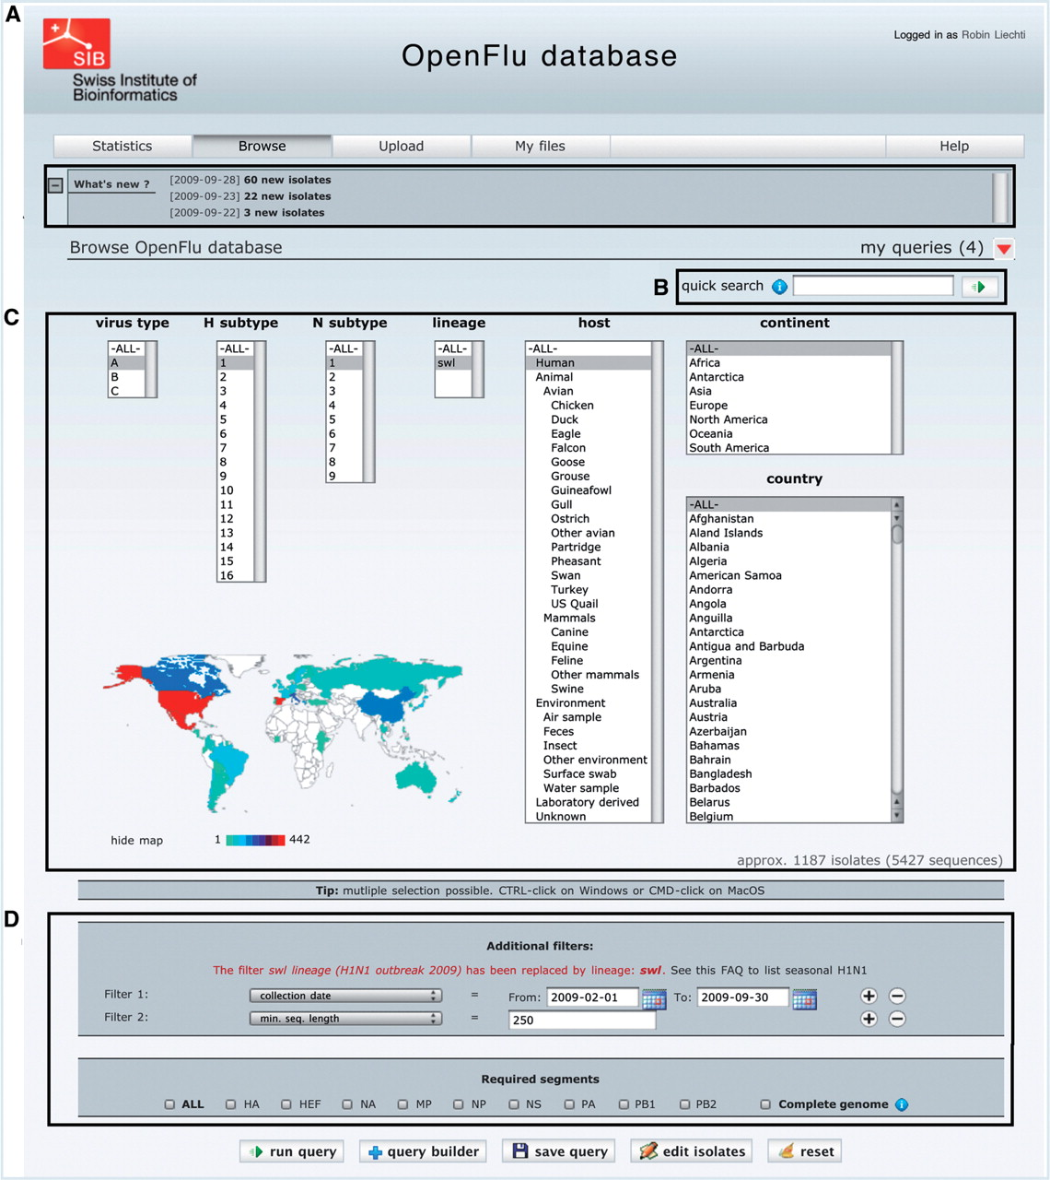
Figure 2. The ‘browse’ form is the major entry point to query the database. (A) ‘What’s new’ section contains links to ...
Notes:
Figure 2. The ‘browse’ form is the major entry point to query the database. (A) ‘What’s new’ section contains links to newly deposited sequences and announcements about OpenFluDB feature development. (B) The ‘Quick search’ field is used to query on EPI_ISL_ID, EPIID, isolate name or EMBL/DDBJ/GenBank accession numbers. (C) Basic ‘browse’ fields are composed of viral type and subtype, viral host and sample collection geographical location. Multiple selections are possible. (D) Several additional filters can be appended to the query; sample collection date, submission date, minimal sequence length, isolate name, EPI_ISL_ID, passage history, lineage, EPIID, DDBJ/EMBL/GenBank accession number, sequence submitter laboratory, whether the isolate has been primarily deposited in OpenFluDB, whether the isolate is publicly accessible in DDBJ/EMBL/GenBank and whether the sequence has a complete CDS. Finally, required segments or complete genome can be specified.
Unless provided in the caption above, the following copyright applies to the content of this slide: © The Author(s) 2010. Published by Oxford University Press.This is Open Access article distributed under the terms of the Creative Commons Attribution Non-Commercial License (http://creativecommons.org/licenses/by-nc/2.5), which permits unrestricted non-commercial use, distribution, and reproduction in any medium, provided the original work is properly cited.

Slide 3
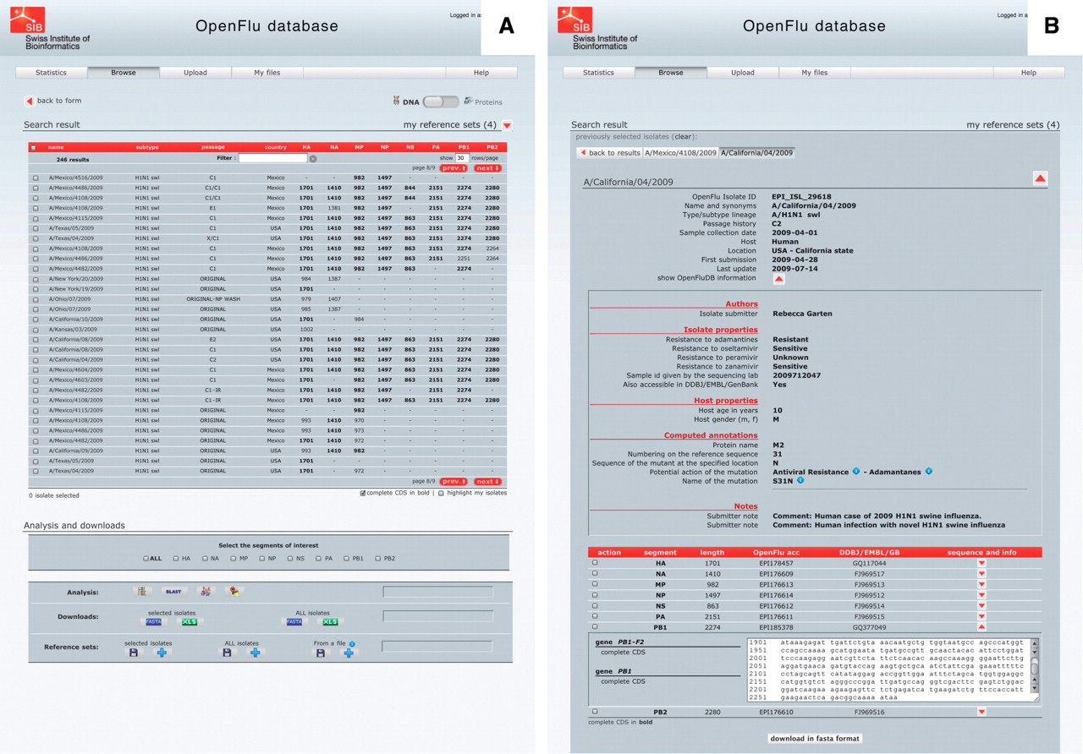
Figure 3. ‘Browse’ results are presented in an isolate-centric view. Columns contain either annotations or sequence ...
Notes:
Figure 3. ‘Browse’ results are presented in an isolate-centric view. Columns contain either annotations or sequence length. Switching between the nucleotide and protein views is done with the top right switch. Complete CDS or proteins can be highlighted in bold. Checkboxes are used to select isolates for further analysis, export or assignment to a reference set. Analysis buttons are from left to right: MUSCLE MSA, BLAST, SSMs and isolate geolocation. Isolate annotations are exported in a Microsoft Excel file and viral nucleotide or protein sequences are exported in a FASTA file.
Unless provided in the caption above, the following copyright applies to the content of this slide: © The Author(s) 2010. Published by Oxford University Press.This is Open Access article distributed under the terms of the Creative Commons Attribution Non-Commercial License (http://creativecommons.org/licenses/by-nc/2.5), which permits unrestricted non-commercial use, distribution, and reproduction in any medium, provided the original work is properly cited.

Slide 4
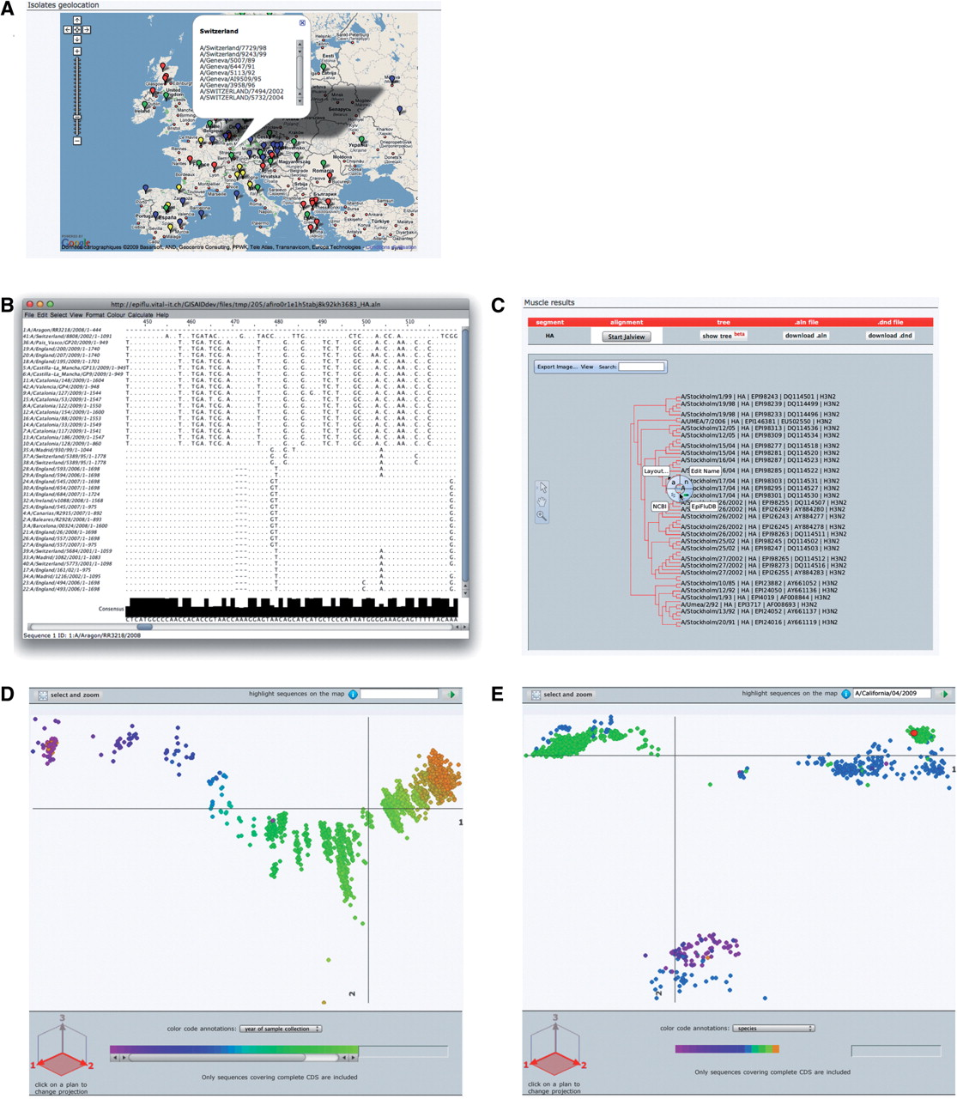
Figure 4. OpenFluDB analysis tools. (A) The Google Maps API is used to position sample collection on a world map. MSA ...
Notes:
Figure 4. OpenFluDB analysis tools. (A) The Google Maps API is used to position sample collection on a world map. MSA are computed with MUSCLE and displayed with Jalview (B) and as a tree with PhyloWidget (C). SSMs of hemaglutinin nucleotide sequences are computed by multidimensional scaling, and projections on the first two principal dimensions are displayed. (D) Human H3N2 sequences are colored based on year of sample collection revealing a genetic drift of the sequences. (E) H1 sequences are colored by host species. Three main clusters are revealed: human, swine and avian. Red highlighted sequences from the recent human swine H1N1 lineage are located near the swine cluster.
Unless provided in the caption above, the following copyright applies to the content of this slide: © The Author(s) 2010. Published by Oxford University Press.This is Open Access article distributed under the terms of the Creative Commons Attribution Non-Commercial License (http://creativecommons.org/licenses/by-nc/2.5), which permits unrestricted non-commercial use, distribution, and reproduction in any medium, provided the original work is properly cited.

