Slide 1
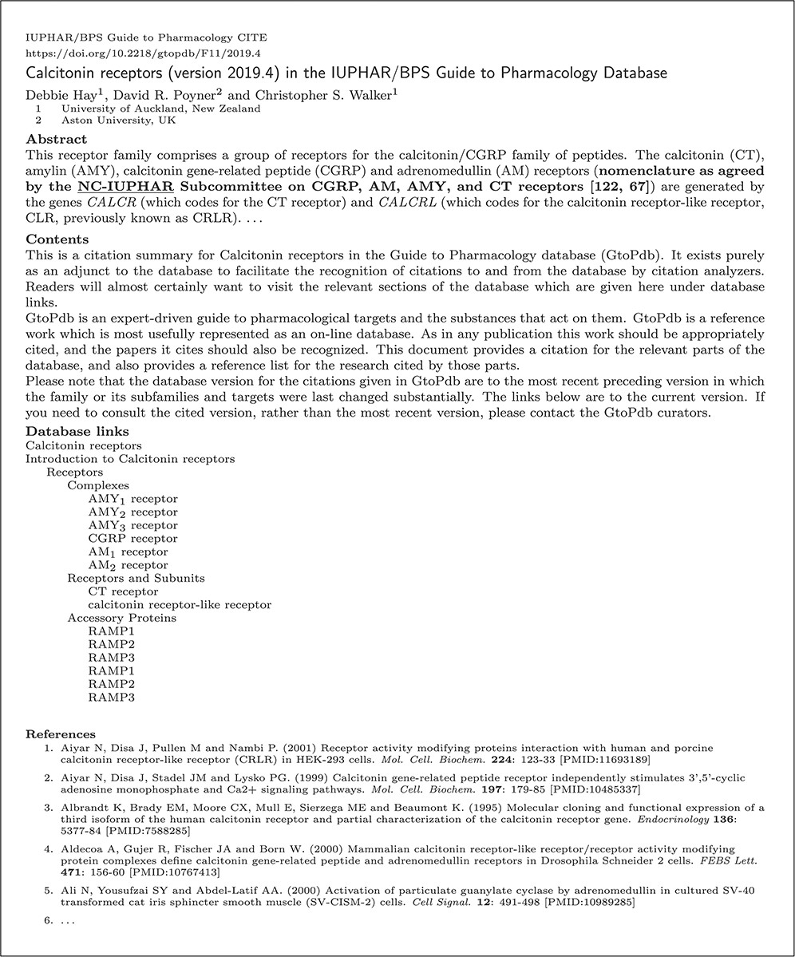
Fig. 8 Figure 8 Shows a heavily redacted (for reasons of space) summary that has been generated from GtoPdb. This is ...
Notes:
Fig. 8 Figure 8 Shows a heavily redacted (for reasons of space) summary that has been generated from GtoPdb. This is a paper (24) in the OJS Journal GtoPdb CITE. Electronic versions of this summary should provide working hypertext links to appropriate sections of the database and cited material.
Unless provided in the caption above, the following copyright applies to the content of this slide: © The Author(s) 2020. Published by Oxford University Press.This is an Open Access article distributed under the terms of the Creative Commons Attribution License (http://creativecommons.org/licenses/by/4.0/), which permits unrestricted reuse, distribution, and reproduction in any medium, provided the original work is properly cited.

