Slide 1
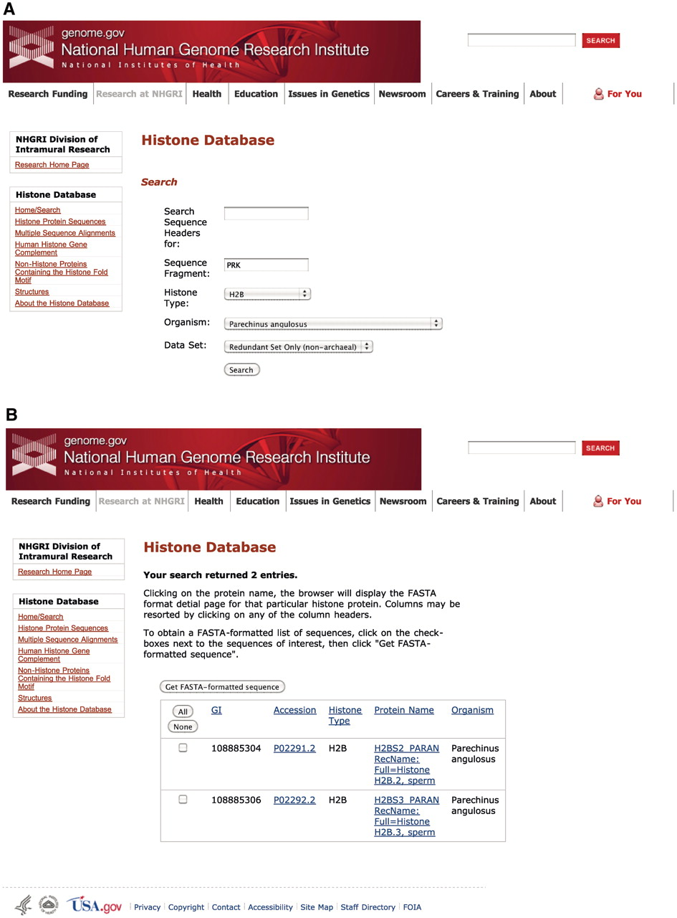
Figure 2. Histone Database query and results. The Histone Database main page displays a search engine that allows users ...
Notes:
Figure 2. Histone Database query and results. The Histone Database main page displays a search engine that allows users to find histone sequences from a large variety of organisms. Additionally, users have the possibility of exploring other features to access complete collections of Histone Protein Sequences, Multiple Sequence Alignments, The Human Histone Gene Complement, Non-Histone Proteins Containing the Histone fold Motif and Histone Structures. The upper panel shown (A) presents the criteria used for the query, which requires the sequence to contain a fragment with amino acids PRK from the angulate sea urchin (Parechinus angulosus) histone H2B. The search results presented in the lower panel (B) include two protein sequences that meet the criteria specified by the query.
Unless provided in the caption above, the following copyright applies to the content of this slide: © The Author(s) 2011. Published by Oxford University Press on behalf of the National Institutes of Health.This is an Open Access article distributed under the terms of the Creative Commons Attribution Non-Commercial License (http://creativecommons.org/licenses/by-nc/3.0), which permits unrestricted non-commercial use, distribution, and reproduction in any medium, provided the original work is properly cited.

