Slide 1
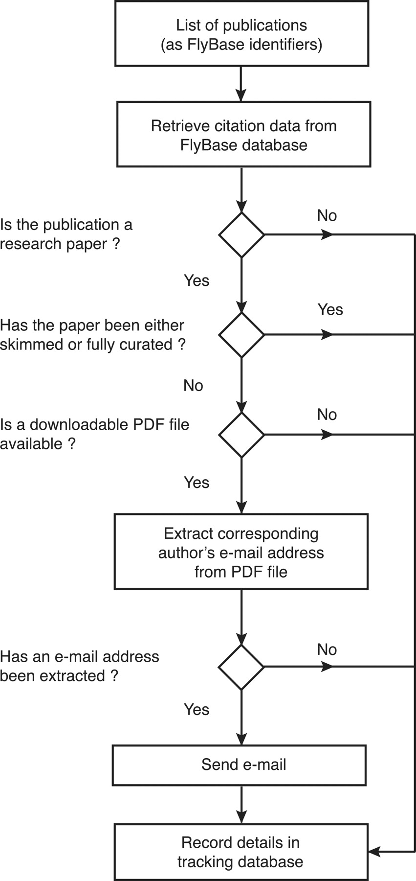
Figure 3. Workflow of the EmailAuthor software suite. For each publication, the software first checks its type and ...
Notes:
Figure 3. Workflow of the EmailAuthor software suite. For each publication, the software first checks its type and curation status using information stored in the FlyBase database. If it is a research paper that has not yet been triaged and a PDF file corresponding to the paper is available, the software attempts to extract the corresponding author’s e-mail address from the PDF file. If this is successful (97% of cases), an e-mail is sent to the extracted e-mail address. At each decision point, the information is stored in a tracking database.
Unless provided in the caption above, the following copyright applies to the content of this slide: © The Author(s) 2012. Published by Oxford University Press.This is an Open Access article distributed under the terms of the Creative Commons Attribution Non-Commercial License (http://creativecommons.org/licenses/by-nc/3.0), which permits unrestricted non-commercial use, distribution, and reproduction in any medium, provided the original work is properly cited.

