Slide 1
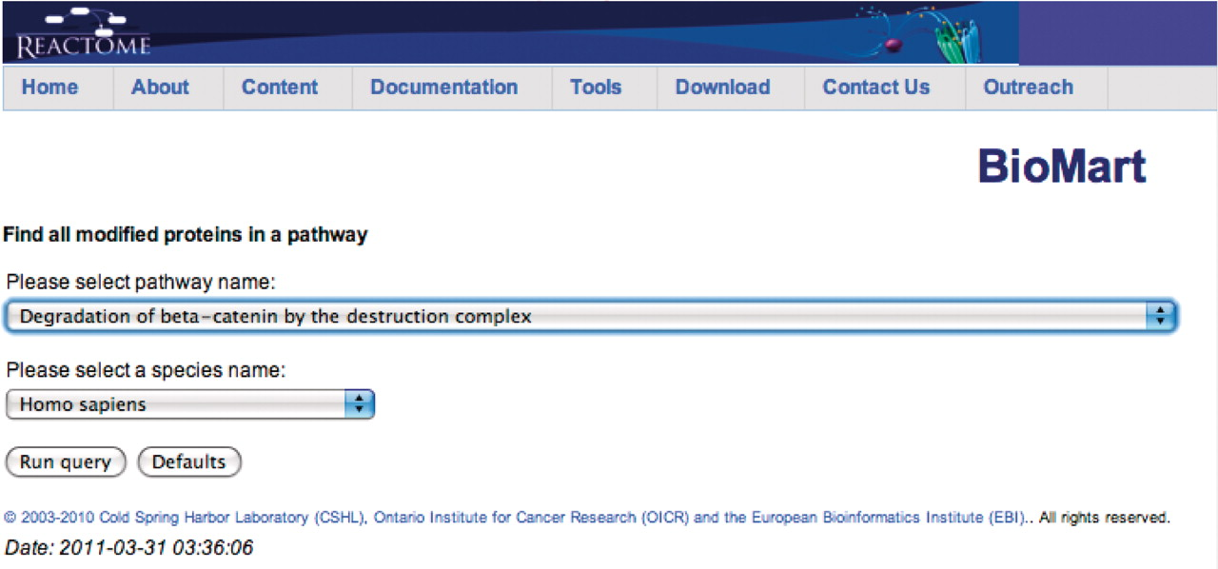
Figure 2. Canned query data input page. The user selects the pathway and species names from the respective drop down ...
Notes:
Figure 2. Canned query data input page. The user selects the pathway and species names from the respective drop down lists and then presses the ‘Run query’ button.
Unless provided in the caption above, the following copyright applies to the content of this slide: © The Author(s) 2011. Published by Oxford University Press.This is Open Access article distributed under the terms of the Creative Commons Attribution Non-Commercial License (http://creativecommons.org/licenses/by-nc/2.5), which permits unrestricted non-commercial use, distribution, and reproduction in any medium, provided the original work is properly cited.

