Slide 1
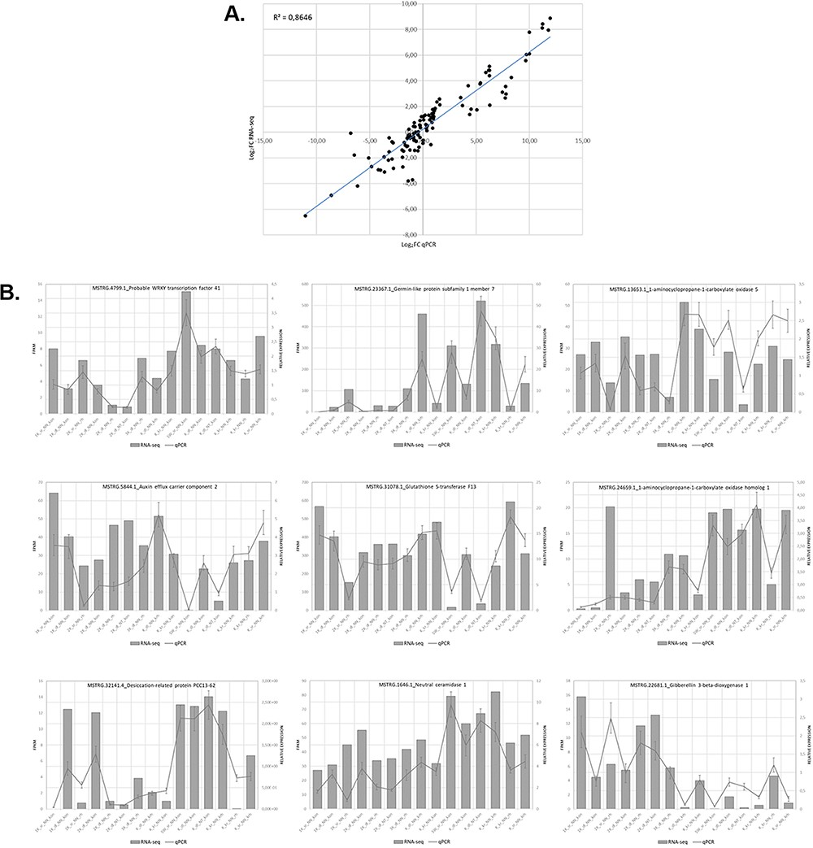
Figure 5. Relationship between levels of expression obtained by RNA-seq and RT-qPCR. (A) Log2 fold change in gene ...
Notes:
Figure 5. Relationship between levels of expression obtained by RNA-seq and RT-qPCR. (A) Log2 fold change in gene expression determined by plotting RNA-seq data against log2 fold change in gene expression assessed by qPCR. (B) Graphs showing similar trends in the expression levels of individual genes determined by RNA-seq and RT-qPCR analyses.
Unless provided in the caption above, the following copyright applies to the content of this slide: © The Author(s) 2022. Published by Oxford University Press.This is an Open Access article distributed under the terms of the Creative Commons Attribution License (https://creativecommons.org/licenses/by/4.0/), which permits unrestricted reuse, distribution, and reproduction in any medium, provided the original work is properly cited.

