Slide 1
Figure 1. Characteristics of topic annotations in LitCovid up to Feb 2022. (A) shows the frequencies of topics; (B) ...
Notes:
Figure 1. Characteristics of topic annotations in LitCovid up to Feb 2022. (A) shows the frequencies of topics; (B) demonstrates topic co-occurrences and (C) illustrates the distributions of the number of topics assigned per document.
Unless provided in the caption above, the following copyright applies to the content of this slide: Published by Oxford University Press 2022. This work is written by (a) US Government employee(s) and is in the public domain in the US.This work is written by (a) US Government employee(s) and is in the public domain in the US.

Slide 2
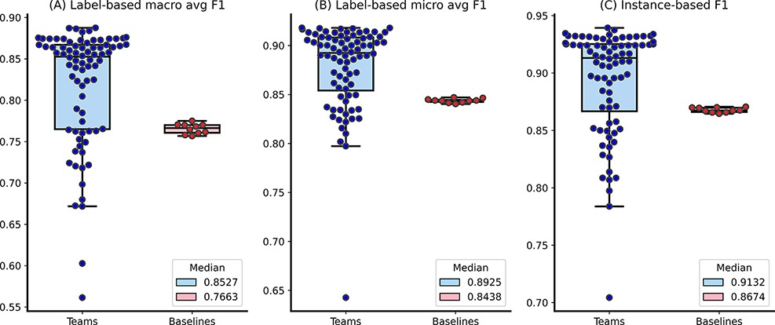
Figure 2. The distributions of team submission and baseline F1-scores. Median F1-scores are shown in the legend.
Notes:
Figure 2. The distributions of team submission and baseline F1-scores. Median F1-scores are shown in the legend.
Unless provided in the caption above, the following copyright applies to the content of this slide: Published by Oxford University Press 2022. This work is written by (a) US Government employee(s) and is in the public domain in the US.This work is written by (a) US Government employee(s) and is in the public domain in the US.

Slide 3
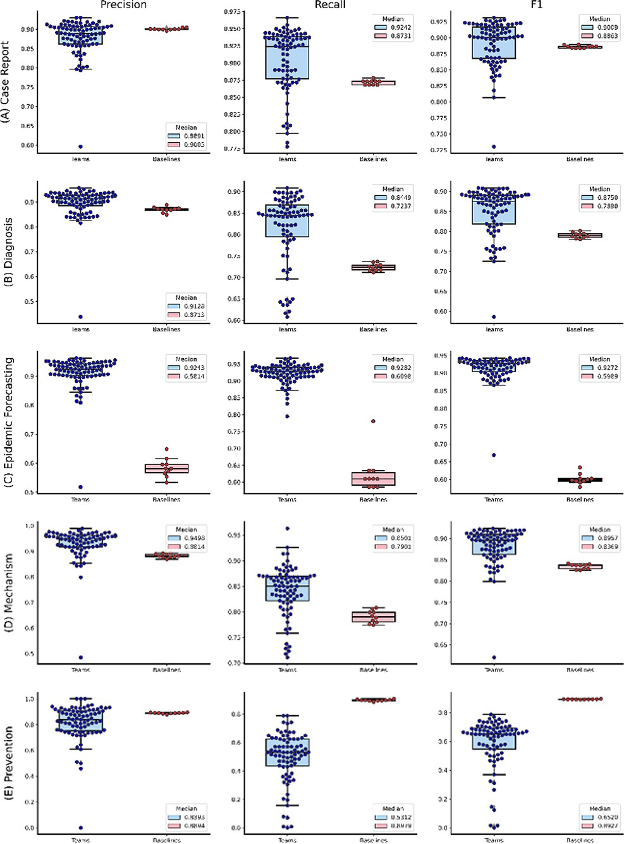
Figure 3. The distributions of team submission and baseline F1-scores for individual topics from (A) Case Report to (C) ...
Notes:
Figure 3. The distributions of team submission and baseline F1-scores for individual topics from (A) Case Report to (C) Epidemic Forecasting. Median F1-scores are shown in the legend. (B) The distributions of team submission and baseline F1-scores for individual topics from (D) Mechanism to (G) Treatment. Median F1-scores are shown in the legend.
Unless provided in the caption above, the following copyright applies to the content of this slide: Published by Oxford University Press 2022. This work is written by (a) US Government employee(s) and is in the public domain in the US.This work is written by (a) US Government employee(s) and is in the public domain in the US.

Slide 4
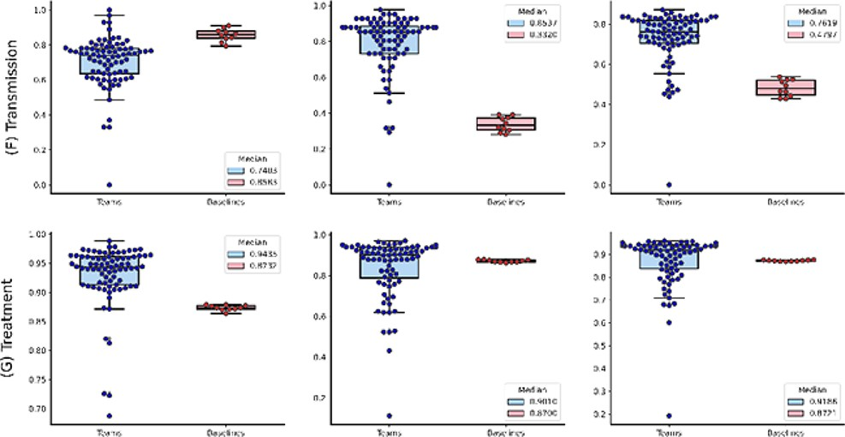
Figure 3. (Continued)
Notes:
Figure 3. (Continued)
Unless provided in the caption above, the following copyright applies to the content of this slide: Published by Oxford University Press 2022. This work is written by (a) US Government employee(s) and is in the public domain in the US.This work is written by (a) US Government employee(s) and is in the public domain in the US.

