Slide 1
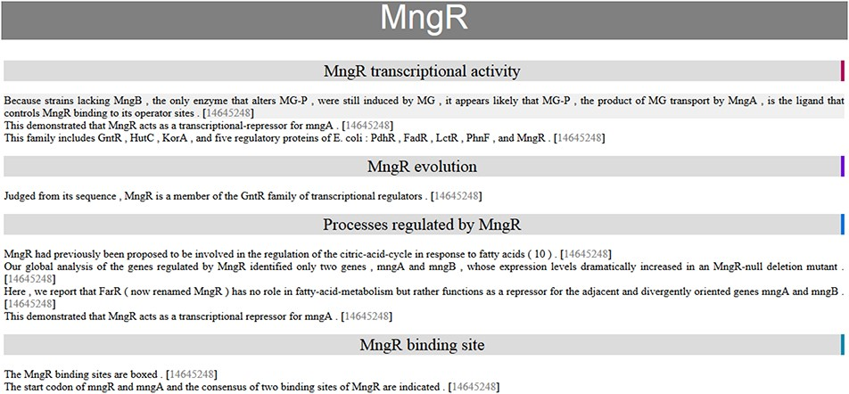
Figure 3. Automatic summary of MngR in HTML format, showing sentences classified into TF properties and with the PubMed ...
Notes:
Figure 3. Automatic summary of MngR in HTML format, showing sentences classified into TF properties and with the PubMed ID hyperlink to the article in the PubMed database. The automatic summary is organized by separating properties in different sections, and sentences are sorted by similarity, so that the curator finds related information together.
Unless provided in the caption above, the following copyright applies to the content of this slide: © The Author(s) 2020. Published by Oxford University Press.This is an Open Access article distributed under the terms of the Creative Commons Attribution License (http://creativecommons.org/licenses/by/4.0/), which permits unrestricted reuse, distribution, and reproduction in any medium, provided the original work is properly cited.

