Slide 1
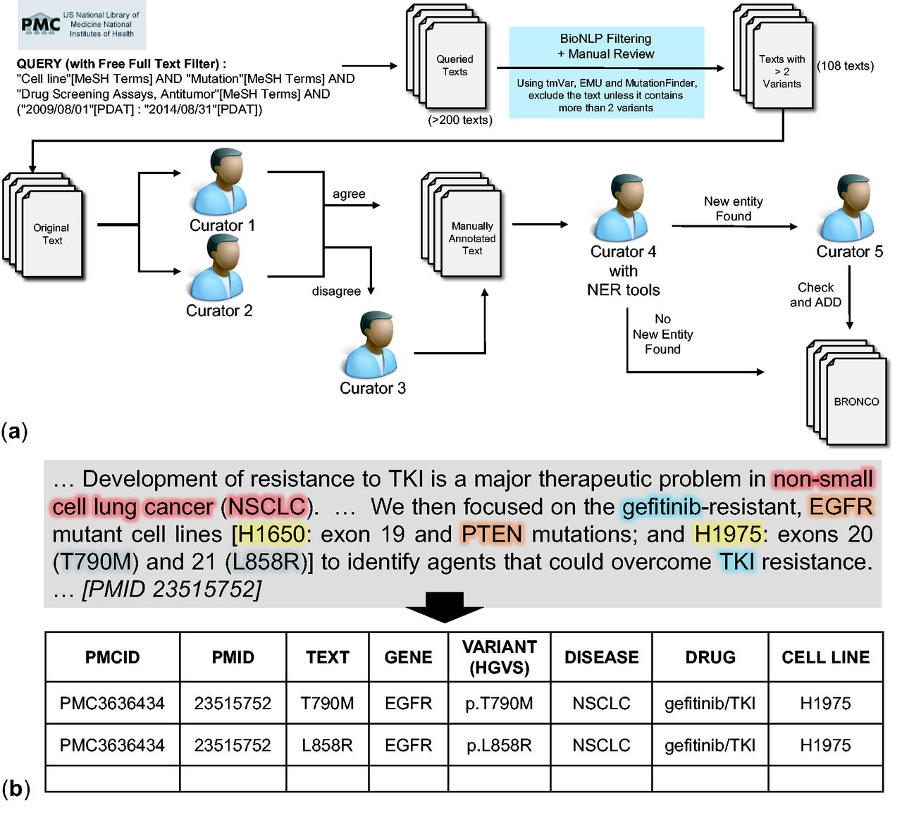
Figure 1. Manual curation of BRONCO. (a) Workflow of manual curation. (b) Example of manual curation.
Notes:
Figure 1. Manual curation of BRONCO. (a) Workflow of manual curation. (b) Example of manual curation.
Unless provided in the caption above, the following copyright applies to the content of this slide: © The Author(s) 2016. Published by Oxford University Press.This is an Open Access article distributed under the terms of the Creative Commons Attribution License (http://creativecommons.org/licenses/by/4.0/), which permits unrestricted reuse, distribution, and reproduction in any medium, provided the original work is properly cited.

Slide 2
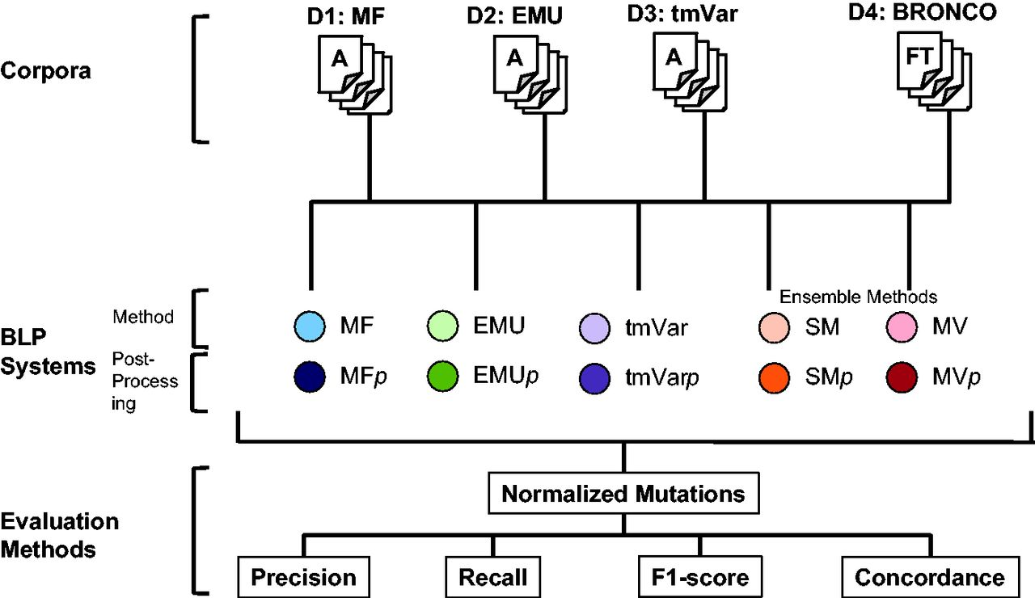
Figure 2. Workflow for assessing the performance of MF, EMU and tmVar in this study.
Notes:
Figure 2. Workflow for assessing the performance of MF, EMU and tmVar in this study.
Unless provided in the caption above, the following copyright applies to the content of this slide: © The Author(s) 2016. Published by Oxford University Press.This is an Open Access article distributed under the terms of the Creative Commons Attribution License (http://creativecommons.org/licenses/by/4.0/), which permits unrestricted reuse, distribution, and reproduction in any medium, provided the original work is properly cited.

Slide 3
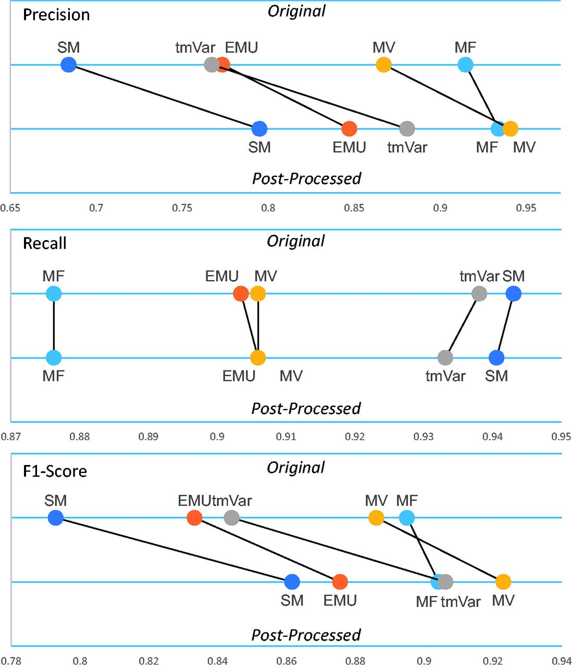
Figure 3. The post-processing module’s performance on the BRONCO corpus.
Notes:
Figure 3. The post-processing module’s performance on the BRONCO corpus.
Unless provided in the caption above, the following copyright applies to the content of this slide: © The Author(s) 2016. Published by Oxford University Press.This is an Open Access article distributed under the terms of the Creative Commons Attribution License (http://creativecommons.org/licenses/by/4.0/), which permits unrestricted reuse, distribution, and reproduction in any medium, provided the original work is properly cited.

Slide 4
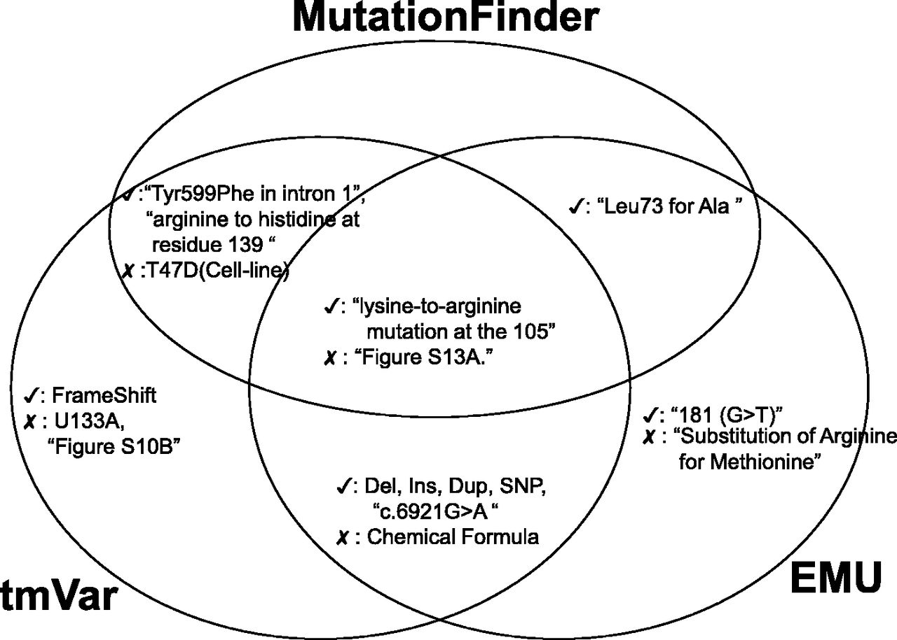
Figure 4. Examples of true and false positives identified by the three methods.
Notes:
Figure 4. Examples of true and false positives identified by the three methods.
Unless provided in the caption above, the following copyright applies to the content of this slide: © The Author(s) 2016. Published by Oxford University Press.This is an Open Access article distributed under the terms of the Creative Commons Attribution License (http://creativecommons.org/licenses/by/4.0/), which permits unrestricted reuse, distribution, and reproduction in any medium, provided the original work is properly cited.

