Slide 1
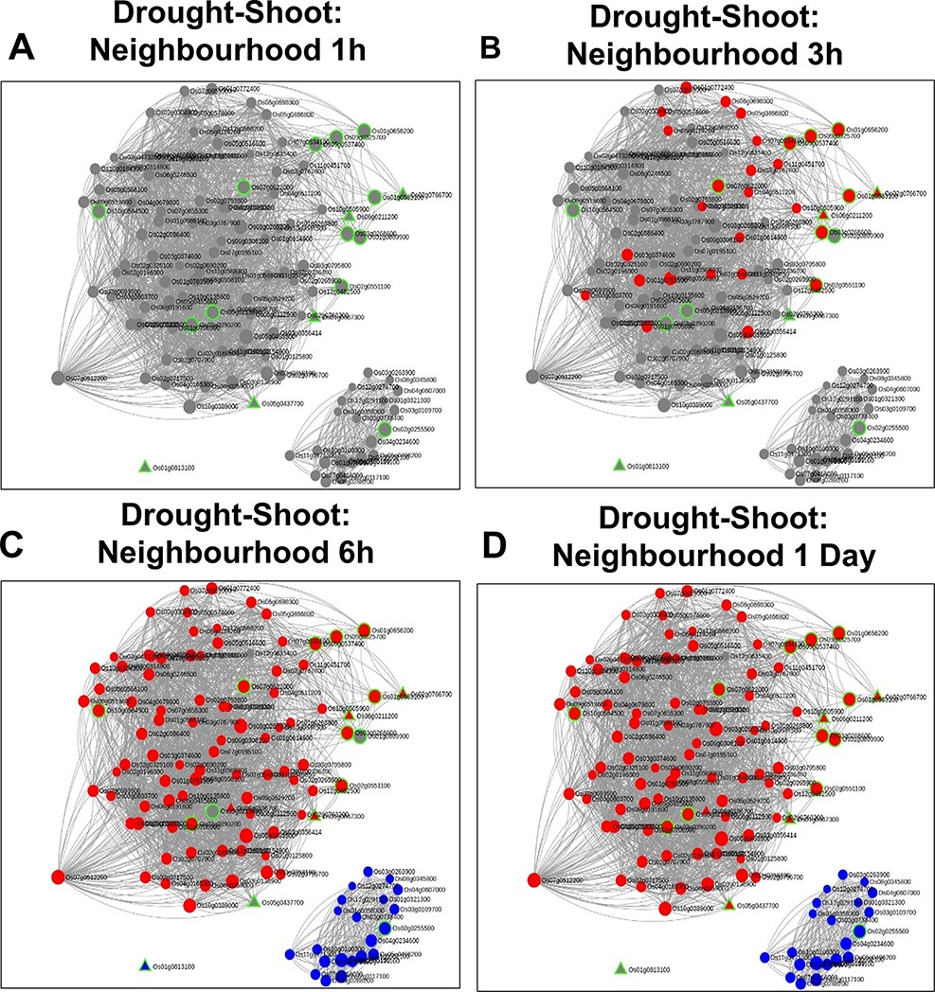
Figure 11. Time point–specific views for the extended neighbourhood for shoot-specific genes at early time points (A and ...
Notes:
Figure 11. Time point–specific views for the extended neighbourhood for shoot-specific genes at early time points (A and B) and late time points (C and D).
Unless provided in the caption above, the following copyright applies to the content of this slide: © The Author(s) 2022. Published by Oxford University Press on behalf of the Center for Excellence in Molecular Cell Science, Chinese Academy of Sciences.This is an Open Access article distributed under the terms of the Creative Commons Attribution-NonCommercial License (https://creativecommons.org/licenses/by-nc/4.0/), which permits non-commercial re-use, distribution, and reproduction in any medium, provided the original work is properly cited. For commercial re-use, please contact journals.permissions@oup.com

