Slide 1
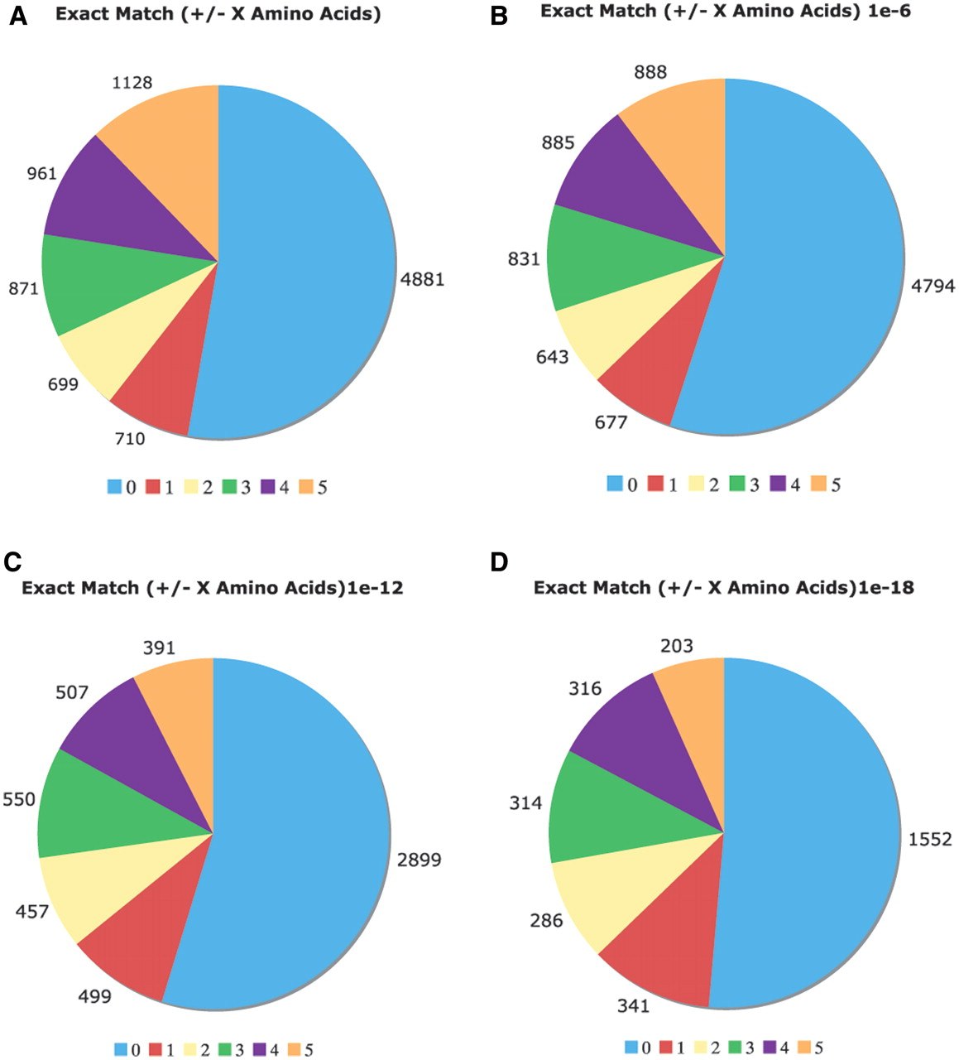
Figure 5. Comparison of the Uniprot COMPBIAS annotations with annotations by the LPS algorithm. Pie charts showing the ...
Notes:
Figure 5. Comparison of the Uniprot COMPBIAS annotations with annotations by the LPS algorithm. Pie charts showing the detailed breakdown of how the new LPS-annotate CB annotations correspond with the UniProt COMPBIAS annotations, for four different P-value thresholds (10−4, i.e. all of the LPS-annotate CB annotations; 10−6; 10−12; 10−18). These are depicted in Figure parts A, B, C and D respectively. Annotations that are exactly matching are colored blue, those that are off by one at either end are colored red and so on. The UniProt COMPBIAS records are intentionally limited in the UniProt/SwissProt databases to a few, more specific cases, such as homopolymeric runs, with up to one or two short interruptions in the run (26).
Unless provided in the caption above, the following copyright applies to the content of this slide: © The Author(s) 2011. Published by Oxford University Press.This is Open Access article distributed under the terms of the Creative Commons Attribution Non-Commercial License (http://creativecommons.org/licenses/by-nc/2.5), which permits unrestricted non-commercial use, distribution, and reproduction in any medium, provided the original work is properly cited.

