Slide 1
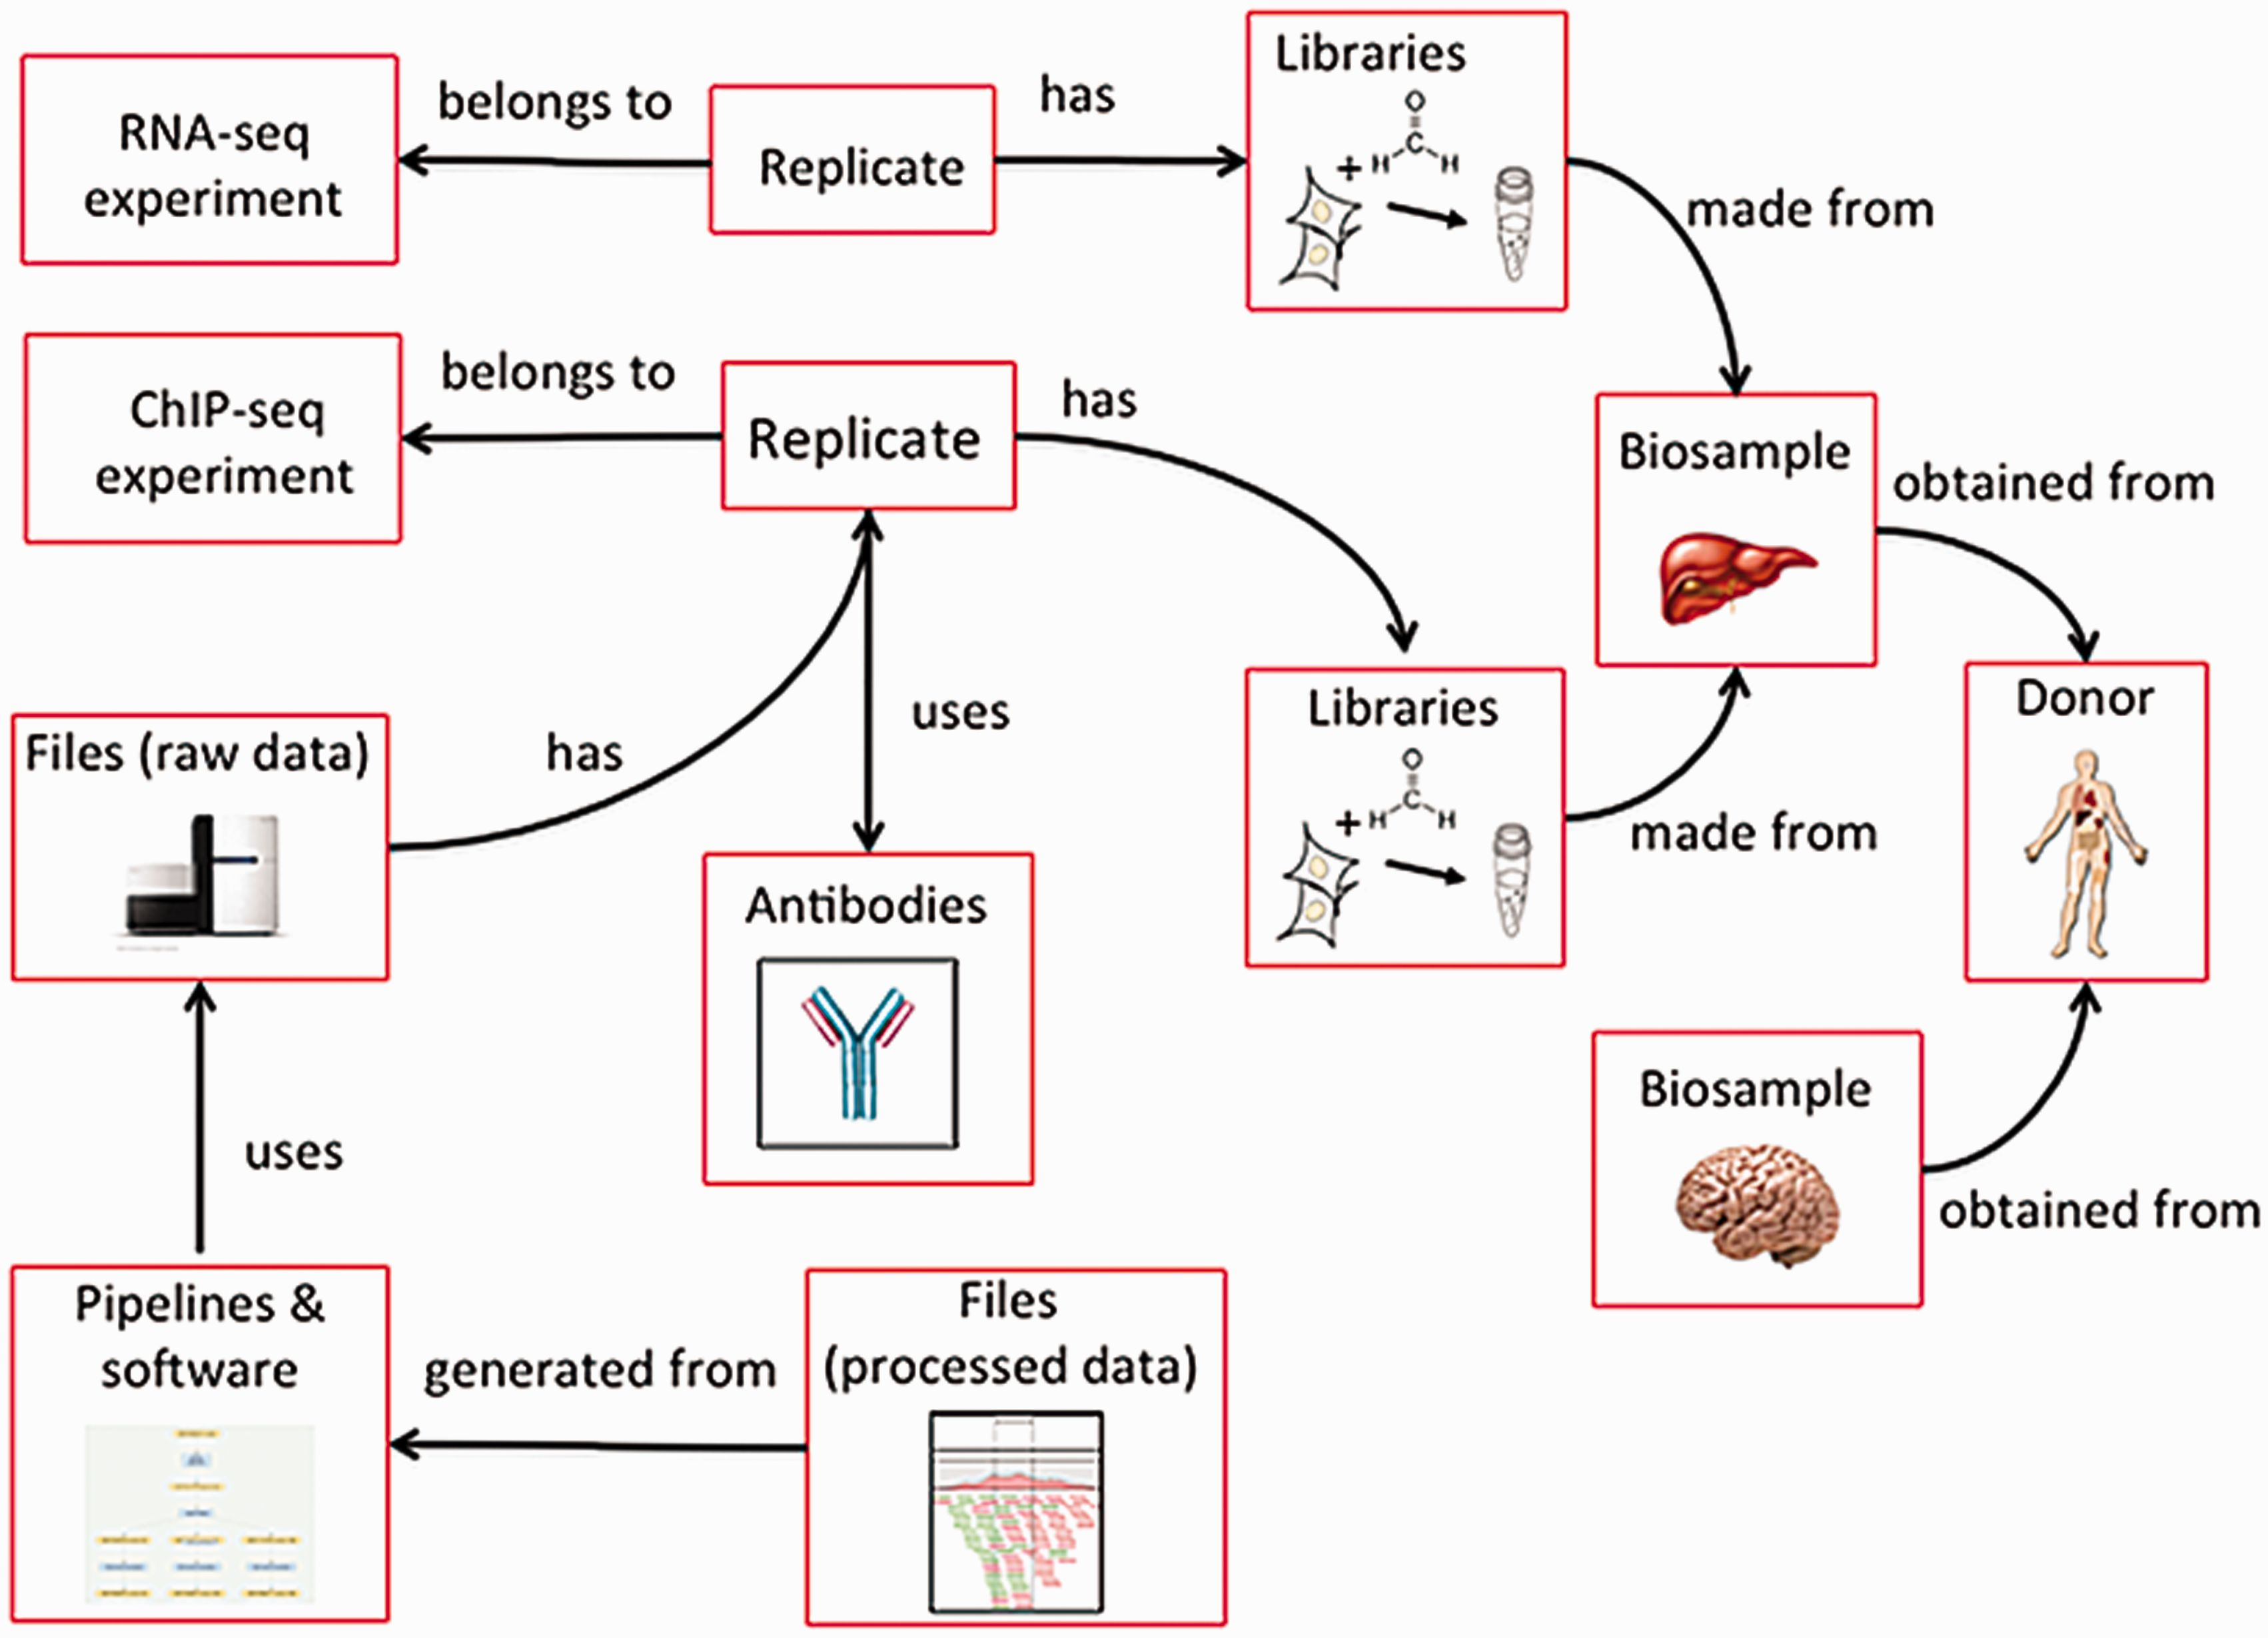
Figure 4 Categories in the metadata model are linked to each other. Categories of metadata are linked to each other ...
Notes:
Figure 4 Categories in the metadata model are linked to each other. Categories of metadata are linked to each other and can be described by relationships between the categories. Each individual category can be referred to multiple times. For example, a liver and a brain can be obtained from the same donor. In addition, a single biosample, like the liver, can be used as input for multiple assays. Because each donor and biosample is accessioned, they can be referred to uniquely.
Unless provided in the caption above, the following copyright applies to the content of this slide: © The Author(s) 2016. Published by Oxford University Press. This is an Open Access article distributed under the terms of the Creative Commons Attribution License ( http://creativecommons.org/licenses/by/4.0/ ), which permits unrestricted reuse, distribution, and reproduction in any medium, provided the original work is properly cited.

