Slide 1
Figure 4 Example for a geographic subset generation, given existing geolocation data. In hepatocellular carcinoma ...
Notes:
Figure 4 Example for a geographic subset generation, given existing geolocation data. In hepatocellular carcinoma (ICD-O 3 Morphology 8170/3) datasets from the Progenetix collection, a query for experiments with a geographic provenance within 2000 km from Heidelberg or Taipei was used to generate CNV frequencies for samples from Central Europe (665 samples) and East Asia (430 samples) ad hoc. Such use cases are supported through the biosample-level location attributes in the (GA4GH derived) Progenetix dataschema. This example does not emphasize differences or similarities between the groups, but rather highlights the power of ‘one click’ geographic stratification options.
Unless provided in the caption above, the following copyright applies to the content of this slide: © The Author(s) 2020. Published by Oxford University Press.This is an Open Access article distributed under the terms of the Creative Commons Attribution License (http://creativecommons.org/licenses/by/4.0/), which permits unrestricted reuse, distribution, and reproduction in any medium, provided the original work is properly cited.

Slide 2
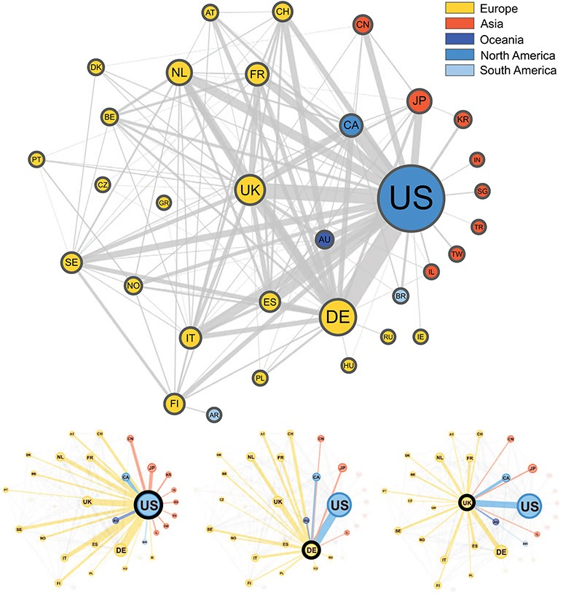
Figure 3 Graphical representation of the collaborations between countries based on 3093 publications contained in the ...
Notes:
Figure 3 Graphical representation of the collaborations between countries based on 3093 publications contained in the Progenetix database. Collaborating countries for the three most frequent countries—the United States (US), Germany (DE) and the United Kingdom (UK)—are also shown in their own graphs. Node size is proportional to the country counts (linearly scaled between 10 and 50), node color represents the country’s continent and edge thickness is proportional to the collaboration counts. To reduce clutter in the graph, only countries appearing on more than seven publications appear in the graph, meaning our graph depicts $\sim $49% of all nodes and 29% of all edges in our data.
Unless provided in the caption above, the following copyright applies to the content of this slide: © The Author(s) 2020. Published by Oxford University Press.This is an Open Access article distributed under the terms of the Creative Commons Attribution License (http://creativecommons.org/licenses/by/4.0/), which permits unrestricted reuse, distribution, and reproduction in any medium, provided the original work is properly cited.

Slide 3
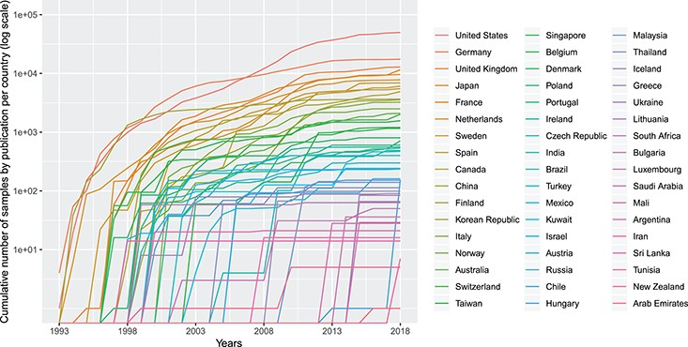
Figure 2 Cumulative number (in logarithmic scale) of genomic array samples (CCGH, ACGH, WES, WGS) contained in 3240 ...
Notes:
Figure 2 Cumulative number (in logarithmic scale) of genomic array samples (CCGH, ACGH, WES, WGS) contained in 3240 publications registered in the Progenetix database, split by their associated country, from 1993 to 2019 (publication year).
Unless provided in the caption above, the following copyright applies to the content of this slide: © The Author(s) 2020. Published by Oxford University Press.This is an Open Access article distributed under the terms of the Creative Commons Attribution License (http://creativecommons.org/licenses/by/4.0/), which permits unrestricted reuse, distribution, and reproduction in any medium, provided the original work is properly cited.

Slide 4
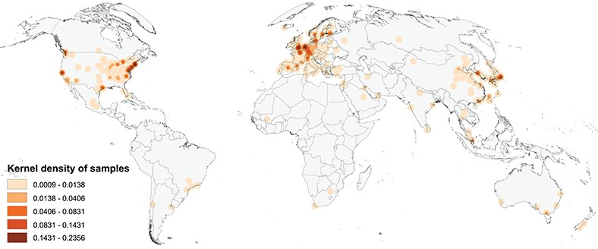
Figure 1 Map of the geographic distribution of genome screening experiments using the first author affiliation ...
Notes:
Figure 1 Map of the geographic distribution of genome screening experiments using the first author affiliation location proxy, derived from 3240 publications registered in the Progenetix database, including 104 543 genomic array, 36 766 cCGH and 15 409 whole genome/exome-based cancer genome profiles. The map is rendered in the Goode Homolosine Land equal area projection (kernel density per square kilometer).
Unless provided in the caption above, the following copyright applies to the content of this slide: © The Author(s) 2020. Published by Oxford University Press.This is an Open Access article distributed under the terms of the Creative Commons Attribution License (http://creativecommons.org/licenses/by/4.0/), which permits unrestricted reuse, distribution, and reproduction in any medium, provided the original work is properly cited.

Slide 5
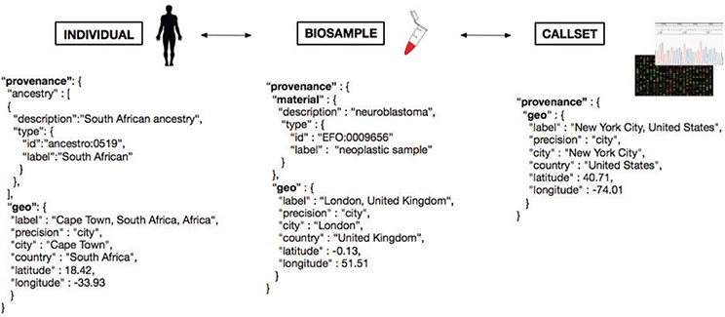
Figure 5 Metadata representation for a geolocation attribution approach based on concepts being developed at GA4GH. ...
Notes:
Figure 5 Metadata representation for a geolocation attribution approach based on concepts being developed at GA4GH. Each extracted ‘Biosample’ from an ‘Individual’ and its ‘Callset’ (i.e. experimental read-out) maintain a relation; ethnicity and geographical provenance of a biosample could be tracked through the attributes at the ‘Individual’ level.
Unless provided in the caption above, the following copyright applies to the content of this slide: © The Author(s) 2020. Published by Oxford University Press.This is an Open Access article distributed under the terms of the Creative Commons Attribution License (http://creativecommons.org/licenses/by/4.0/), which permits unrestricted reuse, distribution, and reproduction in any medium, provided the original work is properly cited.

