Slide 1
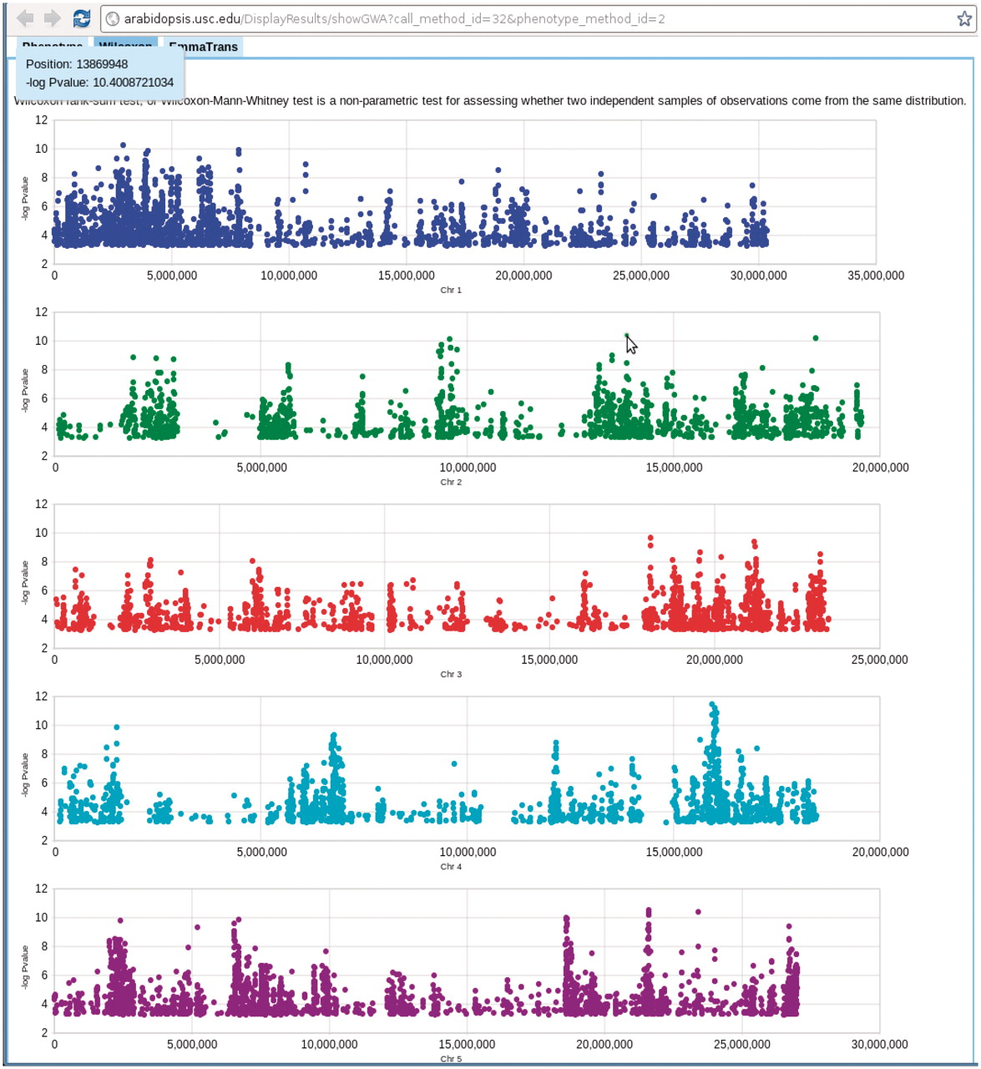
Figure 10. Genome-wide association P-values plot. Mouse-over each dot shows the position and P-value of the SNP. ...
Notes:
Figure 10. Genome-wide association P-values plot. Mouse-over each dot shows the position and P-value of the SNP. Clicking each dot results an 80 kb zoom-in SNP page (Figure 8). This visualization is done by Google Visualization Scatter Chart. This visualization is available in any phenotype page. The example used here is at http://arabidopsis.usc.edu/DisplayResults/showGWA?call_method_id=32&phenotype_method_id=2.
Unless provided in the caption above, the following copyright applies to the content of this slide: © The Author(s) 2011. Published by Oxford University Press.This is Open Access article distributed under the terms of the Creative Commons Attribution Non-Commercial License (http://creativecommons.org/licenses/by-nc/2.5), which permits unrestricted non-commercial use, distribution, and reproduction in any medium, provided the original work is properly cited.

