Slide 1
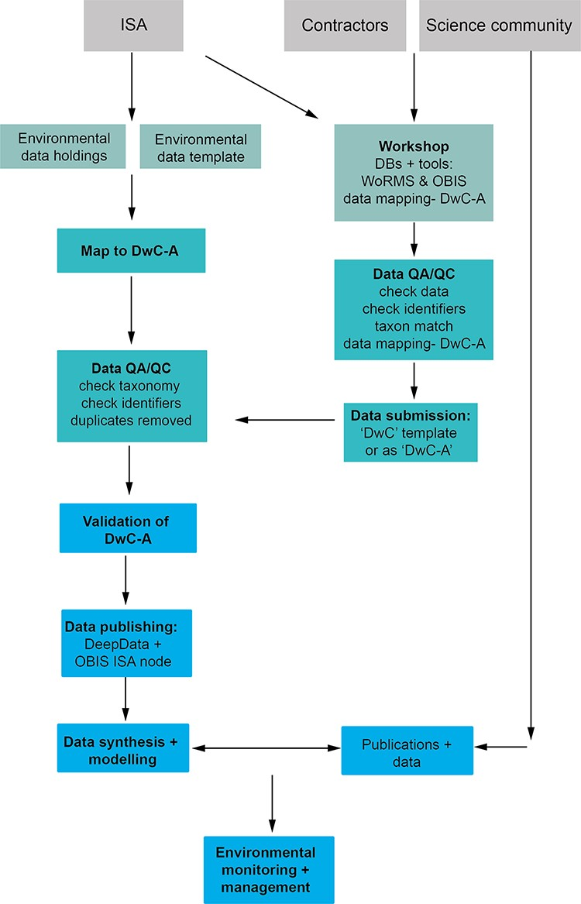
Figure 3. A proposed data management workflow for the ISA (processes shown in bold text). First, the current ...
Notes:
Figure 3. A proposed data management workflow for the ISA (processes shown in bold text). First, the current environmental contractor data template is replaced with a DwC compliant version with all fields (column headings) in DwC format, and contractors/data providers can alternatively submit data as a Darwin Core Archile (DwC-A) file. Existing environmental data holdings are remapped comprehensively to DwC terms as a batch process and undergo QA/QC prior to publication. Concurrently, a public workshop is delivered by the ISA with input from the contractors, the science community and other stakeholders (with full documentation available), covering DwC, databases, in particular WoRMS and OBIS, and tools such as taxon match in WoRMS and the GBIF DwC validator and assistant. Here, contractors undertake QA/QC checks and submit new data (in a new DwC compliant template or as a DwC-A). After QA/QC, datasets are published (as a DwC-A) on both DeepData and the OBIS ISA node. These data subsequently can be utilized for data synthesis and modelling and environmental policy applications.
Unless provided in the caption above, the following copyright applies to the content of this slide: © The Author(s) 2023. Published by Oxford University Press.This is an Open Access article distributed under the terms of the Creative Commons Attribution License (https://creativecommons.org/licenses/by/4.0/), which permits unrestricted reuse, distribution, and reproduction in any medium, provided the original work is properly cited.

