Slide 1
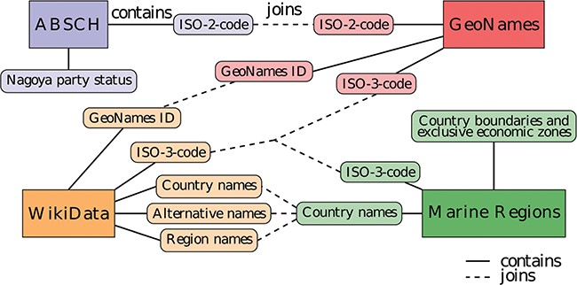
Figure 1 Diagram of the data sources and entity relationships with integrative joins between the different data ...
Notes:
Figure 1 Diagram of the data sources and entity relationships with integrative joins between the different data sources. The same color denotes information originating from the same data source.
Unless provided in the caption above, the following copyright applies to the content of this slide: © The Author(s) 2020. Published by Oxford University Press.This is an Open Access article distributed under the terms of the Creative Commons Attribution License (http://creativecommons.org/licenses/by/4.0/), which permits unrestricted reuse, distribution, and reproduction in any medium, provided the original work is properly cited.

Slide 2
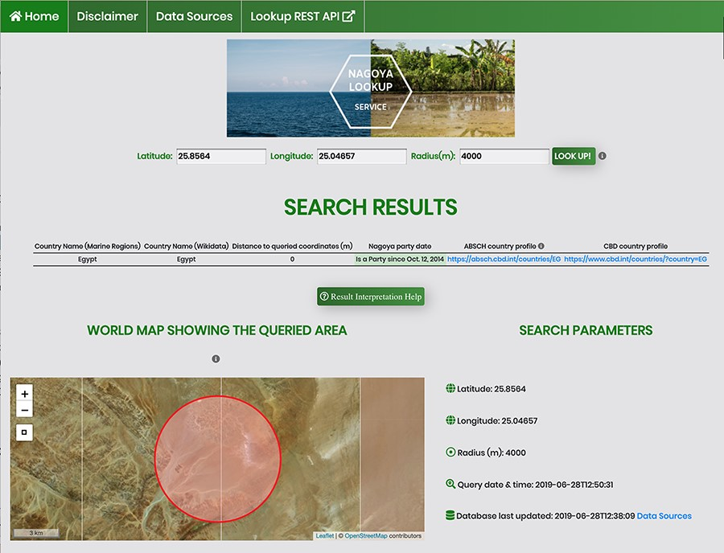
Figure 3 Screenshot of an API request using the HTML form for a coordinate pair and a query radius of 4000 m.
Notes:
Figure 3 Screenshot of an API request using the HTML form for a coordinate pair and a query radius of 4000 m.
Unless provided in the caption above, the following copyright applies to the content of this slide: © The Author(s) 2020. Published by Oxford University Press.This is an Open Access article distributed under the terms of the Creative Commons Attribution License (http://creativecommons.org/licenses/by/4.0/), which permits unrestricted reuse, distribution, and reproduction in any medium, provided the original work is properly cited.

Slide 3
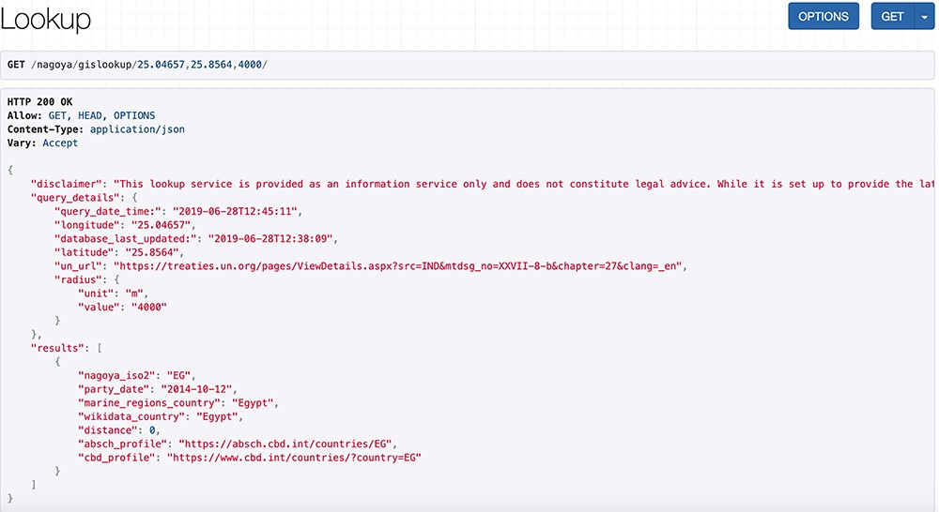
Figure 2 Screenshot of an API request and its JSON response for a coordinate pair and a query radius of 4000 m.
Notes:
Figure 2 Screenshot of an API request and its JSON response for a coordinate pair and a query radius of 4000 m.
Unless provided in the caption above, the following copyright applies to the content of this slide: © The Author(s) 2020. Published by Oxford University Press.This is an Open Access article distributed under the terms of the Creative Commons Attribution License (http://creativecommons.org/licenses/by/4.0/), which permits unrestricted reuse, distribution, and reproduction in any medium, provided the original work is properly cited.

