Slide 1
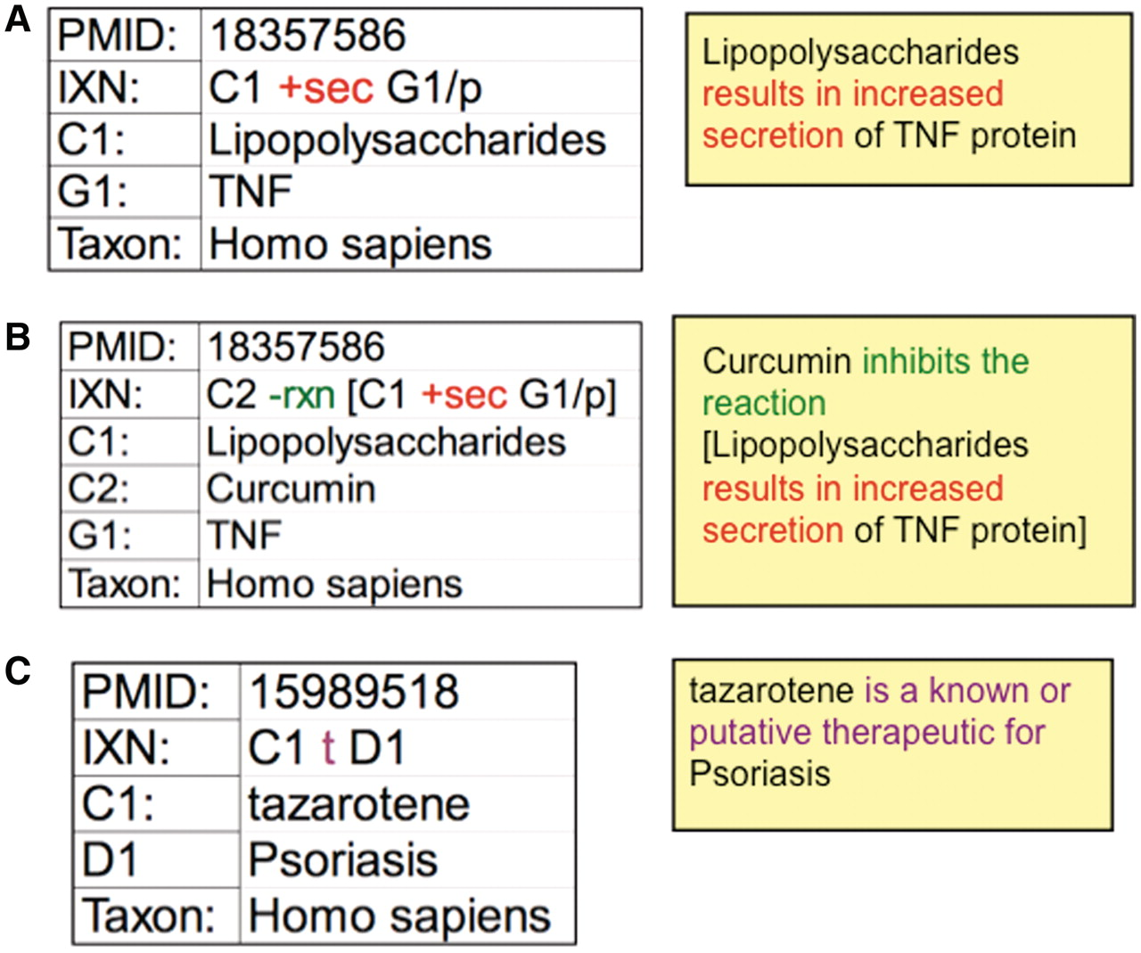
Figure 3. CTD curation codes. (A) Biocurators use controlled vocabularies and mnemonic codes to construct interactions ...
Notes:
Figure 3. CTD curation codes. (A) Biocurators use controlled vocabularies and mnemonic codes to construct interactions describing the molecular interaction (increased secretion) between the chemical lipopolysaccharides (C1) and the protein product of the tumor necrosis factor gene (G1/p). (B) The interaction can be expanded using brackets and the reaction code (rxn) to indicate how another chemical inhibits the first interaction. (C) Disease curation captures the relationship between chemicals/genes and a disease. Every interaction is directly associated to a PMID and includes the species in which the interaction was studied. The interactions are translated into sentences (yellow boxes) for users to interpret more easily.
Unless provided in the caption above, the following copyright applies to the content of this slide: © The Author(s) 2011. Published by Oxford University Press.This is Open Access article distributed under the terms of the Creative Commons Attribution Non-Commercial License (http://creativecommons.org/licenses/by-nc/2.5), which permits unrestricted non-commercial use, distribution, and reproduction in any medium, provided the original work is properly cited.

