Slide 1
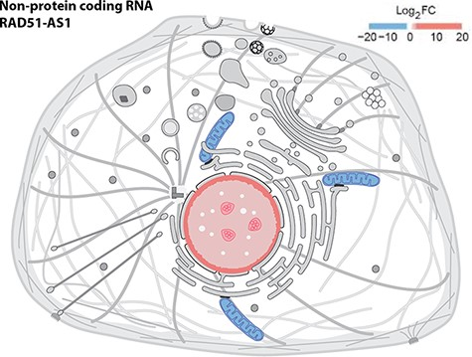
Figure 4. Displaying quantitative data in SwissBioPics using colors. The image shows the fold change (FC) of the ...
Notes:
Figure 4. Displaying quantitative data in SwissBioPics using colors. The image shows the fold change (FC) of the RAD51-AS1 non-protein-coding transcript in the nucleus and mitochondrion (26).
Unless provided in the caption above, the following copyright applies to the content of this slide: © The Author(s) 2022. Published by Oxford University Press.This is an Open Access article distributed under the terms of the Creative Commons Attribution License (https://creativecommons.org/licenses/by/4.0/), which permits unrestricted reuse, distribution, and reproduction in any medium, provided the original work is properly cited.

