Slide 1
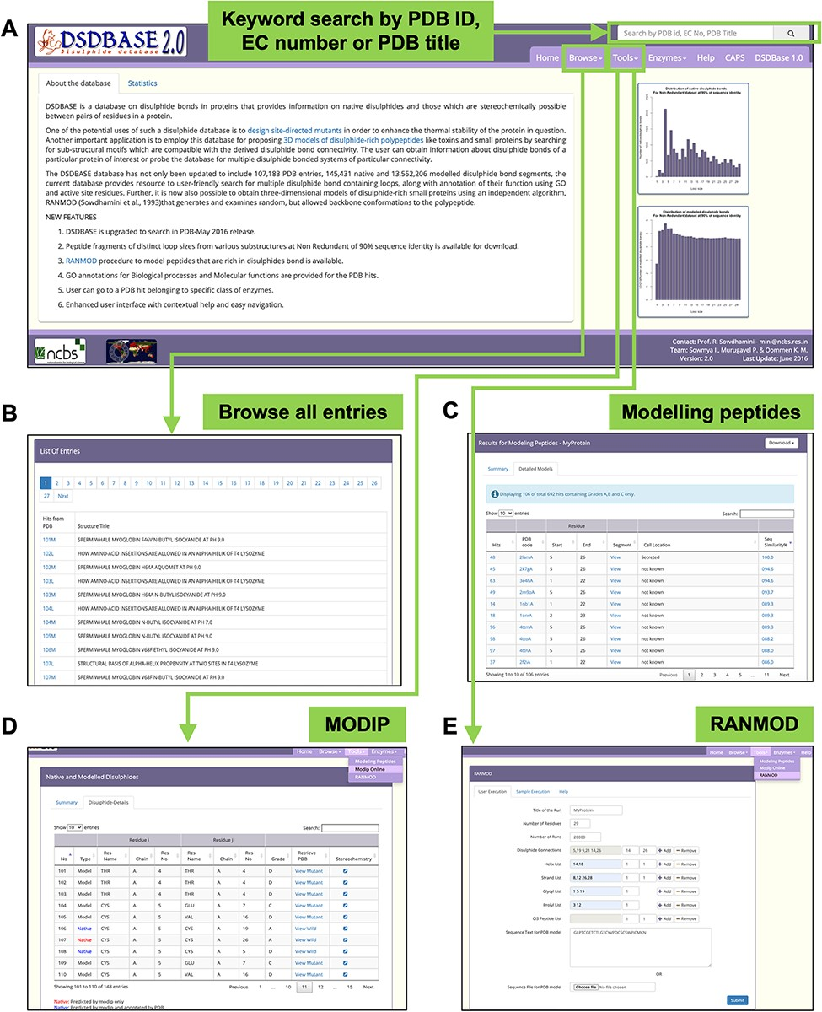
Figure 1. DSDBASE 2.0 database organization and features. Different features of the database have been shown here. (A) ...
Notes:
Figure 1. DSDBASE 2.0 database organization and features. Different features of the database have been shown here. (A) Database browser. The users can browse through the different modules of DSDBASE. The user can also perform keyword search by PDB ID, EC number or PDB title. The distribution of native and modelled disulphide bonds based on loop sizes is provided. (B) List of all entries. The user can also download peptide fragments of distinct loop sizes from various substructures from nr-db-90% (90% sequence identity). (C) Modelling peptide feature. (D) RANMOD feature.
Unless provided in the caption above, the following copyright applies to the content of this slide: © The Author(s) 2022. Published by Oxford University Press.This is an Open Access article distributed under the terms of the Creative Commons Attribution License (https://creativecommons.org/licenses/by/4.0/), which permits unrestricted reuse, distribution, and reproduction in any medium, provided the original work is properly cited.

Slide 2
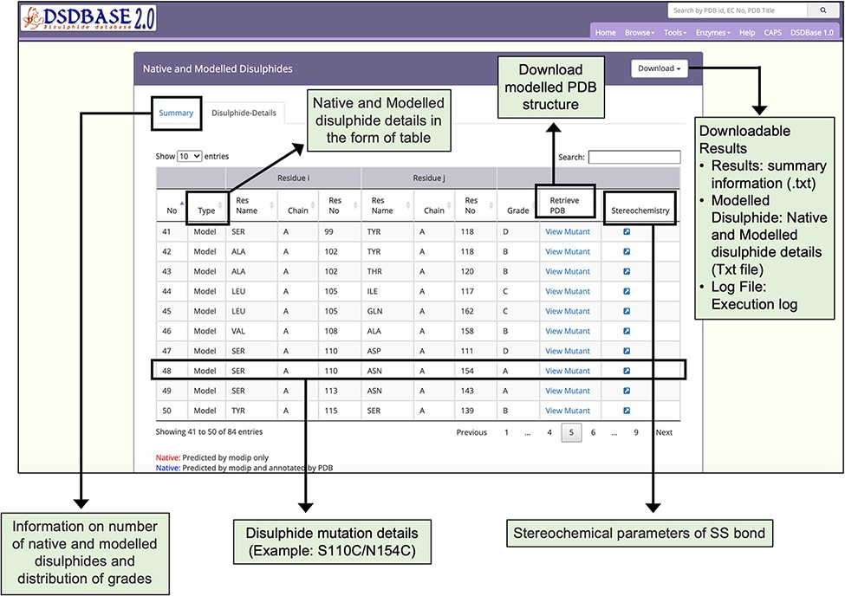
Figure 2. Results page for modelling of disulphide bonds in proteins (MODIP). A snapshot of the search output page ...
Notes:
Figure 2. Results page for modelling of disulphide bonds in proteins (MODIP). A snapshot of the search output page shows the summary of native and modelled disulphides along with the grades and details of native and modelled disulphide in the form of table. The user should provide a structure (PDB format) for running MODIP procedure.
Unless provided in the caption above, the following copyright applies to the content of this slide: © The Author(s) 2022. Published by Oxford University Press.This is an Open Access article distributed under the terms of the Creative Commons Attribution License (https://creativecommons.org/licenses/by/4.0/), which permits unrestricted reuse, distribution, and reproduction in any medium, provided the original work is properly cited.

Slide 3
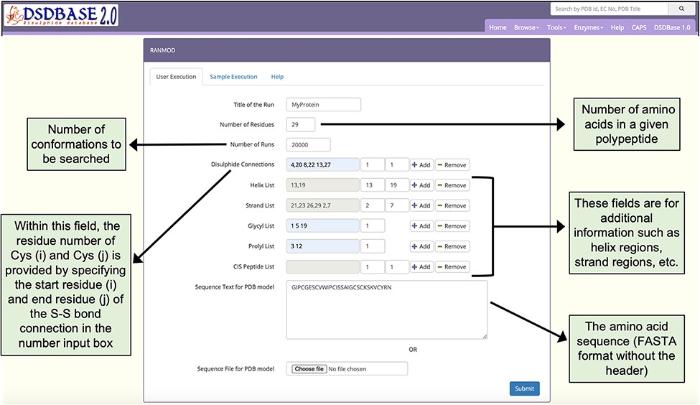
Figure 3. Snapshot of the input page for RANMOD (Random Conformation to Polypeptide Backbone) program. The user should ...
Notes:
Figure 3. Snapshot of the input page for RANMOD (Random Conformation to Polypeptide Backbone) program. The user should provide a sequence (FASTA format) and disulphide connections information for running RANMOD procedure.
Unless provided in the caption above, the following copyright applies to the content of this slide: © The Author(s) 2022. Published by Oxford University Press.This is an Open Access article distributed under the terms of the Creative Commons Attribution License (https://creativecommons.org/licenses/by/4.0/), which permits unrestricted reuse, distribution, and reproduction in any medium, provided the original work is properly cited.

Slide 4
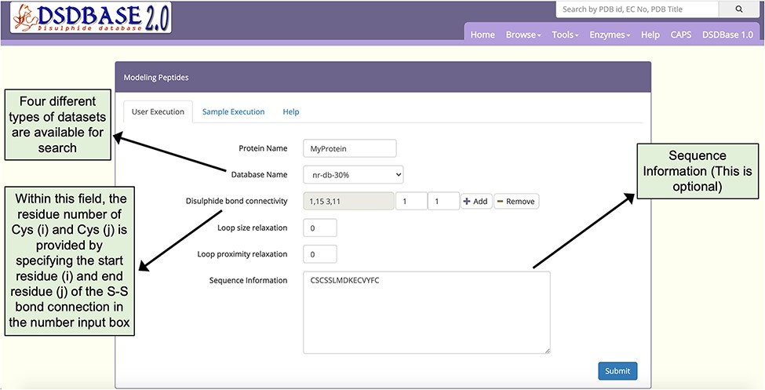
Figure 4. Snapshot of the input page for Modelling peptides. The user can probe the database for multiple ...
Notes:
Figure 4. Snapshot of the input page for Modelling peptides. The user can probe the database for multiple disulphide-bonded systems of particular connectivity and get possible conformations for that segment with the option to provide partial or no sequence information.
Unless provided in the caption above, the following copyright applies to the content of this slide: © The Author(s) 2022. Published by Oxford University Press.This is an Open Access article distributed under the terms of the Creative Commons Attribution License (https://creativecommons.org/licenses/by/4.0/), which permits unrestricted reuse, distribution, and reproduction in any medium, provided the original work is properly cited.

Slide 5
Figure 5. Stereochemistry of the predicted mutation site (S110C-N154C) for disulphide bridge modelling in the case of ...
Notes:
Figure 5. Stereochemistry of the predicted mutation site (S110C-N154C) for disulphide bridge modelling in the case of xylanase (PDB ID: 1XYP).
Unless provided in the caption above, the following copyright applies to the content of this slide: © The Author(s) 2022. Published by Oxford University Press.This is an Open Access article distributed under the terms of the Creative Commons Attribution License (https://creativecommons.org/licenses/by/4.0/), which permits unrestricted reuse, distribution, and reproduction in any medium, provided the original work is properly cited.

Slide 6
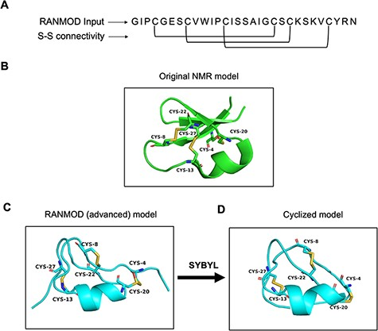
Figure 6. Model generated using RANMOD program for test case of cycloviolacin O2. (A) The input sequence of ...
Notes:
Figure 6. Model generated using RANMOD program for test case of cycloviolacin O2. (A) The input sequence of cycloviolacin O2 from Violoa odorata (PDB ID: 2KNM) and disulphide connectivity information. (B) The native NMR model (the first model of the ensemble) with the disulphide connectivity highlighted. (C) Cartoon representation of the generated model using secondary structural clues. (D) Cartoon representation of the cyclized and energy minimized model. Green and cyan cartoon corresponds to conformations of native template and modelled structures, respectively.
Unless provided in the caption above, the following copyright applies to the content of this slide: © The Author(s) 2022. Published by Oxford University Press.This is an Open Access article distributed under the terms of the Creative Commons Attribution License (https://creativecommons.org/licenses/by/4.0/), which permits unrestricted reuse, distribution, and reproduction in any medium, provided the original work is properly cited.

Slide 7
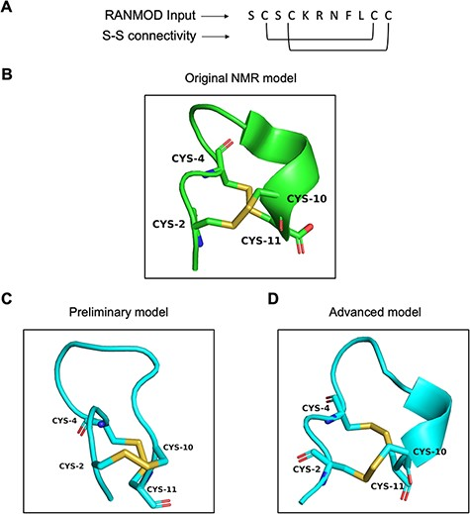
Figure 7. Model generated using RANMOD program for test case of conotoxin pc16a. (A) The input sequence of conotoxin ...
Notes:
Figure 7. Model generated using RANMOD program for test case of conotoxin pc16a. (A) The input sequence of conotoxin pc16a (PDB ID: 2LER) and disulphide connectivity information. (B) The native NMR model (the first model of the ensemble) with the disulphide connectivity highlighted. (C) Cartoon representation of the generated model using no secondary structural clues (preliminary modelling). (D) Cartoon representation of the generated model using secondary structure information (advanced modelling). Green and cyan cartoon corresponds to conformation of native template and modelled structures, respectively.
Unless provided in the caption above, the following copyright applies to the content of this slide: © The Author(s) 2022. Published by Oxford University Press.This is an Open Access article distributed under the terms of the Creative Commons Attribution License (https://creativecommons.org/licenses/by/4.0/), which permits unrestricted reuse, distribution, and reproduction in any medium, provided the original work is properly cited.

Slide 8
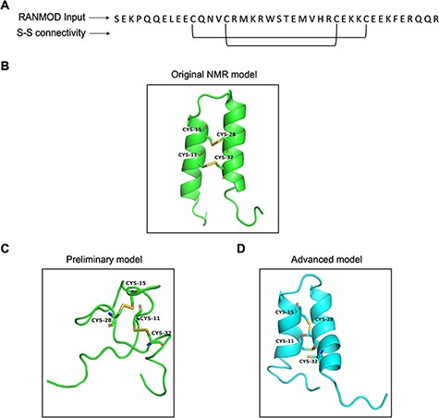
Figure 8. Model generated using RANMOD program for test case of buckwheat trypsin inhibitor BWI-2c. (A) The input ...
Notes:
Figure 8. Model generated using RANMOD program for test case of buckwheat trypsin inhibitor BWI-2c. (A) The input sequence of BWI-2c (PDB ID: 2LQX). and disulphide connectivity information. (B) The native NMR model (the first model of the ensemble) with the disulphide connectivity highlighted. (C) Cartoon representation of the generated model using no secondary structural clues (preliminary modelling). (D) Cartoon representation of the generated model using secondary structure information (advanced modelling). Green and cyan cartoon corresponds to conformation of native template and modelled structures, respectively.
Unless provided in the caption above, the following copyright applies to the content of this slide: © The Author(s) 2022. Published by Oxford University Press.This is an Open Access article distributed under the terms of the Creative Commons Attribution License (https://creativecommons.org/licenses/by/4.0/), which permits unrestricted reuse, distribution, and reproduction in any medium, provided the original work is properly cited.

Slide 9
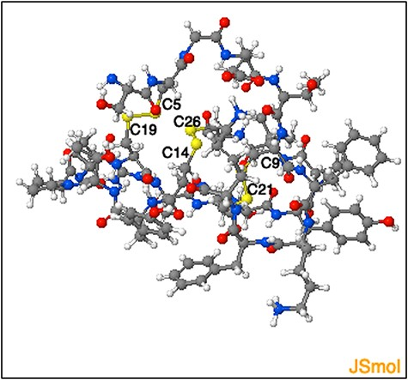
Figure 9. Representation of the three-dimensional structure segment obtained using ‘Modelling peptide’ tool. The ...
Notes:
Figure 9. Representation of the three-dimensional structure segment obtained using ‘Modelling peptide’ tool. The three-dimensional structure segment of the homologue identified by querying ‘C4 - C19, C9- C21 and C14 - C26’ disulphide connectivity. The cysteine residues and the corresponding disulphide bridges are highlighted.
Unless provided in the caption above, the following copyright applies to the content of this slide: © The Author(s) 2022. Published by Oxford University Press.This is an Open Access article distributed under the terms of the Creative Commons Attribution License (https://creativecommons.org/licenses/by/4.0/), which permits unrestricted reuse, distribution, and reproduction in any medium, provided the original work is properly cited.

