Slide 1
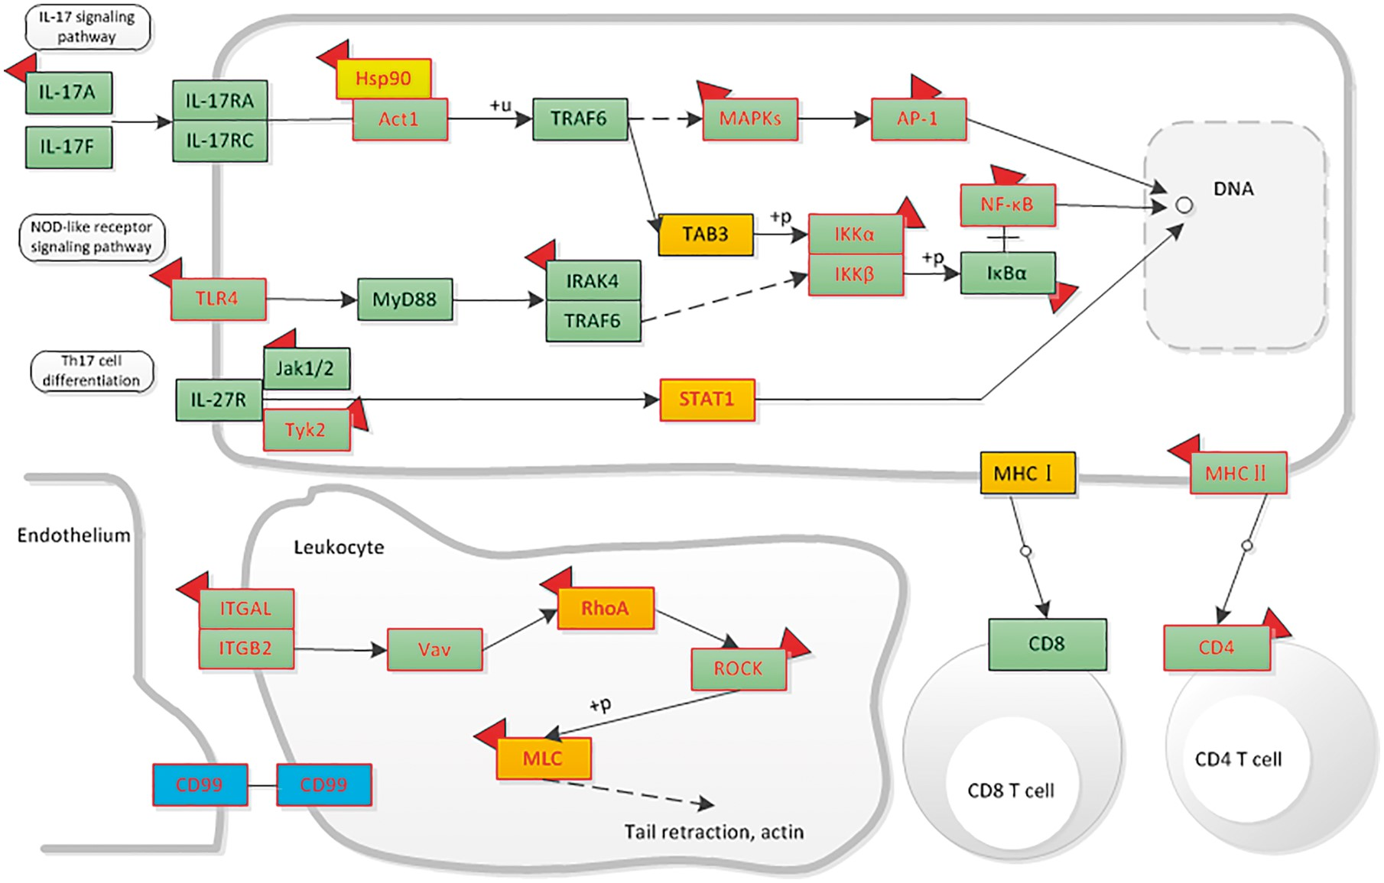
Figure 7. The distribution of liver-associated proteins in immune system related signaling networks. Orange means the ...
Notes:
Figure 7. The distribution of liver-associated proteins in immune system related signaling networks. Orange means the up-regulated protein, blue means the down-regulated protein. Protein with mutation information is colored by red frame. The drug targets are attached with a red symbol.
Unless provided in the caption above, the following copyright applies to the content of this slide: © The Author(s) 2018. Published by Oxford University Press.This is an Open Access article distributed under the terms of the Creative Commons Attribution License (http://creativecommons.org/licenses/by/4.0/), which permits unrestricted reuse, distribution, and reproduction in any medium, provided the original work is properly cited.

