Slide 1
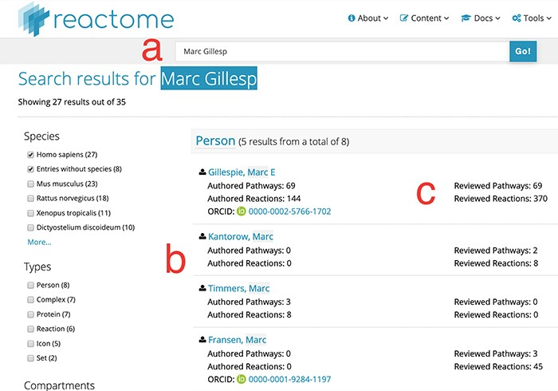
Figure 1 Search results for partial author name ‘Marc Gillesp’. Direct access URL ...
Notes:
Figure 1 Search results for partial author name ‘Marc Gillesp’. Direct access URL https://reactome.org/content/query?q=Marc+Gillesp&species=Homo+sapiens&species=Entries+without+species&cluster=true, accessed 2019/08/15. Within the figure, label ‘a’ marks the mis-spelt contributor name, label ‘b’ marks the list of other contributor names matching the search terms and label ‘c’ marks the fine-grained ‘contribution matrix’, distinguishing between pathways and reactions in one dimension and authoring/reviewing in the other dimension.
Unless provided in the caption above, the following copyright applies to the content of this slide: © The Author(s) 2019. Published by Oxford University Press.This is an Open Access article distributed under the terms of the Creative Commons Attribution License (http://creativecommons.org/licenses/by/4.0/), which permits unrestricted reuse, distribution, and reproduction in any medium, provided the original work is properly cited.

