Slide 1
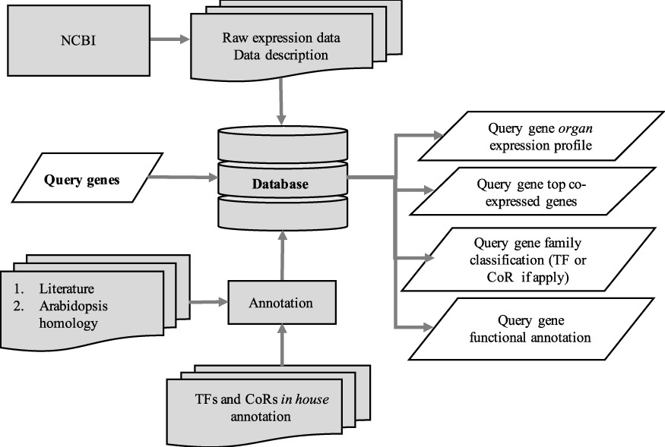
Figure 1. Schematic diagram outlining the architecture of CamRegBase 1.0.
Notes:
Figure 1. Schematic diagram outlining the architecture of CamRegBase 1.0.
Unless provided in the caption above, the following copyright applies to the content of this slide: © The Author(s) 2020. Published by Oxford University Press.This is an Open Access article distributed under the terms of the Creative Commons Attribution License (http://creativecommons.org/licenses/by/4.0/), which permits unrestricted reuse, distribution, and reproduction in any medium, provided the original work is properly cited.

Slide 2
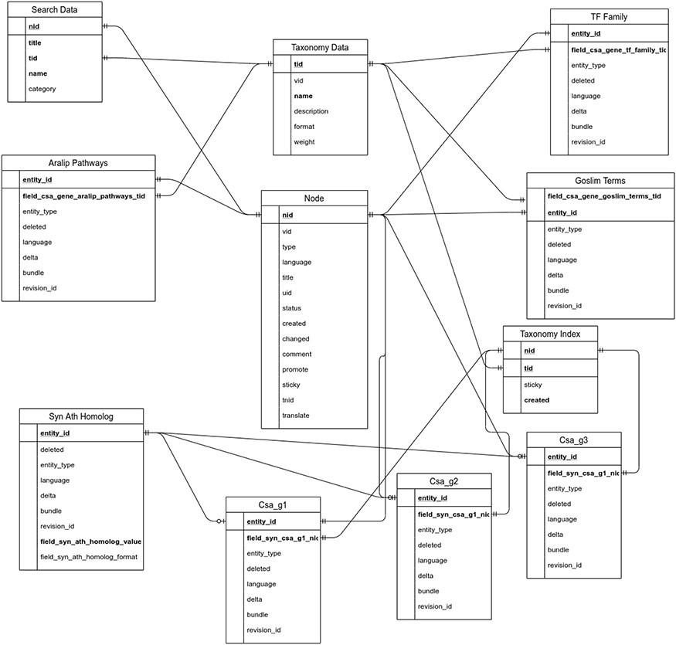
Figure 2. Entity relationship diagram of the main tables used in the backend of CamRegBase 1.0.
Notes:
Figure 2. Entity relationship diagram of the main tables used in the backend of CamRegBase 1.0.
Unless provided in the caption above, the following copyright applies to the content of this slide: © The Author(s) 2020. Published by Oxford University Press.This is an Open Access article distributed under the terms of the Creative Commons Attribution License (http://creativecommons.org/licenses/by/4.0/), which permits unrestricted reuse, distribution, and reproduction in any medium, provided the original work is properly cited.

Slide 3
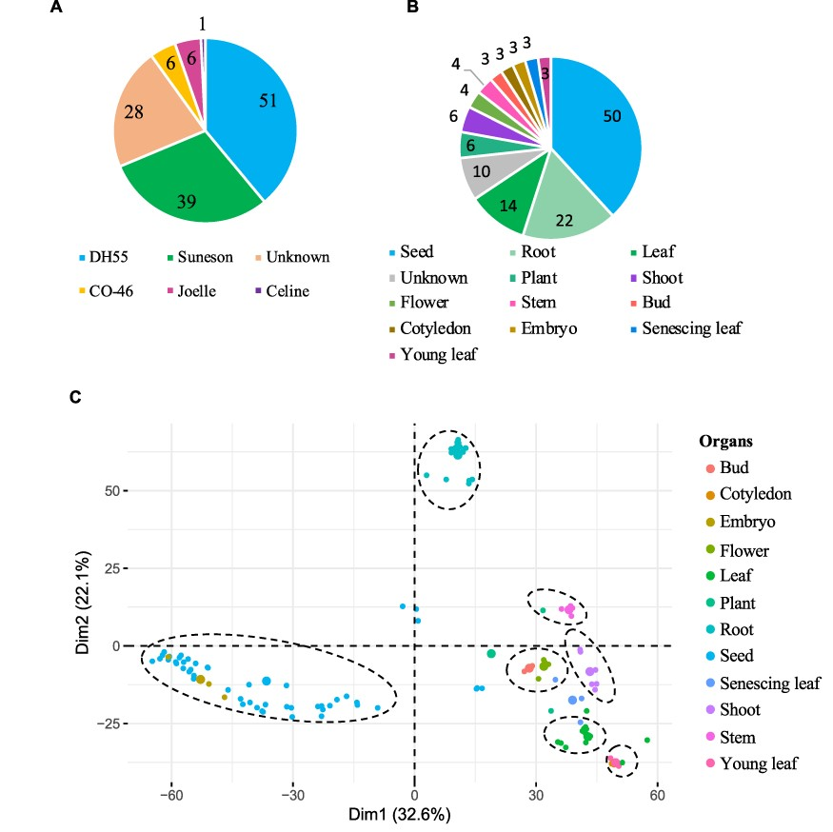
Figure 3. Gene expression data hosted on CamRegBase 1.0. Summary of expression data available on CamRegBase at the ...
Notes:
Figure 3. Gene expression data hosted on CamRegBase 1.0. Summary of expression data available on CamRegBase at the level of (A) Camelina varieties and (B) organ-specific samples. (C) PCA of the Camelina transcriptome using log2TPMs. Dotted ovals indicate major groups of samples identify by visual inspection of the PCA results.
Unless provided in the caption above, the following copyright applies to the content of this slide: © The Author(s) 2020. Published by Oxford University Press.This is an Open Access article distributed under the terms of the Creative Commons Attribution License (http://creativecommons.org/licenses/by/4.0/), which permits unrestricted reuse, distribution, and reproduction in any medium, provided the original work is properly cited.

Slide 4
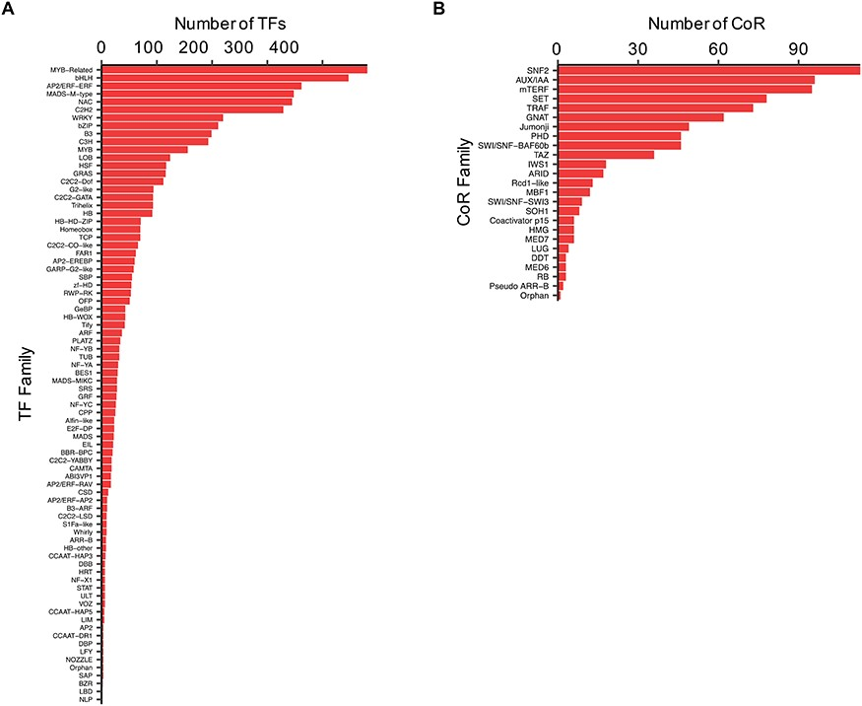
Figure 4. Distribution of the (A) TF and (B) CoR genes according to families, as currently present in CamRegBase 1.0.
Notes:
Figure 4. Distribution of the (A) TF and (B) CoR genes according to families, as currently present in CamRegBase 1.0.
Unless provided in the caption above, the following copyright applies to the content of this slide: © The Author(s) 2020. Published by Oxford University Press.This is an Open Access article distributed under the terms of the Creative Commons Attribution License (http://creativecommons.org/licenses/by/4.0/), which permits unrestricted reuse, distribution, and reproduction in any medium, provided the original work is properly cited.

