Slide 1
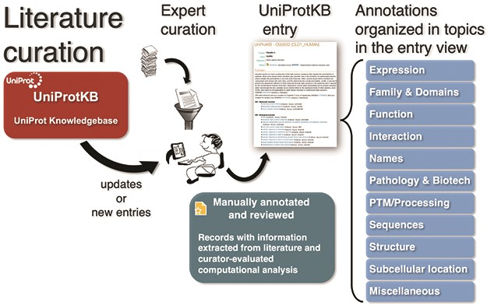
Figure 1 UniProt Knowledgebase annotation process. Manually protein-annotated documents (Swiss-Prot) are associated ...
Notes:
Figure 1 UniProt Knowledgebase annotation process. Manually protein-annotated documents (Swiss-Prot) are associated with UniProt entry categories (Function, Name & Taxonomy, etc.) according to the type of information available in the publication, improving the organization of the annotations within the knowledge base. A much larger set of publications (TrEMBL) is then automatically annotated according to their source characteristics.
Unless provided in the caption above, the following copyright applies to the content of this slide: © The Author(s) 2020. Published by Oxford University Press.This is an Open Access article distributed under the terms of the Creative Commons Attribution License (http://creativecommons.org/licenses/by/4.0/), which permits unrestricted reuse, distribution, and reproduction in any medium, provided the original work is properly cited.

Slide 2
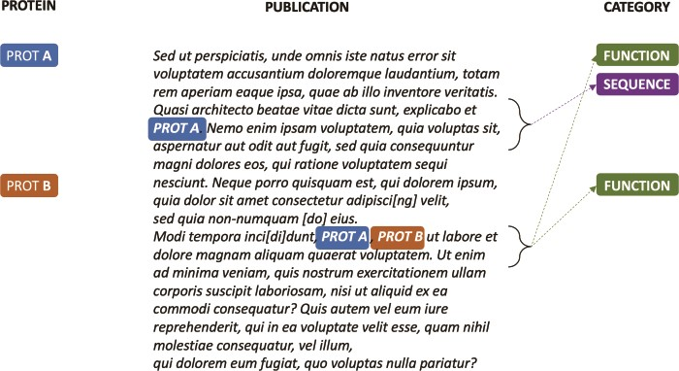
Figure 2 Synthetic annotation example illustrating how a single publication can be associated with different sets of ...
Notes:
Figure 2 Synthetic annotation example illustrating how a single publication can be associated with different sets of UniProtKB entry categories.
Unless provided in the caption above, the following copyright applies to the content of this slide: © The Author(s) 2020. Published by Oxford University Press.This is an Open Access article distributed under the terms of the Creative Commons Attribution License (http://creativecommons.org/licenses/by/4.0/), which permits unrestricted reuse, distribution, and reproduction in any medium, provided the original work is properly cited.

Slide 3
Figure 3 Positive passages extracted from annotations in Figure 2. k-nearest (k = 0) sentences containing candidate ...
Notes:
Figure 3 Positive passages extracted from annotations in Figure 2. k-nearest (k = 0) sentences containing candidate evidence for the protein annotation are concatenated to create a ‘positive’ document. Similarly, sentences that do not contain evidence for the category are concatenated to create a ‘negative’ document (not shown).
Unless provided in the caption above, the following copyright applies to the content of this slide: © The Author(s) 2020. Published by Oxford University Press.This is an Open Access article distributed under the terms of the Creative Commons Attribution License (http://creativecommons.org/licenses/by/4.0/), which permits unrestricted reuse, distribution, and reproduction in any medium, provided the original work is properly cited.

Slide 4
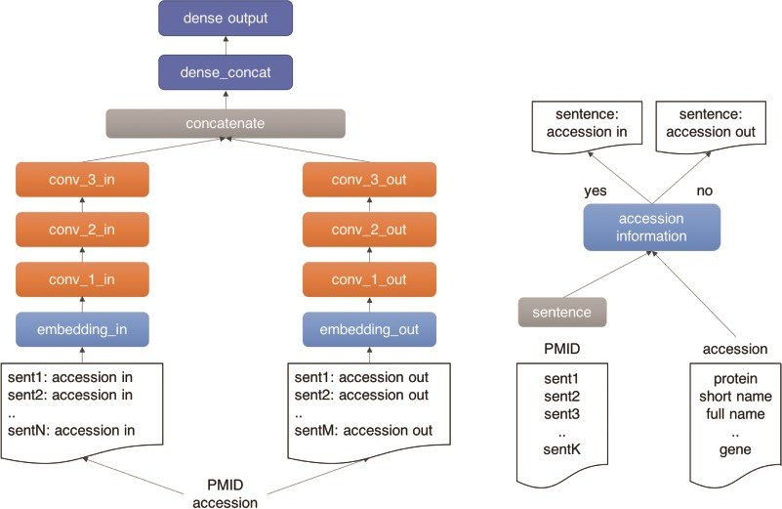
Figure 4 Outline of the UPCLASS CNN-based classification architecture with an embedding layer, three CNN layers ...
Notes:
Figure 4 Outline of the UPCLASS CNN-based classification architecture with an embedding layer, three CNN layers followed by two dense layers. The ‘positive’ sentences (accession in) are concatenated and fed to one branch of the model (‘in’ branch). The leftover sentences (accession out) are used to create the ‘negative’ document and fed to the other branch of the model (‘out’ branch).
Unless provided in the caption above, the following copyright applies to the content of this slide: © The Author(s) 2020. Published by Oxford University Press.This is an Open Access article distributed under the terms of the Creative Commons Attribution License (http://creativecommons.org/licenses/by/4.0/), which permits unrestricted reuse, distribution, and reproduction in any medium, provided the original work is properly cited.

Slide 5
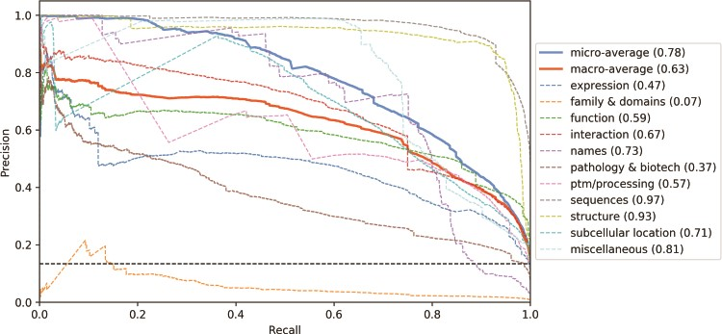
Figure 5 Precision-recall curves for the UniProtKB categories obtained from the CNN tagged classification. Mean ...
Notes:
Figure 5 Precision-recall curves for the UniProtKB categories obtained from the CNN tagged classification. Mean average precision is shown in parentheses. Black horizontal dashed line: performance of a random classifier.
Unless provided in the caption above, the following copyright applies to the content of this slide: © The Author(s) 2020. Published by Oxford University Press.This is an Open Access article distributed under the terms of the Creative Commons Attribution License (http://creativecommons.org/licenses/by/4.0/), which permits unrestricted reuse, distribution, and reproduction in any medium, provided the original work is properly cited.

Slide 6
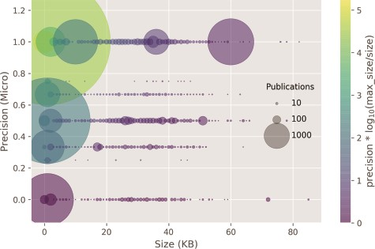
Figure 6 Classifier precision as a function of the publication size. There is no correlation between the size of the ...
Notes:
Figure 6 Classifier precision as a function of the publication size. There is no correlation between the size of the input size and precision. Circle size: number of publications within a size bin. Yellow points: high precision and lower ratio between publication size and the max publication size in the test set. Purple points: low precision and higher ratio between the publication size and the max publication size in the test set.
Unless provided in the caption above, the following copyright applies to the content of this slide: © The Author(s) 2020. Published by Oxford University Press.This is an Open Access article distributed under the terms of the Creative Commons Attribution License (http://creativecommons.org/licenses/by/4.0/), which permits unrestricted reuse, distribution, and reproduction in any medium, provided the original work is properly cited.

Slide 7
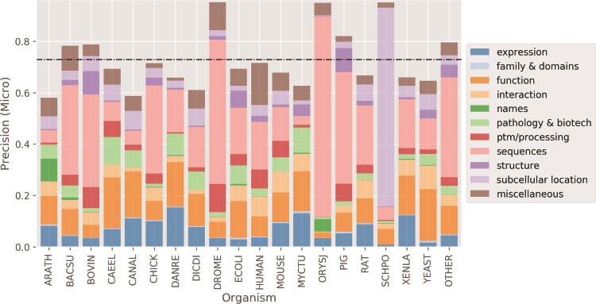
Figure 7 Micro average precision performance per organism. Higher precision for organisms happens when there is a ...
Notes:
Figure 7 Micro average precision performance per organism. Higher precision for organisms happens when there is a concentration of categories. Black dashed horizontal line: mean organism precision.
Unless provided in the caption above, the following copyright applies to the content of this slide: © The Author(s) 2020. Published by Oxford University Press.This is an Open Access article distributed under the terms of the Creative Commons Attribution License (http://creativecommons.org/licenses/by/4.0/), which permits unrestricted reuse, distribution, and reproduction in any medium, provided the original work is properly cited.

