Slide 1
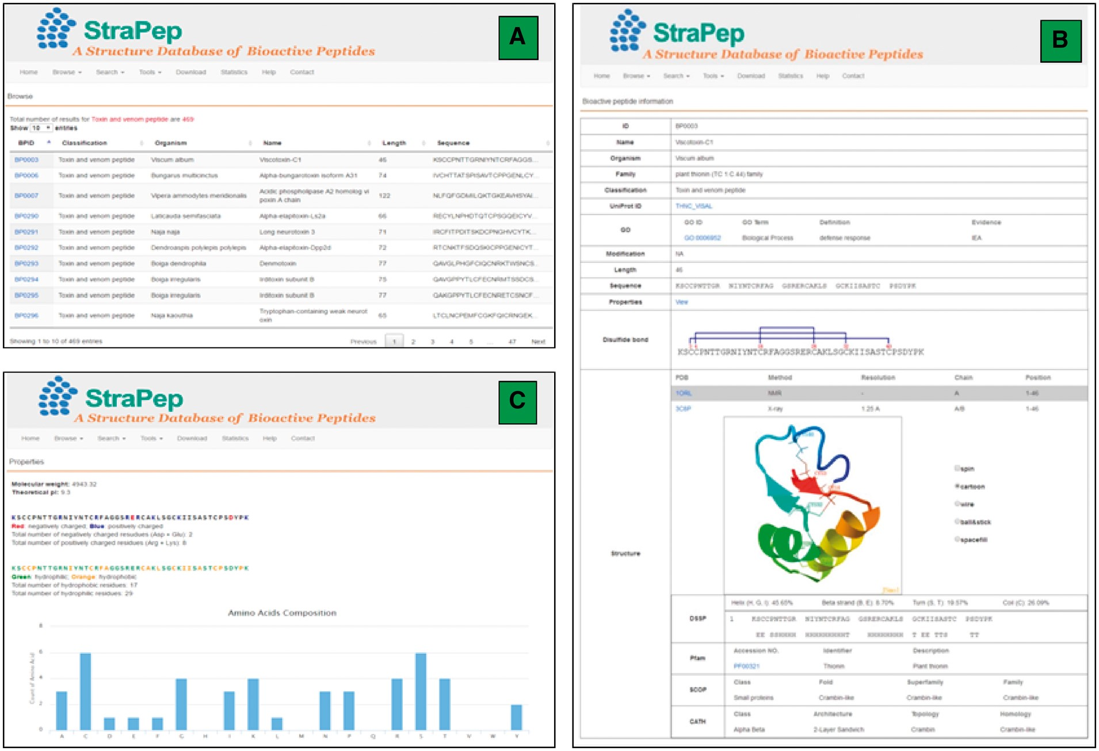
Figure 2. An overview of the user interface of the web interface of StraPep. (A) The browse output of toxin and venom ...
Notes:
Figure 2. An overview of the user interface of the web interface of StraPep. (A) The browse output of toxin and venom peptides. (B) Entry BP0003 as an example of toxin and venom peptides. ID: a unique code to identify each database entry. Organism: the scientific name of the organism producing the peptide. Classification: the classification of the peptide, which was based on the function annotation of the peptide in UniProt or PDB. Modification: the type of posttranslational modification and the position of each modified residue in the sequence. Structure: the three-dimensional structure of the peptide, the secondary structure information derived from DSSP, and the domain information of the peptide in Pfam, SCOP and CATH (if available) are shown. (C) The properties page of the entry BP0003. the frequency of each common amino acids, the number of charged, hydrophilic and hydrophobic amino acids, the isoelectric points and molecular weight of each peptide were computed.
Unless provided in the caption above, the following copyright applies to the content of this slide: © The Author(s) 2018. Published by Oxford University Press.This is an Open Access article distributed under the terms of the Creative Commons Attribution License (http://creativecommons.org/licenses/by/4.0/), which permits unrestricted reuse, distribution, and reproduction in any medium, provided the original work is properly cited.

