Slide 1
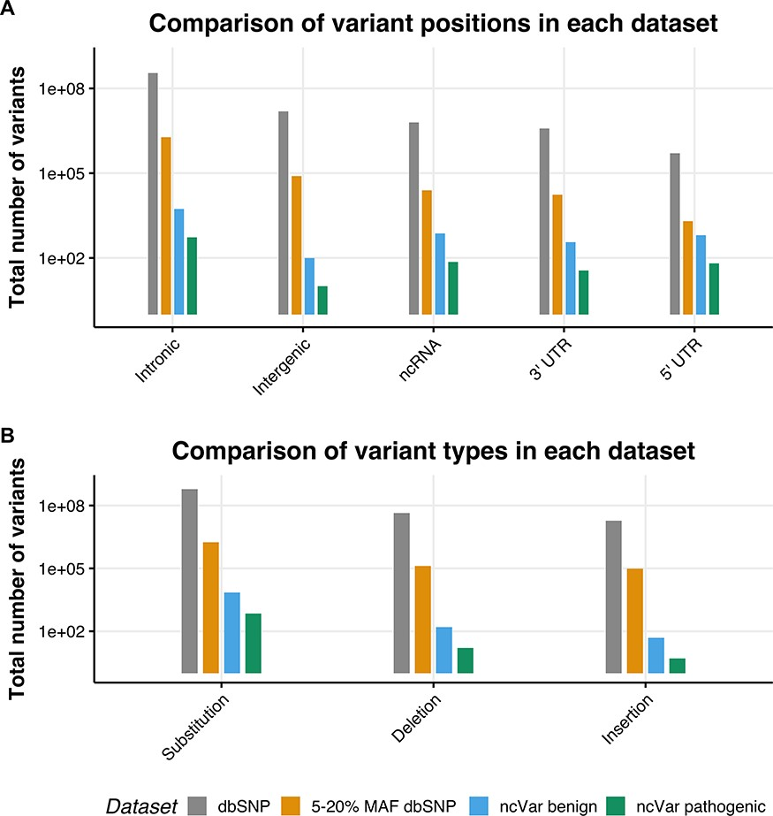
Figure 1. The location and single-nucleotide polymorphism (SNP) types of ncVarDB variants in comparison to variants ...
Notes:
Figure 1. The location and single-nucleotide polymorphism (SNP) types of ncVarDB variants in comparison to variants from the dbSNP database. A comparison of the variant positions and the type of variants in every SNP in dbSNP dataset excluding variants from alternate contigs (dbSNP), every non-coding SNP with a MAF between 5 and 20% (5–20% MAF dbSNP), the ncVar benign dataset and the ncVar pathogenic dataset. (A) A comparison of the frequency of genomic positions of variants present in each dataset. Positions are based on the genomic notation submitted with the variant in either dbSNP or ClinVar. (B) A comparison of the frequency of variant types for each dataset. Variant types have been simplified to three types to avoid type expansion.
Unless provided in the caption above, the following copyright applies to the content of this slide: © The Author(s) 2020. Published by Oxford University Press.This is an Open Access article distributed under the terms of the Creative Commons Attribution License (http://creativecommons.org/licenses/by/4.0/), which permits unrestricted reuse, distribution, and reproduction in any medium, provided the original work is properly cited.

Slide 2
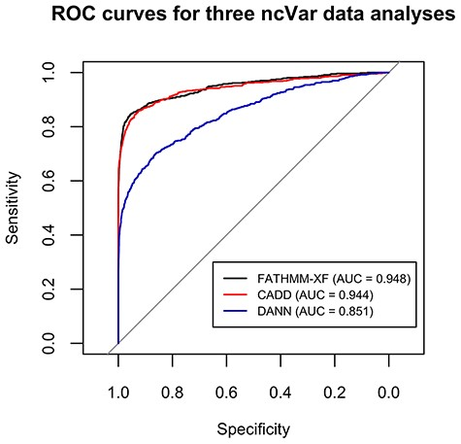
Figure 2. ROC curves for the classification analyses of the ncVar dataset by three different software tools: FATHMM-XF, ...
Notes:
Figure 2. ROC curves for the classification analyses of the ncVar dataset by three different software tools: FATHMM-XF, CADD v1.4 and DANN. FATHMM-XF and CADD predict the pathogenicity of the ncVarDB variants with noticeably higher specificity and sensitivity than DANN. Overall good performance of all three tools additionally validates the ncVar dataset.
Unless provided in the caption above, the following copyright applies to the content of this slide: © The Author(s) 2020. Published by Oxford University Press.This is an Open Access article distributed under the terms of the Creative Commons Attribution License (http://creativecommons.org/licenses/by/4.0/), which permits unrestricted reuse, distribution, and reproduction in any medium, provided the original work is properly cited.

