Slide 1
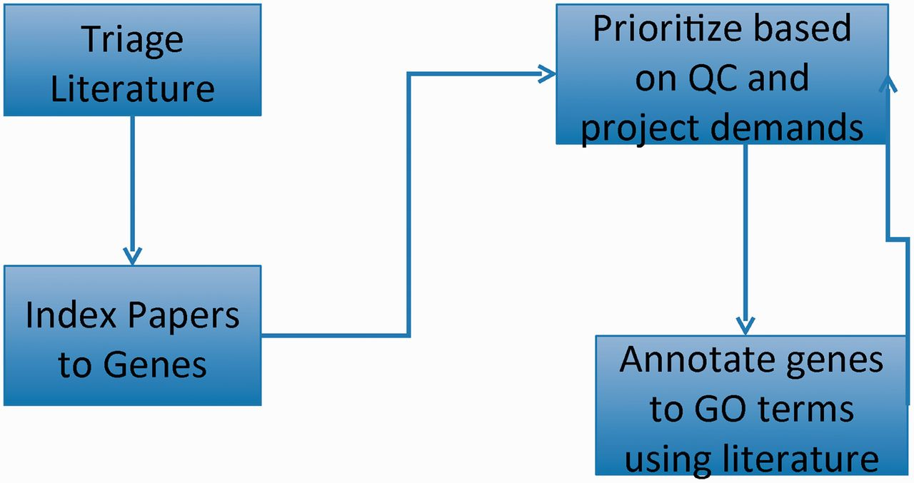
Figure 1. GO curation workflow: papers of interest are identified and entered into the database system (triage) and ...
Notes:
Figure 1. GO curation workflow: papers of interest are identified and entered into the database system (triage) and associated with genes (indexed). GO annotations are made using papers selected based on quality control reports and projects. The quality control reports in turn are revised daily based on added annotation.
Unless provided in the caption above, the following copyright applies to the content of this slide: © The Author(s) 2012. Published by Oxford University Press.This is an Open Access article distributed under the terms of the Creative Commons Attribution License (http://creativecommons.org/licenses/by-nc/3.0/), which permits non-commercial reuse, distribution, and reproduction in any medium, provided the original work is properly cited. For commercial re-use, please contact journals.permissions@oup.com.

Slide 2
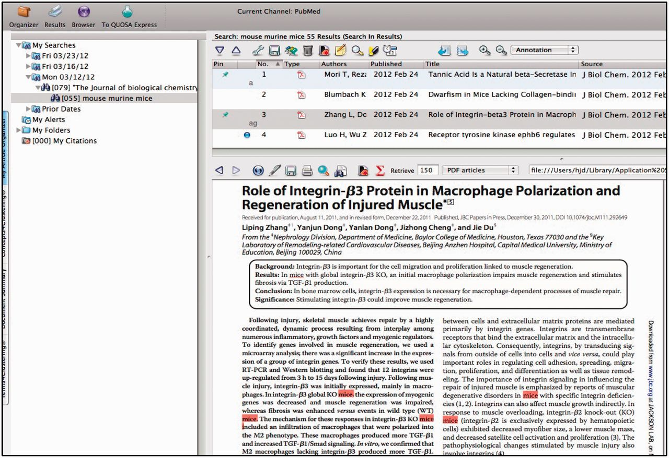
Figure 2. QUOSA Information Manager showing part of a paper from an issue of JBC with mouse, murine or mice ...
Notes:
Figure 2. QUOSA Information Manager showing part of a paper from an issue of JBC with mouse, murine or mice highlighted. Curator quickly looks at context to select appropriate area of MGI that the paper best fits. The paper shown has been ‘tagged’ for alleles and GO.
Unless provided in the caption above, the following copyright applies to the content of this slide: © The Author(s) 2012. Published by Oxford University Press.This is an Open Access article distributed under the terms of the Creative Commons Attribution License (http://creativecommons.org/licenses/by-nc/3.0/), which permits non-commercial reuse, distribution, and reproduction in any medium, provided the original work is properly cited. For commercial re-use, please contact journals.permissions@oup.com.

Slide 3
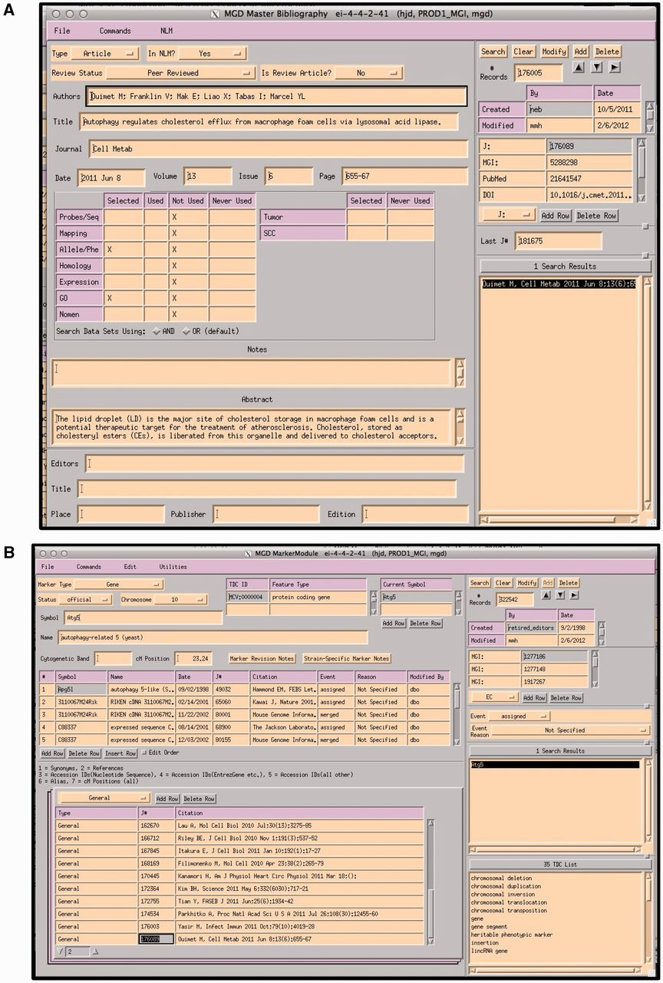
Figure 3. (A) MGI Master Bib EI, showing a record for a paper that has been selected for alleles/phenotypes and GO. The ...
Notes:
Figure 3. (A) MGI Master Bib EI, showing a record for a paper that has been selected for alleles/phenotypes and GO. The paper has not yet been curated for GO (indicated by an X in the selected and X in Not Used). (B) MGI Gene Feature Detail Module. References to be associated with this gene are entered into the lower left hand panel. If a paper is associated with multiple genes, the same paper is entered for each gene. All EIs are TeleUSE graphical user interface applications running under X-windows.
Unless provided in the caption above, the following copyright applies to the content of this slide: © The Author(s) 2012. Published by Oxford University Press.This is an Open Access article distributed under the terms of the Creative Commons Attribution License (http://creativecommons.org/licenses/by-nc/3.0/), which permits non-commercial reuse, distribution, and reproduction in any medium, provided the original work is properly cited. For commercial re-use, please contact journals.permissions@oup.com.

Slide 4
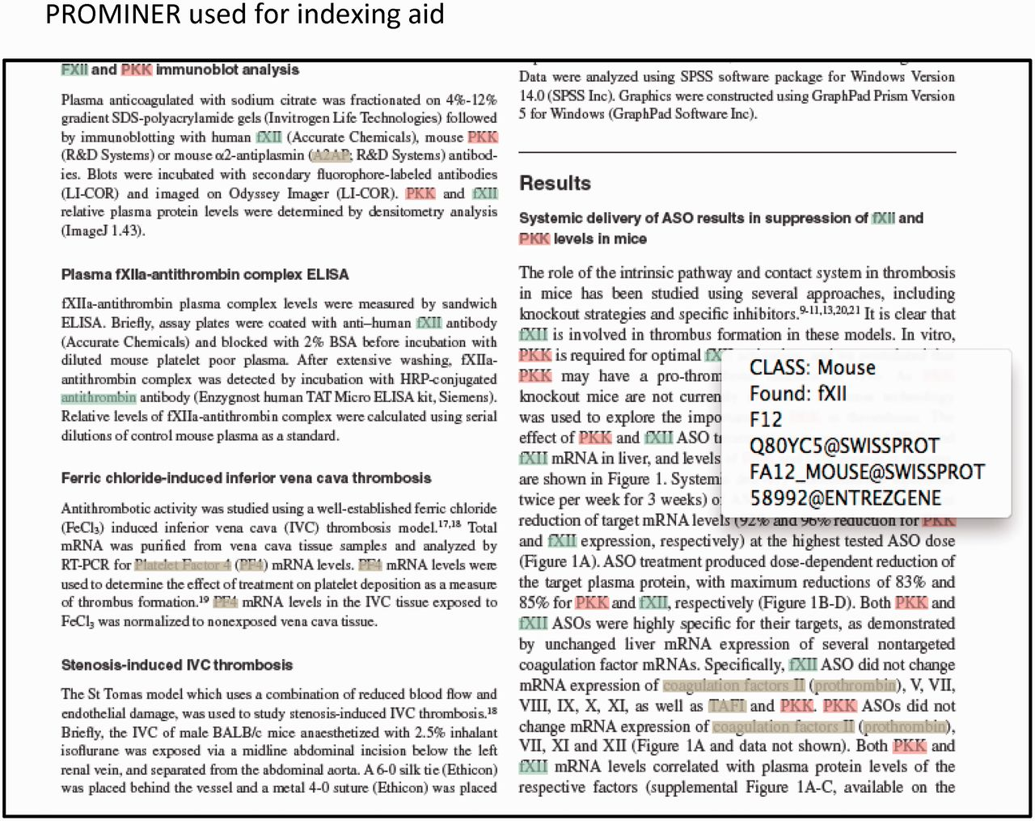
Figure 4. Output from PROMINER: PROMINER is used to assist in the gene indexing process. Utilizing official ...
Notes:
Figure 4. Output from PROMINER: PROMINER is used to assist in the gene indexing process. Utilizing official nomenclatures and synonym lists for mouse/rat/human gene names and gene symbols, PROMINER marks up papers for review by a curator, who then associates genes-to-papers in the MGI EI.
Unless provided in the caption above, the following copyright applies to the content of this slide: © The Author(s) 2012. Published by Oxford University Press.This is an Open Access article distributed under the terms of the Creative Commons Attribution License (http://creativecommons.org/licenses/by-nc/3.0/), which permits non-commercial reuse, distribution, and reproduction in any medium, provided the original work is properly cited. For commercial re-use, please contact journals.permissions@oup.com.

Slide 5
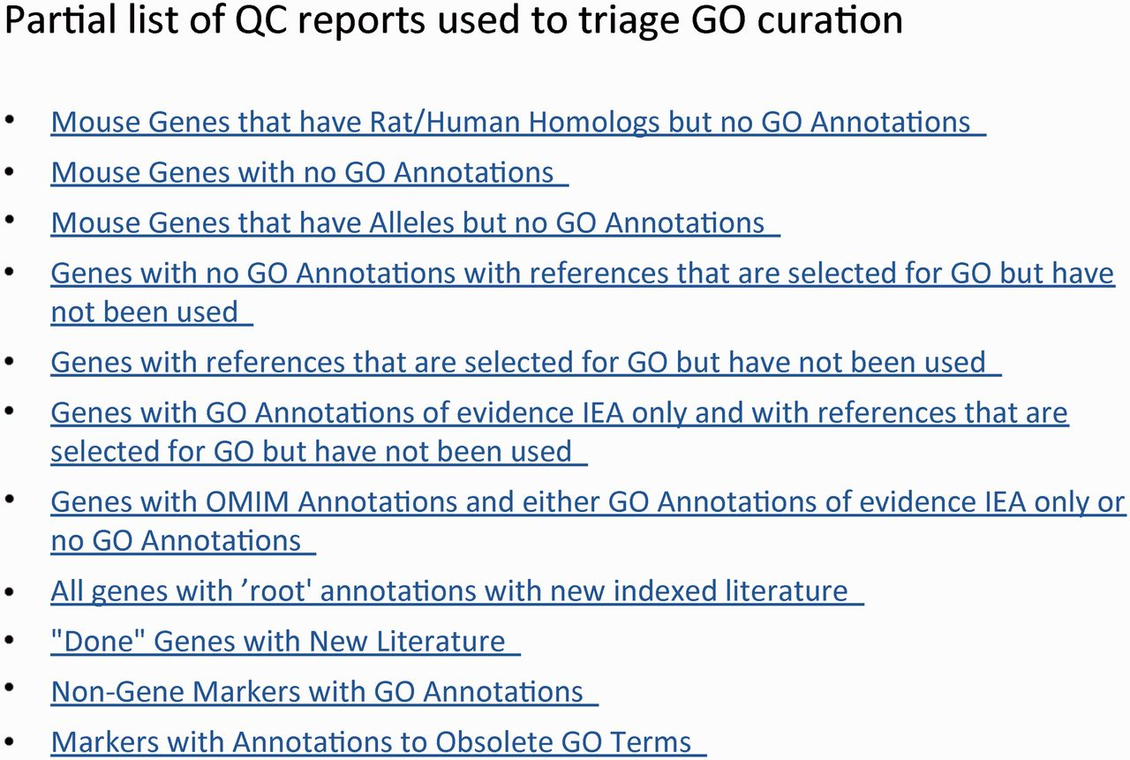
Figure 5. GO QC reports used for annotation triage and quality control.
Notes:
Figure 5. GO QC reports used for annotation triage and quality control.
Unless provided in the caption above, the following copyright applies to the content of this slide: © The Author(s) 2012. Published by Oxford University Press.This is an Open Access article distributed under the terms of the Creative Commons Attribution License (http://creativecommons.org/licenses/by-nc/3.0/), which permits non-commercial reuse, distribution, and reproduction in any medium, provided the original work is properly cited. For commercial re-use, please contact journals.permissions@oup.com.

Slide 6
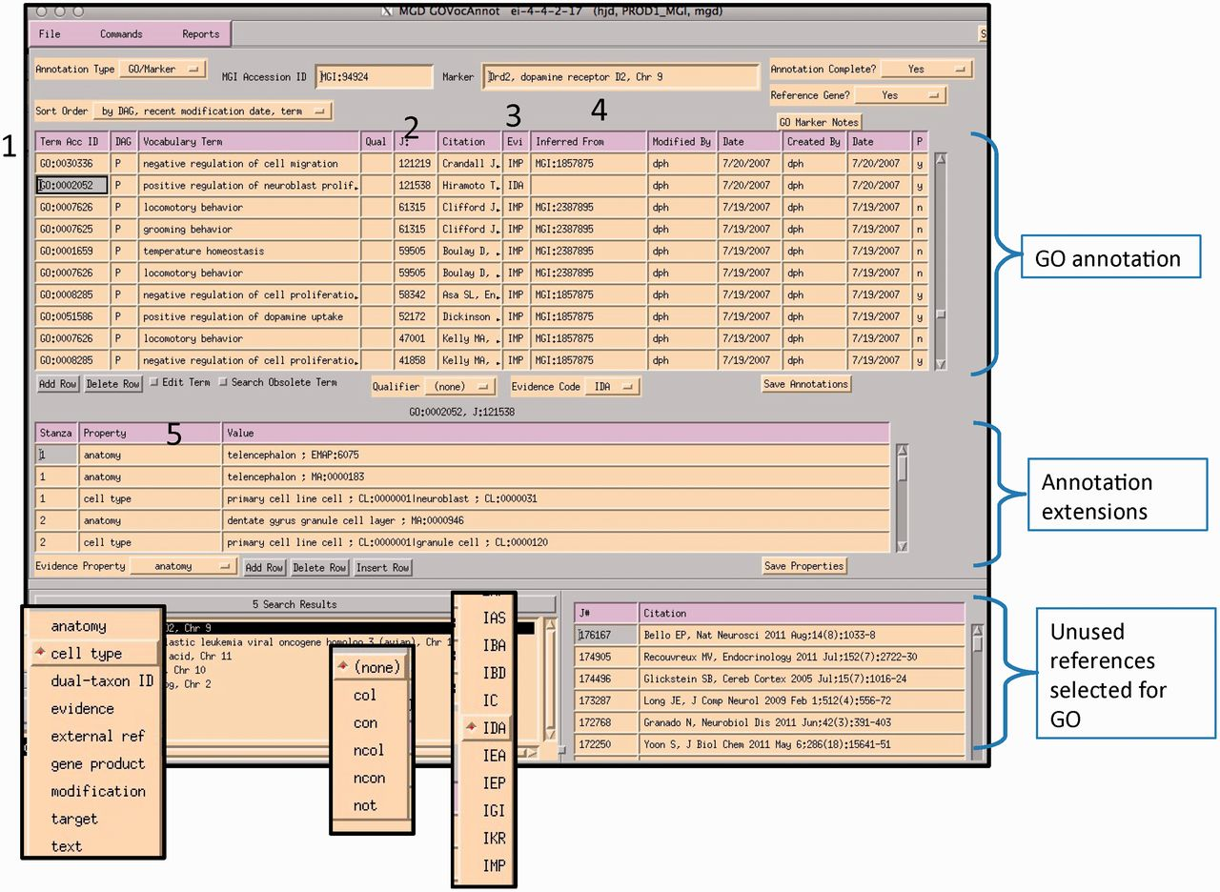
Figure 6. MGI GO data entry module: the interface is divided into three main sections: GO annotation, annotation ...
Notes:
Figure 6. MGI GO data entry module: the interface is divided into three main sections: GO annotation, annotation properties and search and reference tracking. Drop-down menus display pick-lists of allowed entries in various fields (evidence property, GO qualifier and evidence codes). Numbered areas: 1, GO ID entry; 2, reference entry; 3, evidence code entry; 4, ‘inferred_from’ entry required for certain evidence codes and 5, annotation properties entry.
Unless provided in the caption above, the following copyright applies to the content of this slide: © The Author(s) 2012. Published by Oxford University Press.This is an Open Access article distributed under the terms of the Creative Commons Attribution License (http://creativecommons.org/licenses/by-nc/3.0/), which permits non-commercial reuse, distribution, and reproduction in any medium, provided the original work is properly cited. For commercial re-use, please contact journals.permissions@oup.com.

Slide 7
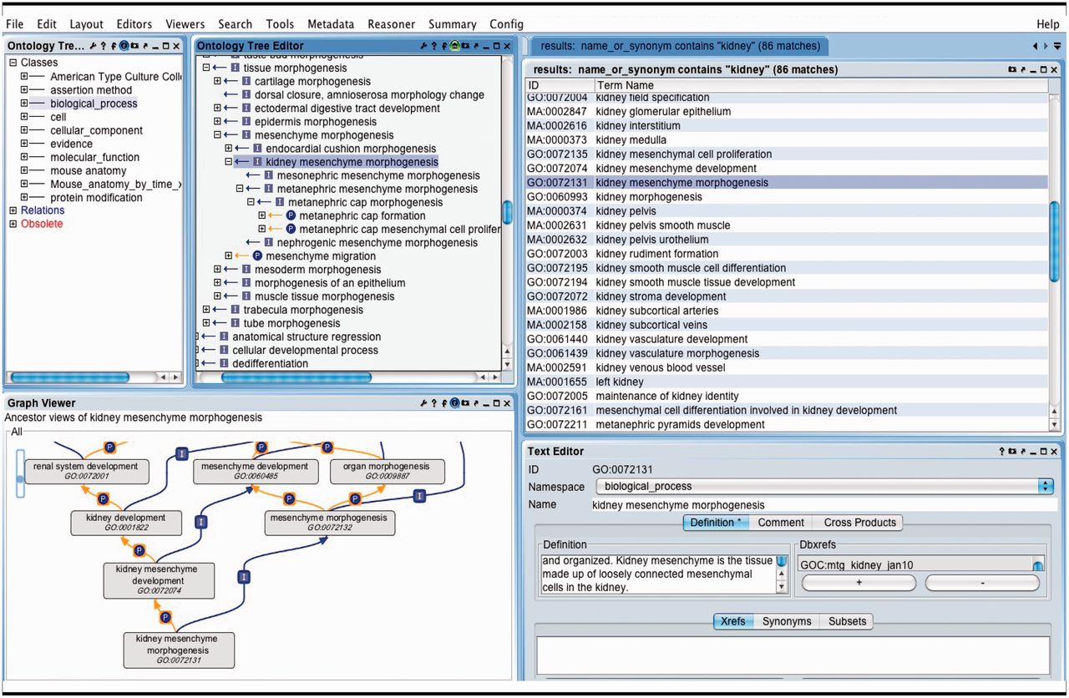
Figure 7. OBO-Edit ontology tool used to browse multiple OBO ontologies. The far left panel shows the vocabularies that ...
Notes:
Figure 7. OBO-Edit ontology tool used to browse multiple OBO ontologies. The far left panel shows the vocabularies that have been loaded for searching and viewing. The right panel displays the terms in all of the vocabularies that contain the word ‘kidney’. The GO term ‘kidney mesenchyme morphogenesis’ is selected and is visible as a tree view showing its children (middle panel), and as a graphical view showing its parents (lower left).
Unless provided in the caption above, the following copyright applies to the content of this slide: © The Author(s) 2012. Published by Oxford University Press.This is an Open Access article distributed under the terms of the Creative Commons Attribution License (http://creativecommons.org/licenses/by-nc/3.0/), which permits non-commercial reuse, distribution, and reproduction in any medium, provided the original work is properly cited. For commercial re-use, please contact journals.permissions@oup.com.

Slide 8
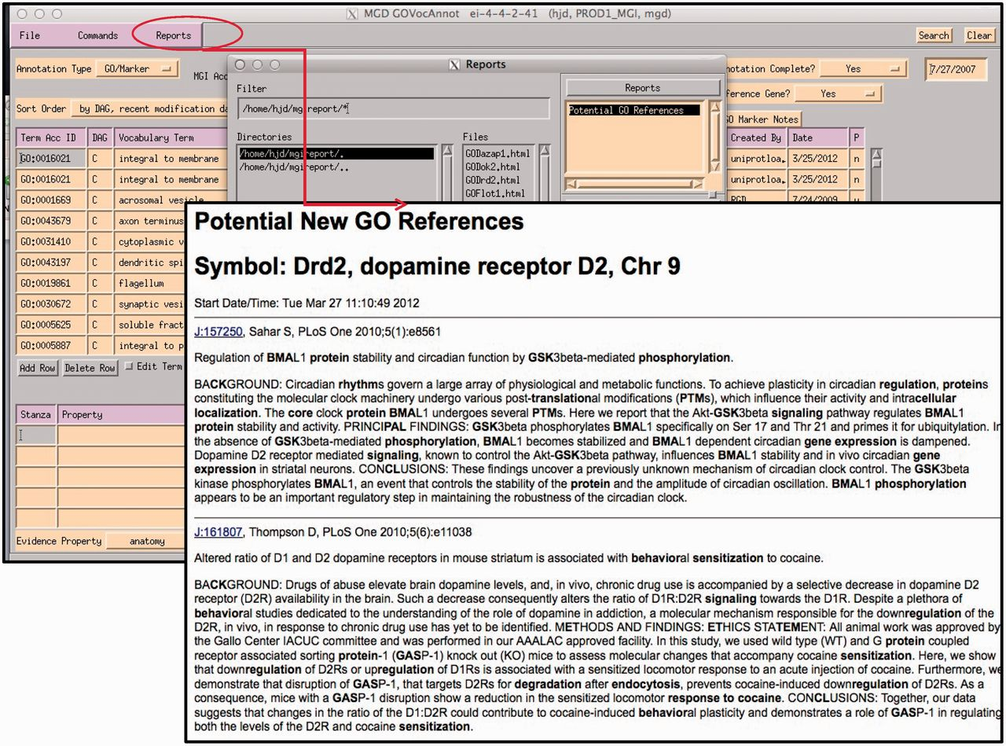
Figure 8. Report generated using the abstracts of papers selected for GO for the gene being annotated within the GO EI. ...
Notes:
Figure 8. Report generated using the abstracts of papers selected for GO for the gene being annotated within the GO EI. Text contained in GO terms in each abstract is highlighted.
Unless provided in the caption above, the following copyright applies to the content of this slide: © The Author(s) 2012. Published by Oxford University Press.This is an Open Access article distributed under the terms of the Creative Commons Attribution License (http://creativecommons.org/licenses/by-nc/3.0/), which permits non-commercial reuse, distribution, and reproduction in any medium, provided the original work is properly cited. For commercial re-use, please contact journals.permissions@oup.com.

Slide 9
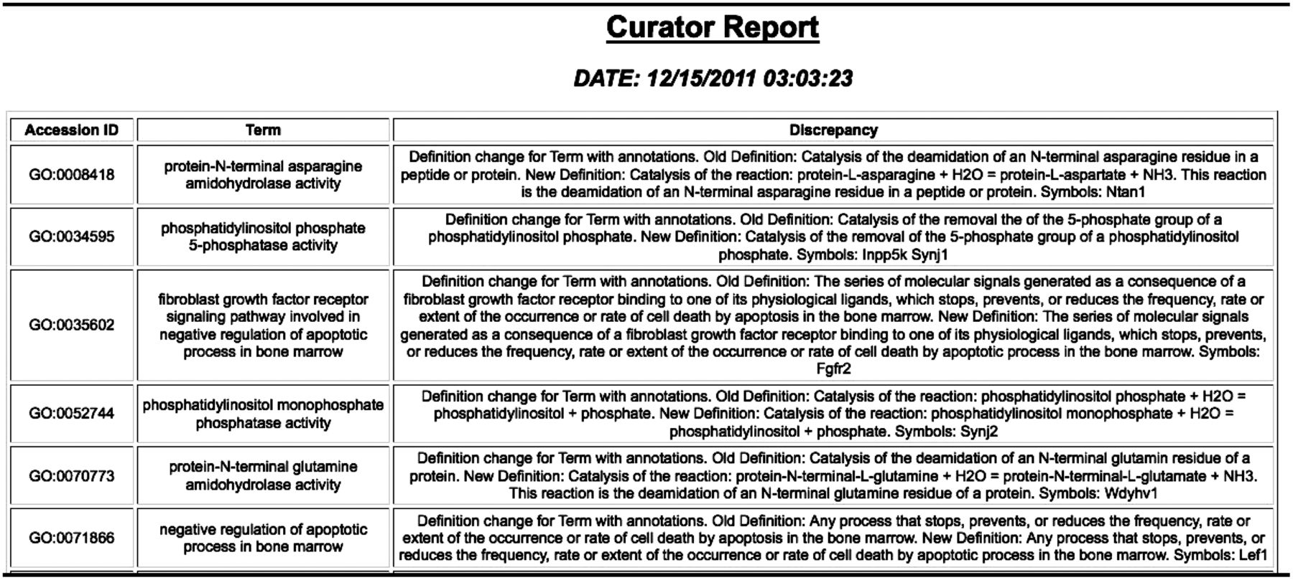
Figure 9. GO change log report showing changes to the GO and genes with annotations using the term that may need to be ...
Notes:
Figure 9. GO change log report showing changes to the GO and genes with annotations using the term that may need to be looked at.
Unless provided in the caption above, the following copyright applies to the content of this slide: © The Author(s) 2012. Published by Oxford University Press.This is an Open Access article distributed under the terms of the Creative Commons Attribution License (http://creativecommons.org/licenses/by-nc/3.0/), which permits non-commercial reuse, distribution, and reproduction in any medium, provided the original work is properly cited. For commercial re-use, please contact journals.permissions@oup.com.

Slide 10
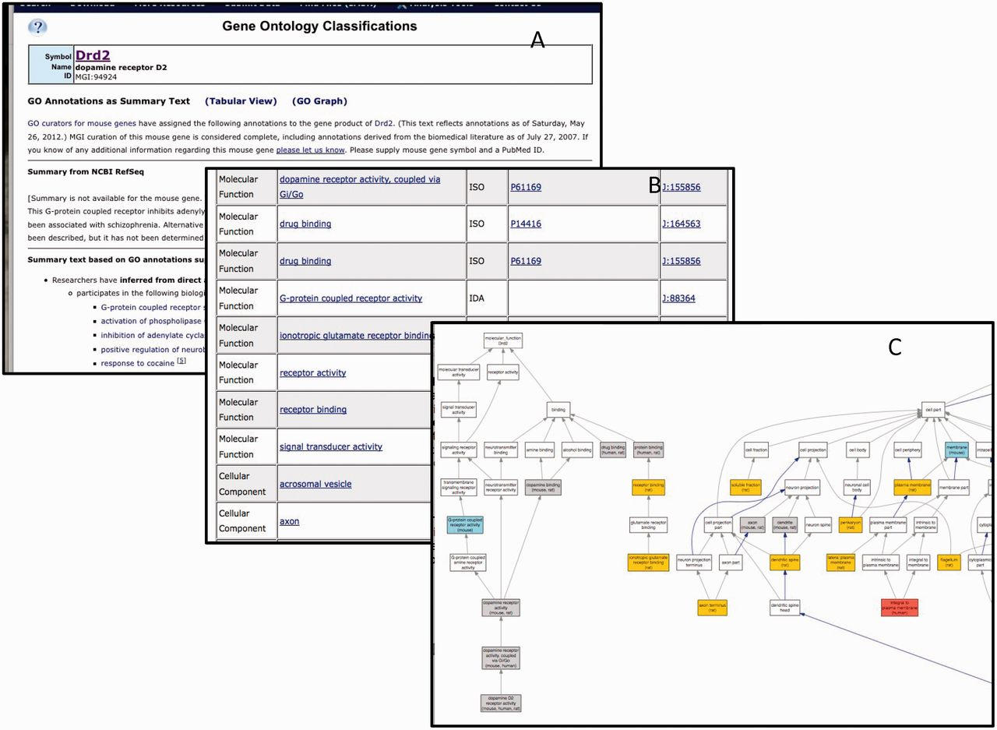
Figure 10. The GO annotation details for Drd2 displayed as summary text (A), table (B) or graph (C). Only a portion of ...
Notes:
Figure 10. The GO annotation details for Drd2 displayed as summary text (A), table (B) or graph (C). Only a portion of each summary is shown. There are 175 annotations total.
Unless provided in the caption above, the following copyright applies to the content of this slide: © The Author(s) 2012. Published by Oxford University Press.This is an Open Access article distributed under the terms of the Creative Commons Attribution License (http://creativecommons.org/licenses/by-nc/3.0/), which permits non-commercial reuse, distribution, and reproduction in any medium, provided the original work is properly cited. For commercial re-use, please contact journals.permissions@oup.com.

