Slide 1
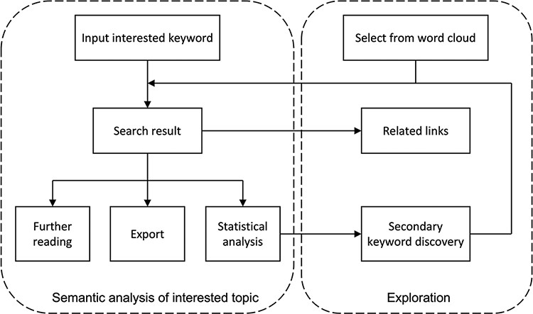
Figure 2. Flow chart of semantic analysis and exploration on the user interface of ProBioQuest. Users can simply input ...
Notes:
Figure 2. Flow chart of semantic analysis and exploration on the user interface of ProBioQuest. Users can simply input the keyword of interest, and ProBioQuest will show related search results. Users can then click the results for further reading or export the selected result. To explore deep searching, ProBioQuest provides a statistical analysis of the search result and Keywords Bank allows further searching by adding a secondary keyword.
Unless provided in the caption above, the following copyright applies to the content of this slide: © The Author(s) 2022. Published by Oxford University Press.This is an Open Access article distributed under the terms of the Creative Commons Attribution-NonCommercial License (https://creativecommons.org/licenses/by-nc/4.0/), which permits non-commercial re-use, distribution, and reproduction in any medium, provided the original work is properly cited. For commercial re-use, please contact journals.permissions@oup.com

