Slide 1
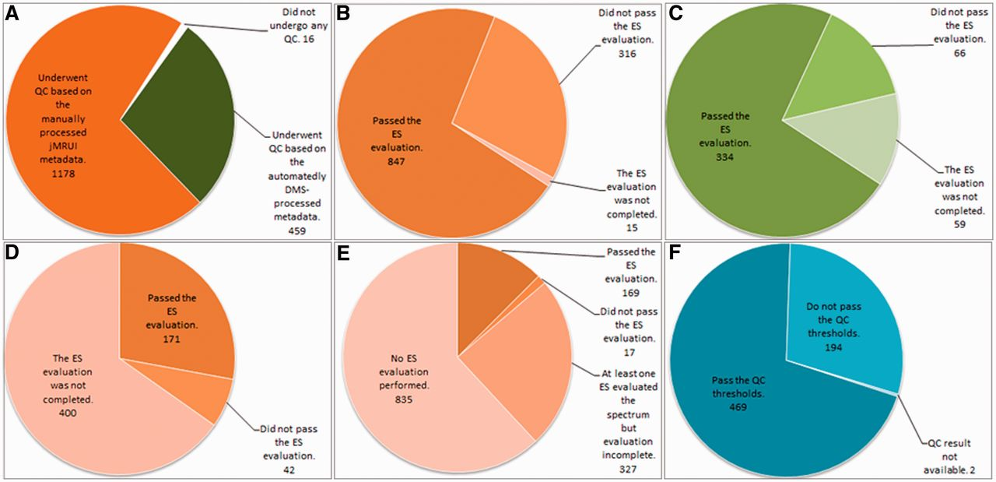
Figure 7 Summary results of the QC over the different data types. (A) Number of cases undergoing SV QC; (B) Results of ...
Notes:
Figure 7 Summary results of the QC over the different data types. (A) Number of cases undergoing SV QC; (B) Results of the SV QC over the spectra that had been manually processed with jMRUI. (C) Results of the SV QC over the spectra that had been automatically processed with the DMS. (D) Results of the MV QC, all processing being manual. (E) Results of the HRMAS QC, all processing being manual. (F) Results of the automated microarray QC.
Unless provided in the caption above, the following copyright applies to the content of this slide: © The Author(s) 2012. Published by Oxford University Press.This is an Open Access article distributed under the terms of the Creative Commons Attribution License (http://creativecommons.org/licenses/by-nc/3.0/), which permits non-commercial reuse, distribution, and reproduction in any medium, provided the original work is properly cited. For commercial re-use, please contact journals.permissions@oup.com.

