Slide 1
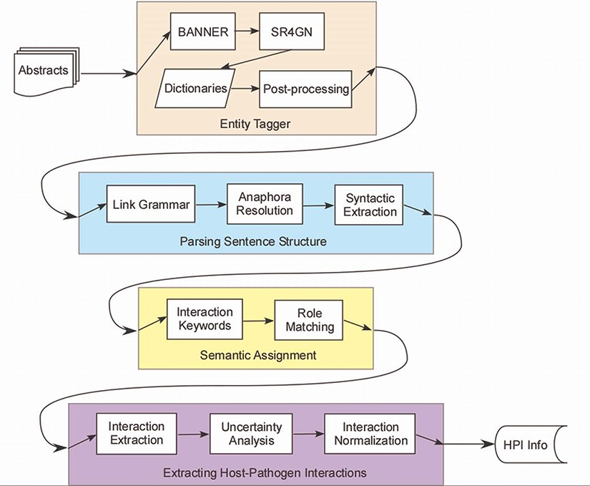
Figure 1. Host–pathogen literature mining system. PHILM consisted of four phases: (i) entity tagging, where ...
Notes:
Figure 1. Host–pathogen literature mining system. PHILM consisted of four phases: (i) entity tagging, where proteins/genes and organism names were identified and linked according to species-gene relationship; (ii) parsing sentence structure, where input text was parsed into dependency structures that allowed resolution of anaphors and splitting a complex sentence into simple sentences; (iii) semantic assignment, where HPI roles of components of a simple sentence were determined and (iv) extraction of HPI information, where both host and pathogen parties of an interaction were localized, normalized and analyzed for uncertainty.
Unless provided in the caption above, the following copyright applies to the content of this slide: © The Author(s) 2022. Published by Oxford University Press.This is an Open Access article distributed under the terms of the Creative Commons Attribution-NonCommercial License (https://creativecommons.org/licenses/by-nc/4.0/), which permits non-commercial re-use, distribution, and reproduction in any medium, provided the original work is properly cited. For commercial re-use, please contact journals.permissions@oup.com

Slide 2
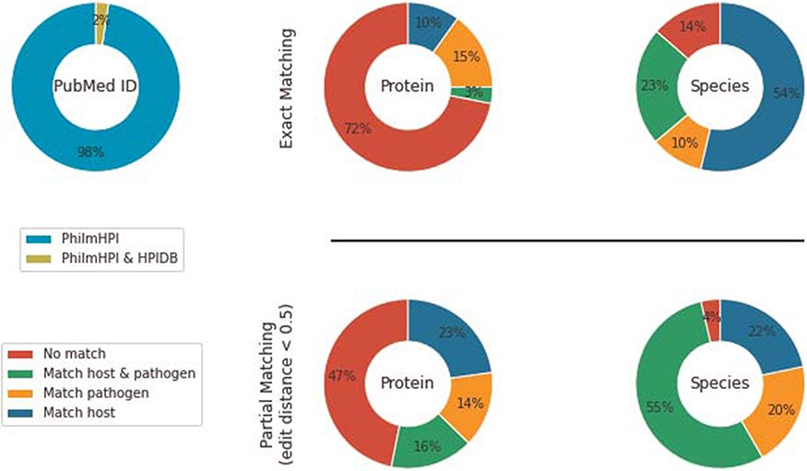
Figure 2. Overlap between PhilmHPI and HPIDB.
Notes:
Figure 2. Overlap between PhilmHPI and HPIDB.
Unless provided in the caption above, the following copyright applies to the content of this slide: © The Author(s) 2022. Published by Oxford University Press.This is an Open Access article distributed under the terms of the Creative Commons Attribution-NonCommercial License (https://creativecommons.org/licenses/by-nc/4.0/), which permits non-commercial re-use, distribution, and reproduction in any medium, provided the original work is properly cited. For commercial re-use, please contact journals.permissions@oup.com

Slide 3
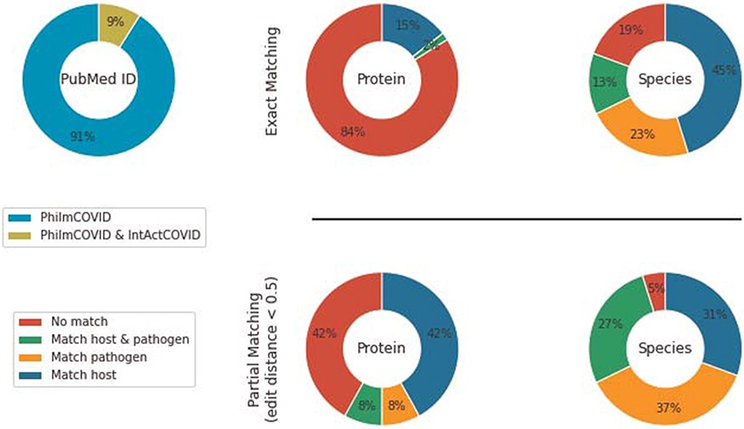
Figure 3. Overlap between PhilmCOVID and IntAct COVID.
Notes:
Figure 3. Overlap between PhilmCOVID and IntAct COVID.
Unless provided in the caption above, the following copyright applies to the content of this slide: © The Author(s) 2022. Published by Oxford University Press.This is an Open Access article distributed under the terms of the Creative Commons Attribution-NonCommercial License (https://creativecommons.org/licenses/by-nc/4.0/), which permits non-commercial re-use, distribution, and reproduction in any medium, provided the original work is properly cited. For commercial re-use, please contact journals.permissions@oup.com

Slide 4
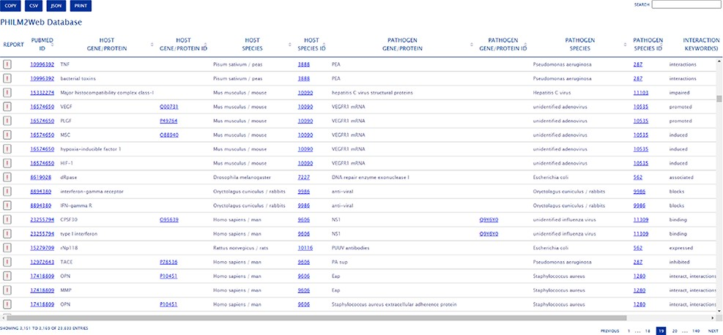
Figure 4. PHILM2Web web interface.
Notes:
Figure 4. PHILM2Web web interface.
Unless provided in the caption above, the following copyright applies to the content of this slide: © The Author(s) 2022. Published by Oxford University Press.This is an Open Access article distributed under the terms of the Creative Commons Attribution-NonCommercial License (https://creativecommons.org/licenses/by-nc/4.0/), which permits non-commercial re-use, distribution, and reproduction in any medium, provided the original work is properly cited. For commercial re-use, please contact journals.permissions@oup.com

