Slide 1
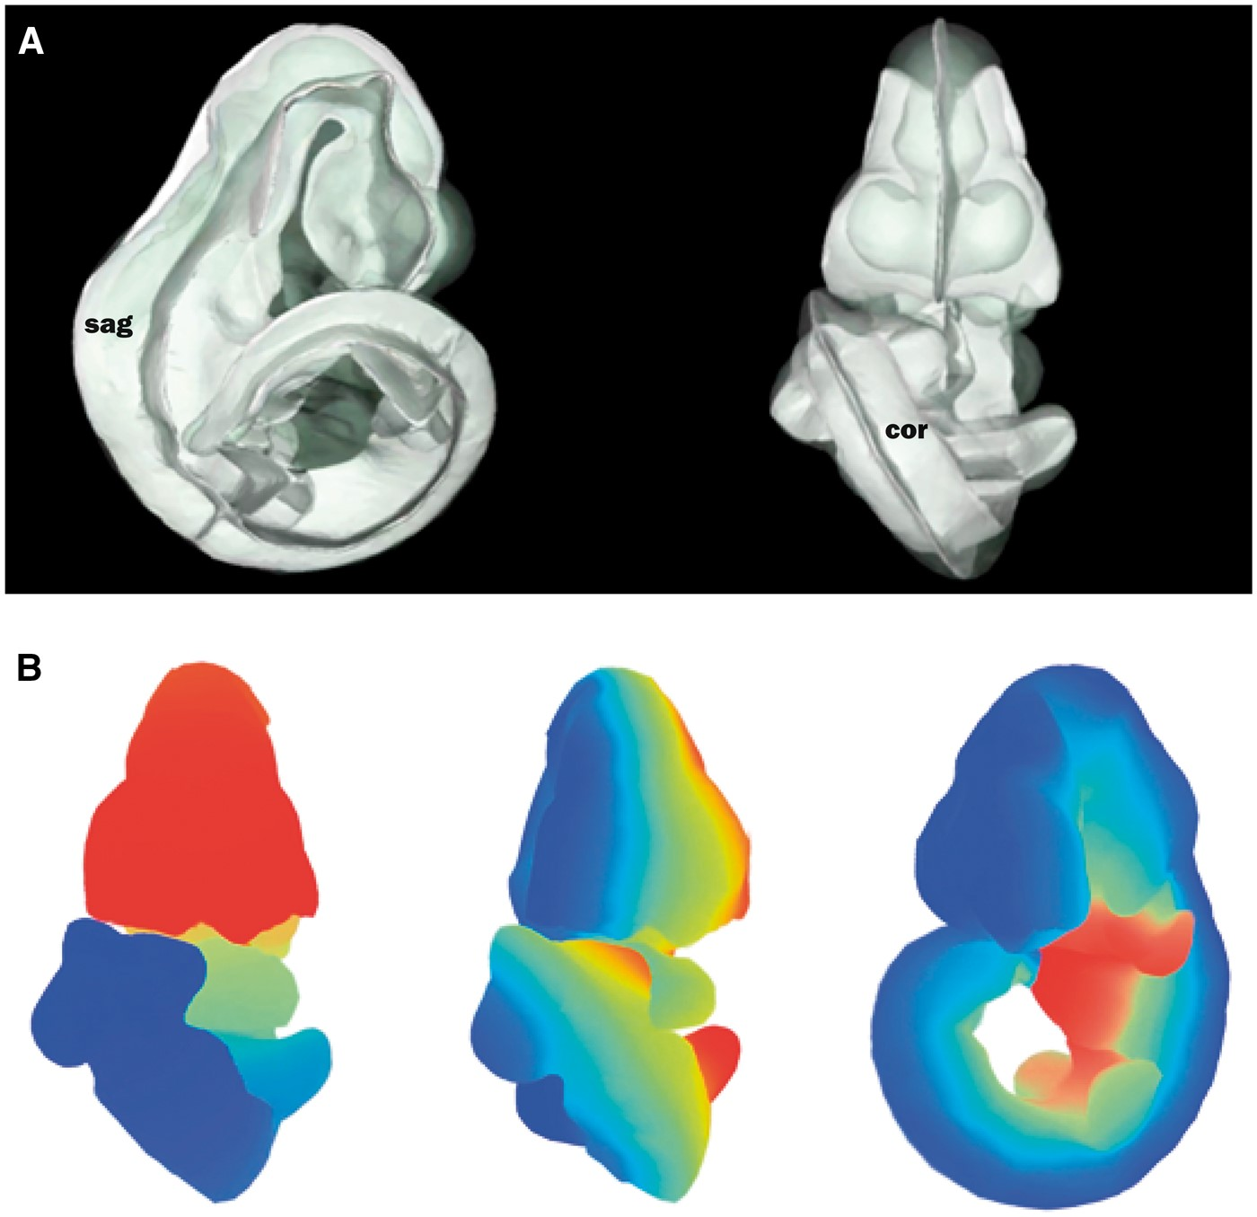
Figure 3. Defining axial planes on the 3D mouse embryo model. (A) Reverse spatial warping allowed axial planes to be ...
Notes:
Figure 3. Defining axial planes on the 3D mouse embryo model. (A) Reverse spatial warping allowed axial planes to be defined on the straight mouse embryo model. Sagittal and coronal planes from this reverse transform are shown in the context of the original 3D mouse embryo model. sag, sagittal plane; cor, coronal plane. (B) Colourmaps from red to blue used to demonstrate A–P (left), L–R (middle) and V–D (right) axes in the original, curled embryo model. These axes represent the anatomical coordinates of the embryo model.
Unless provided in the caption above, the following copyright applies to the content of this slide: © The Author(s) 2017. Published by Oxford University Press.This is an Open Access article distributed under the terms of the Creative Commons Attribution License (http://creativecommons.org/licenses/by/4.0/), which permits unrestricted reuse, distribution, and reproduction in any medium, provided the original work is properly cited.

