Slide 1
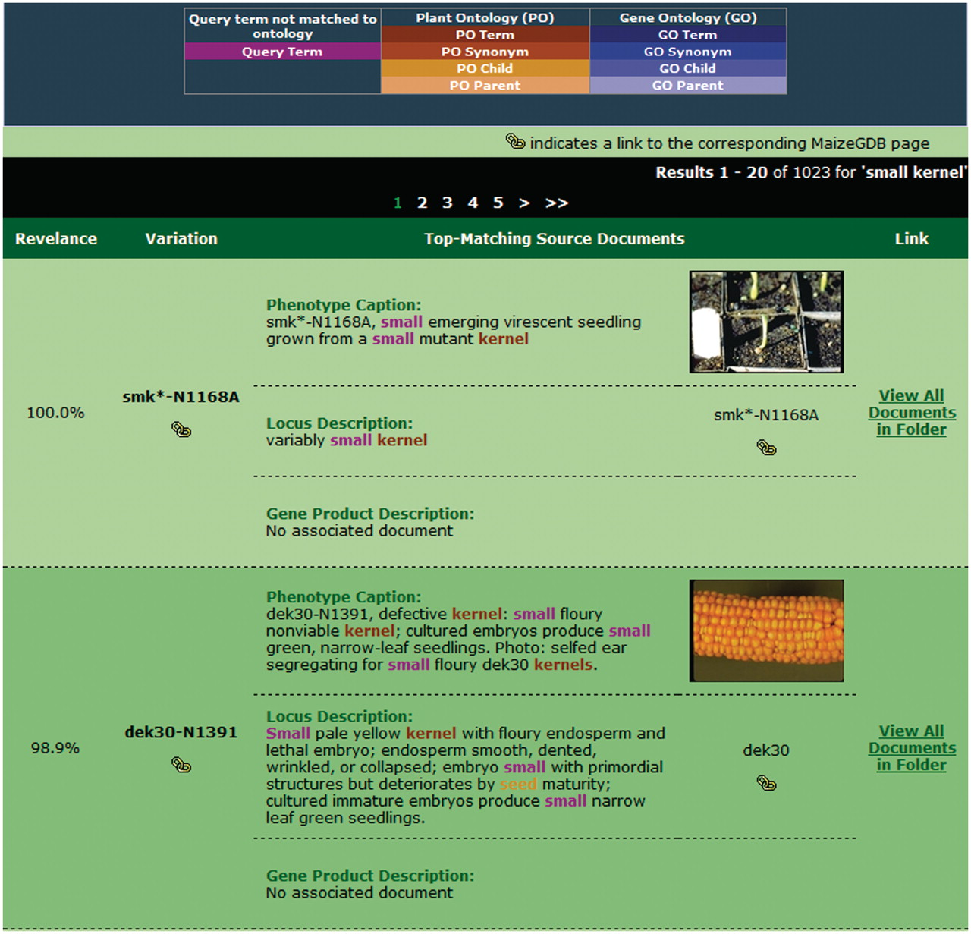
Figure 5. Sample search results for our retrieval engine using the query ‘small kernels’. Highlighted terms indicate ...
Notes:
Figure 5. Sample search results for our retrieval engine using the query ‘small kernels’. Highlighted terms indicate matches to the query (including original terms and terms included through query expansion), with the color providing information about the term.
Unless provided in the caption above, the following copyright applies to the content of this slide: © The Author(s) 2011. Published by Oxford University Press.This is Open Access article distributed under the terms of the Creative Commons Attribution Non-Commercial License (http://creativecommons.org/licenses/by-nc/2.5), which permits unrestricted non-commercial use, distribution, and reproduction in any medium, provided the original work is properly cited.

