Slide 1
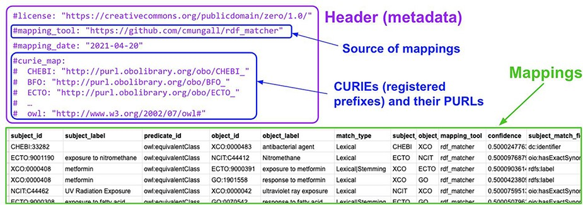
Figure 3. An example SSSOM TSV table (generated by the developers of the environmental exposure ontology (19) using ...
Notes:
Figure 3. An example SSSOM TSV table (generated by the developers of the environmental exposure ontology (19) using rdf-matcher (26)), with a table header (lines that start with #, shown in purple) that contains the mapping set metadata, followed by the mappings (27).
Unless provided in the caption above, the following copyright applies to the content of this slide: © The Author(s) 2022. Published by Oxford University Press.This is an Open Access article distributed under the terms of the Creative Commons Attribution License (https://creativecommons.org/licenses/by/4.0/), which permits unrestricted reuse, distribution, and reproduction in any medium, provided the original work is properly cited.

