Slide 1
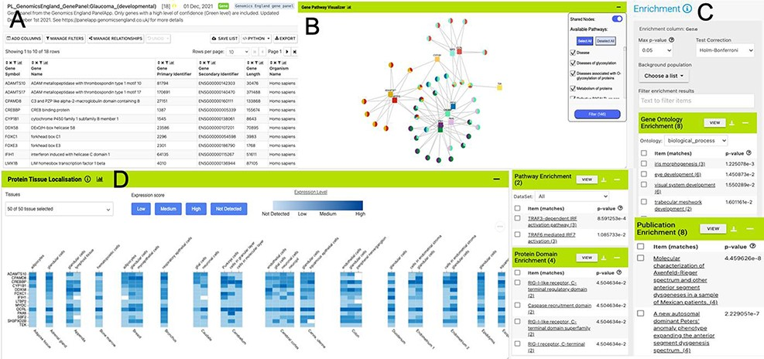
Figure 3. List analysis page for the public list: PL_GenomicsEngland_GenePanel:Glaucoma_(developmental). Like the ...
Notes:
Figure 3. List analysis page for the public list: PL_GenomicsEngland_GenePanel:Glaucoma_(developmental). Like the report pages, list analysis pages provide a number of interactive tables and graphs. A selection is shown here. (A). Interactive table summarizing the contents of the list. (B) A network graph showing Gene–Pathway connections for genes in the list. Only genes that have two or more pathway connections are shown (this option can be toggled on the menu panel). The menu panel also allows filtering of the pathway annotations used in the graph. (C) Enrichment statistics for Gene Ontology terms, Publications, Protein domains and Pathway annotations. (D) A heat map showing protein localization for each gene in the list (original data from The Protein Atlas project https://www.proteinatlas.org/humanproteome/tissue).
Unless provided in the caption above, the following copyright applies to the content of this slide: © The Author(s) 2022. Published by Oxford University Press.This is an Open Access article distributed under the terms of the Creative Commons Attribution-NonCommercial License (https://creativecommons.org/licenses/by-nc/4.0/), which permits non-commercial re-use, distribution, and reproduction in any medium, provided the original work is properly cited. For commercial re-use, please contact journals.permissions@oup.com

