Slide 1
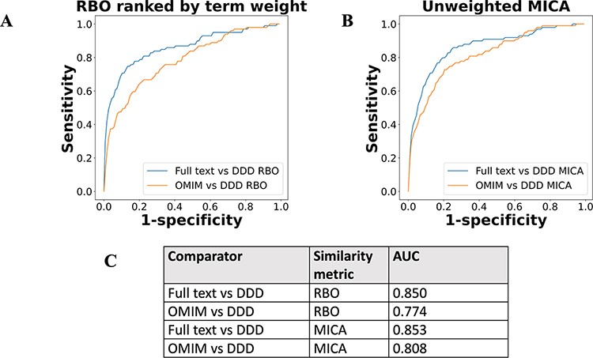
Figure 5. ROC curves using threshold ranking for literature-derived/OMIM disease models compared to real-life terms in ...
Notes:
Figure 5. ROC curves using threshold ranking for literature-derived/OMIM disease models compared to real-life terms in the DDD study, across sample of 99 diseases, with a disease model and DDD model for each. Each disease model is compared to every model in the DDD set. (A) uses RBO to compare ranked lists of terms. Literature-derived and DDD models were ranked according to the model term frequency. OMIM models were ranked according to the frequency of terms across all OMIM models. (B) uses mean MICA to compare models, with IC calculated according to Resnik. Unweighted models were used for comparison, meaning each term in a model appeared only once, and term frequencies were not utilized. (C) shows the AUC for each model comparison.
Unless provided in the caption above, the following copyright applies to the content of this slide: © The Author(s) 2022. Published by Oxford University Press.This is an Open Access article distributed under the terms of the Creative Commons Attribution-NonCommercial License (https://creativecommons.org/licenses/by-nc/4.0/), which permits non-commercial re-use, distribution, and reproduction in any medium, provided the original work is properly cited. For commercial re-use, please contact journals.permissions@oup.com

