Slide 1
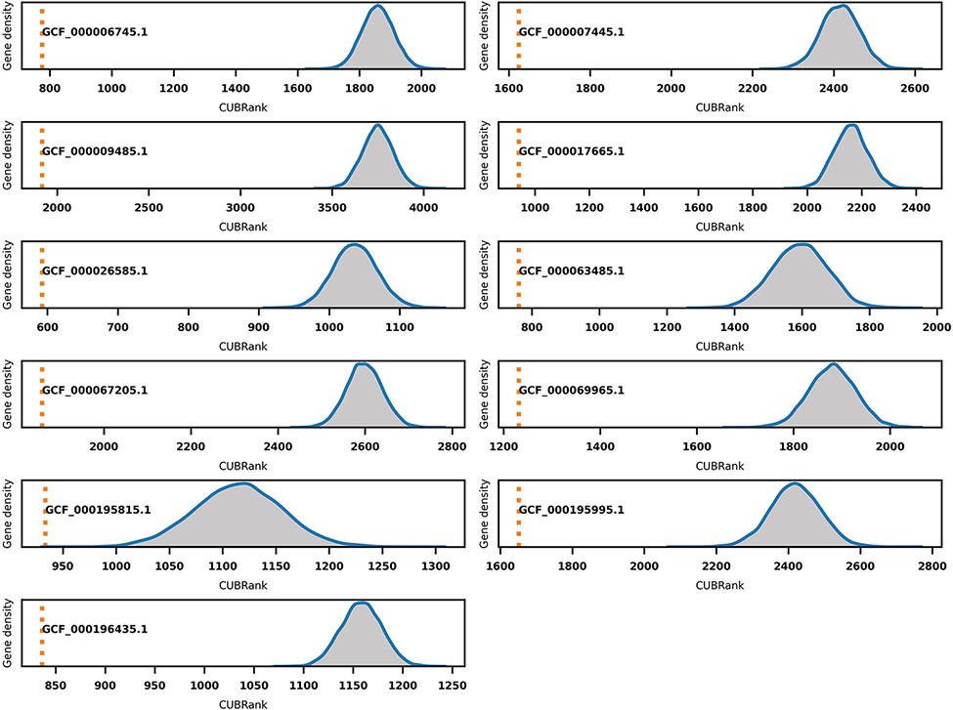
Figure 6. Monte Carlo simulation for CUBRank based on 11 species with well-studied GI annotations. The orange dotted ...
Notes:
Figure 6. Monte Carlo simulation for CUBRank based on 11 species with well-studied GI annotations. The orange dotted line represents the average CUBRank within GIs. The blue curve with gray background is the kernel density estimation of CUBRank for genes in non-GI regions in the total 10 000 Monte Carlo simulations. The annotation near orange dotted line indicates the Genbank accession number for the genome assembly (GCF_000196435.1: Bartonella tribocorum CIP 105 476, GCF_000067205.1: Bordetella petrii DSM 12 804, GCF_000009485.1: Burkholderia cenocepacia J2315, GCF_000063485.1: Clavibacter michiganensis NCPPB 382, GCF_000195815.1: Corynebacterium diphtheriae NCTC 13 129, GCF_000017665.1: Cronobacter sakazakii ATCC BAA-894, GCF_000007445.1: Escherichia coli CFT073, GCF_000069965.1: Proteus mirabilis HI4320, GCF_000195995.1: Salmonella enterica Typhi CT18, GCF_000026585.1: Streptococcus equi 4047, GCF_000006745.1: Vibrio cholerae O1 biovar eltor str. N16961).
Unless provided in the caption above, the following copyright applies to the content of this slide: © The Author(s) 2022. Published by Oxford University Press.This is an Open Access article distributed under the terms of the Creative Commons Attribution License (https://creativecommons.org/licenses/by/4.0/), which permits unrestricted reuse, distribution, and reproduction in any medium, provided the original work is properly cited.

