Slide 1
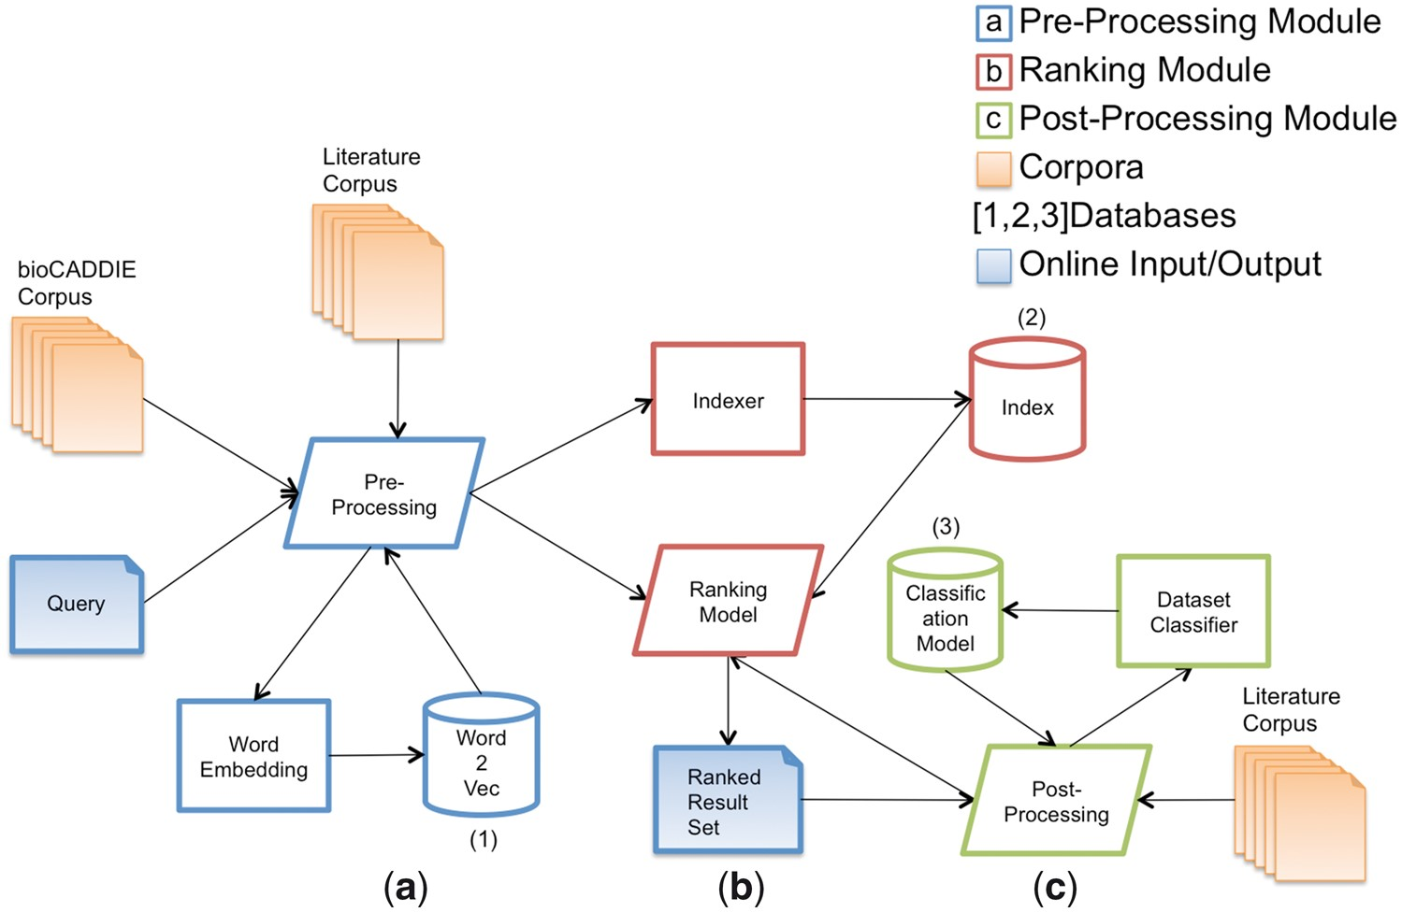
Figure 1. Architecture of the SIB Text Mining dataset retrieval system.
Notes:
Figure 1. Architecture of the SIB Text Mining dataset retrieval system.
Unless provided in the caption above, the following copyright applies to the content of this slide: © The Author(s) 2017. Published by Oxford University Press.This is an Open Access article distributed under the terms of the Creative Commons Attribution License (http://creativecommons.org/licenses/by/4.0/), which permits unrestricted reuse, distribution, and reproduction in any medium, provided the original work is properly cited.

Slide 2
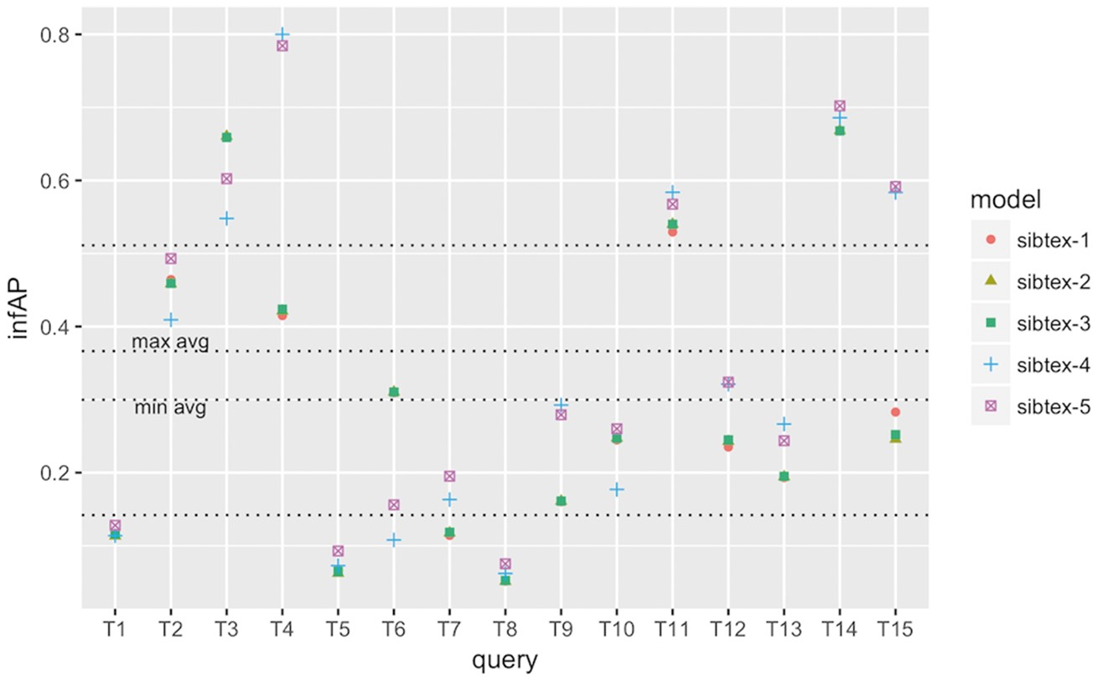
Figure 2. infAP performance at the query level for SIB Text Mining models. Results obtained using 5-fold ...
Notes:
Figure 2. infAP performance at the query level for SIB Text Mining models. Results obtained using 5-fold cross-validation. Lowest horizontal line: 1st quartile computed for all results. Highest horizontal line: 3rd quartile computed for all results. min avg horizontal line: minimum infAP among the five models. max avg horizontal line: maximum infAP among the five models.
Unless provided in the caption above, the following copyright applies to the content of this slide: © The Author(s) 2017. Published by Oxford University Press.This is an Open Access article distributed under the terms of the Creative Commons Attribution License (http://creativecommons.org/licenses/by/4.0/), which permits unrestricted reuse, distribution, and reproduction in any medium, provided the original work is properly cited.

Slide 3
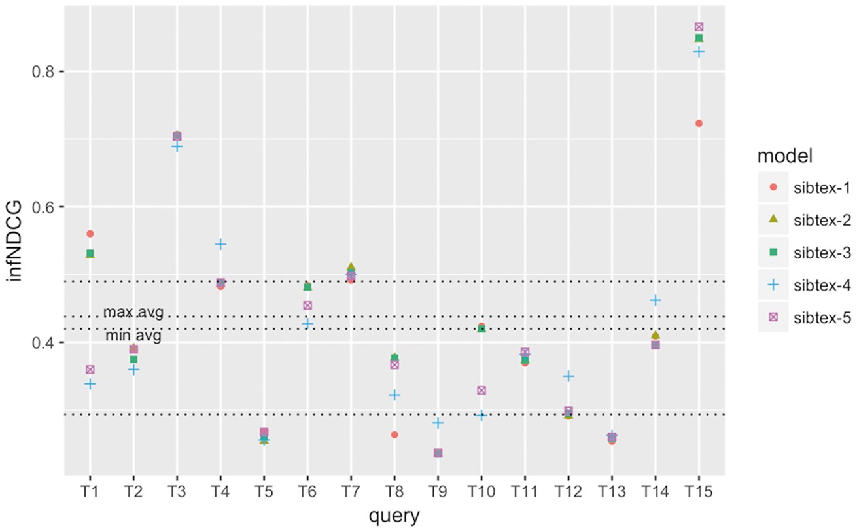
Figure 3. infNDCG performance at the query level for SIB Text Mining models. Results obtained using 5-fold ...
Notes:
Figure 3. infNDCG performance at the query level for SIB Text Mining models. Results obtained using 5-fold cross-validation. Lowest horizontal line: 1st quartile computed for all results. Highest horizontal line: 3rd quartile computed for all results. min avg horizontal line: minimum infNDCG among the five models. max avg horizontal line: maximum infNDCG among the five models.
Unless provided in the caption above, the following copyright applies to the content of this slide: © The Author(s) 2017. Published by Oxford University Press.This is an Open Access article distributed under the terms of the Creative Commons Attribution License (http://creativecommons.org/licenses/by/4.0/), which permits unrestricted reuse, distribution, and reproduction in any medium, provided the original work is properly cited.

Slide 4
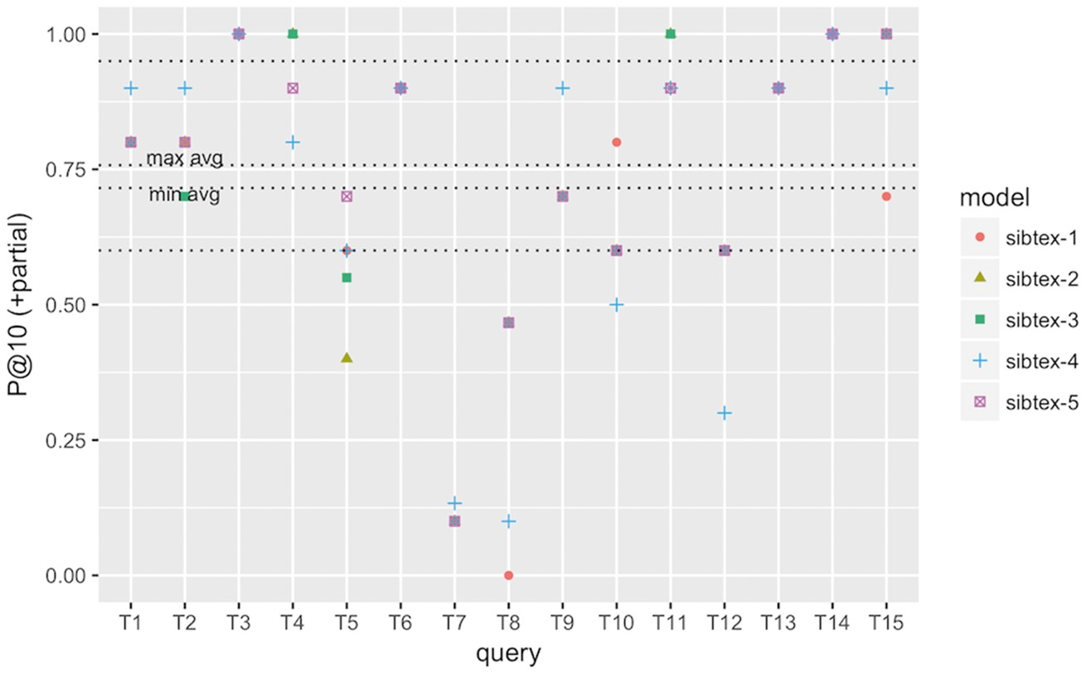
Figure 4. P@10 (+partial) performance at the query level for SIB Text Mining models. Results obtained using 5-fold ...
Notes:
Figure 4. P@10 (+partial) performance at the query level for SIB Text Mining models. Results obtained using 5-fold cross-validation. Lowest horizontal line: 1st quartile computed for all results. Highest horizontal line: 3rd quartile computed for all results. min avg horizontal line: minimum P@10 (+partial) among the five models. max avg horizontal line: maximum P@10 (+partial) among the five models.
Unless provided in the caption above, the following copyright applies to the content of this slide: © The Author(s) 2017. Published by Oxford University Press.This is an Open Access article distributed under the terms of the Creative Commons Attribution License (http://creativecommons.org/licenses/by/4.0/), which permits unrestricted reuse, distribution, and reproduction in any medium, provided the original work is properly cited.

