Slide 1
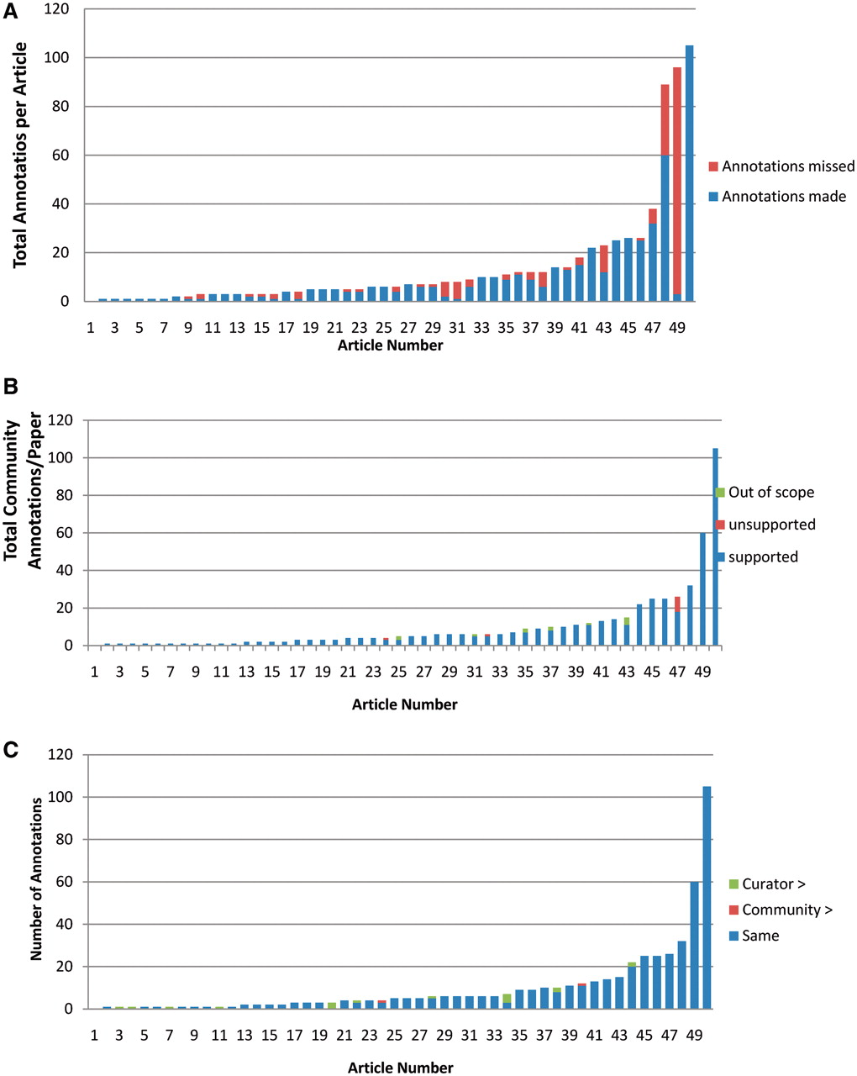
Figure 4. Analysis of community annotations. (A) Completeness of community annotations. The 50 articles analyzed are ...
Notes:
Figure 4. Analysis of community annotations. (A) Completeness of community annotations. The 50 articles analyzed are shown on X-axis, and the total number of curator and community annotations per paper shown on the Y-axis. The number of community annotations is shown in blue, and the number of added curator annotations in orange. (B) Experimental support for community annotations. Supported community annotations in blue, unsupported community annotations in orange, out of scope annotations in green. (C) Level of specificity of community annotations. Papers shown on X-axis, total number of community annotations per paper shown on Y-axis. Community annotations with same specificity as curator annotations are shown in blue, more specific community annotations in orange, more specific curator annotations in green.
Unless provided in the caption above, the following copyright applies to the content of this slide: © The Author(s) 2012. Published by Oxford University Press.This is an Open Access article distributed under the terms of the Creative Commons Attribution Non-Commercial License (http://creativecommons.org/licenses/by-nc/3.0), which permits unrestricted non-commercial use, distribution, and reproduction in any medium, provided the original work is properly cited.

Slide 2
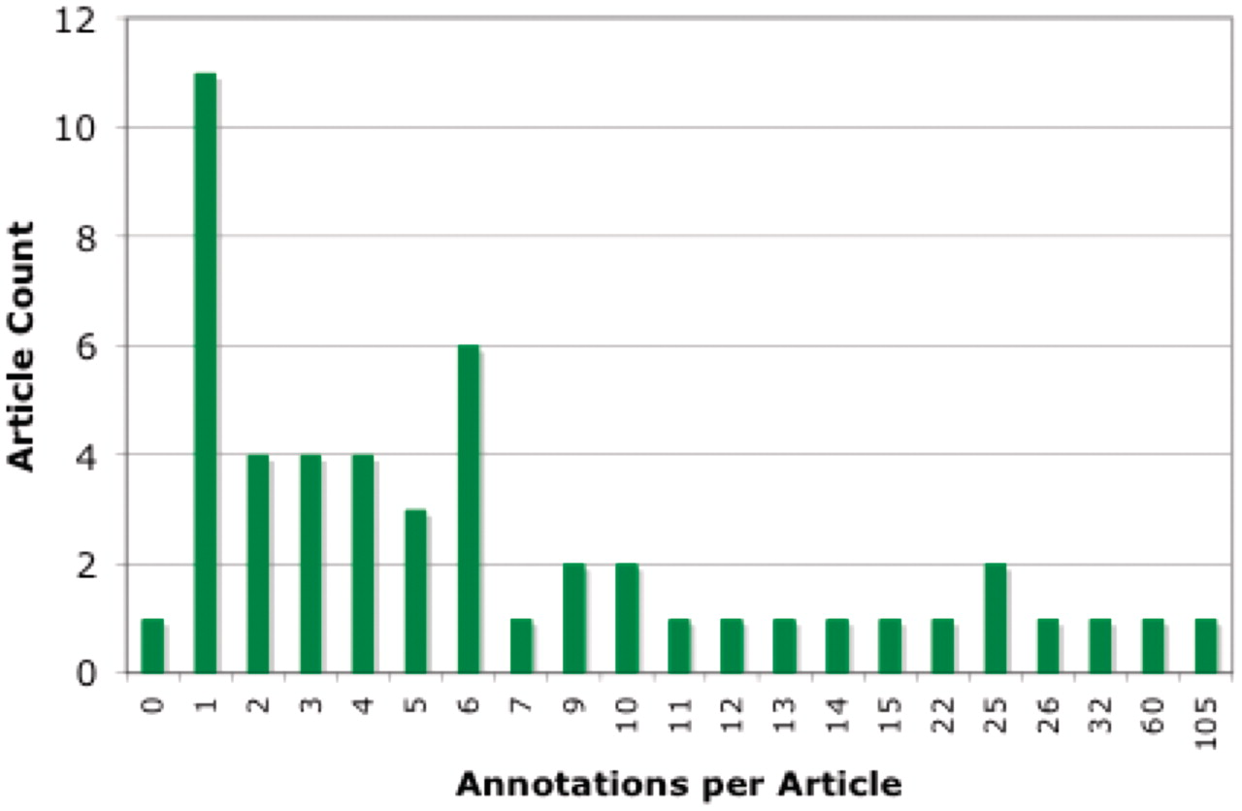
Figure 3. Distribution of community annotation counts. The bins group articles by number of associated community ...
Notes:
Figure 3. Distribution of community annotation counts. The bins group articles by number of associated community annotations.
Unless provided in the caption above, the following copyright applies to the content of this slide: © The Author(s) 2012. Published by Oxford University Press.This is an Open Access article distributed under the terms of the Creative Commons Attribution Non-Commercial License (http://creativecommons.org/licenses/by-nc/3.0), which permits unrestricted non-commercial use, distribution, and reproduction in any medium, provided the original work is properly cited.

Slide 3
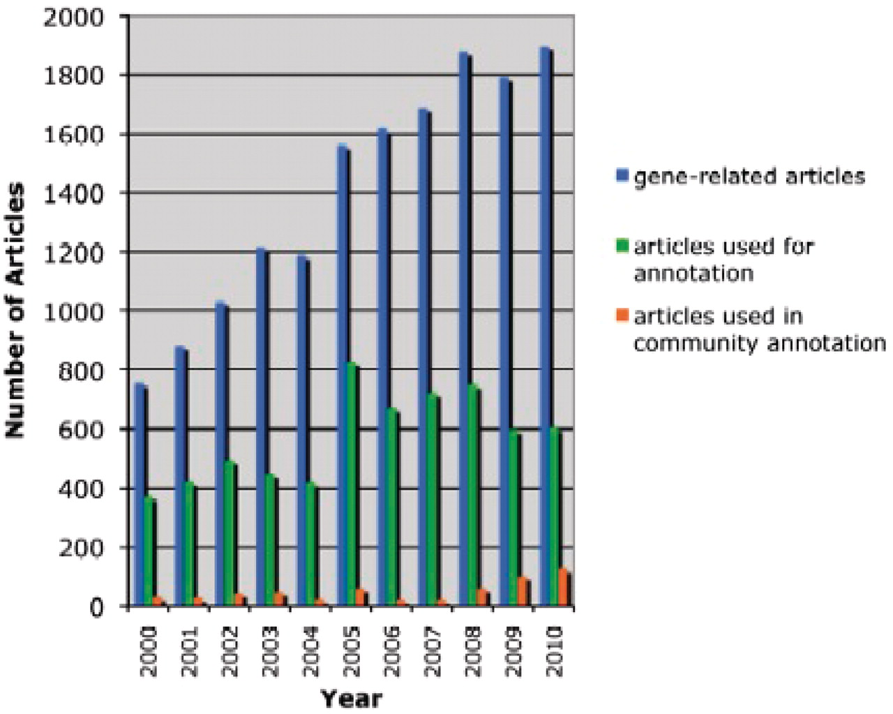
Figure 2. Literature-based annotation at TAIR (2000–2010). The total number of research articles containing Arabidopsis ...
Notes:
Figure 2. Literature-based annotation at TAIR (2000–2010). The total number of research articles containing Arabidopsis gene-related information in the TAIR database is represented in blue. In green and orange are the number of articles used for controlled vocabulary annotations by either TAIR or the community, respectively.
Unless provided in the caption above, the following copyright applies to the content of this slide: © The Author(s) 2012. Published by Oxford University Press.This is an Open Access article distributed under the terms of the Creative Commons Attribution Non-Commercial License (http://creativecommons.org/licenses/by-nc/3.0), which permits unrestricted non-commercial use, distribution, and reproduction in any medium, provided the original work is properly cited.

Slide 4
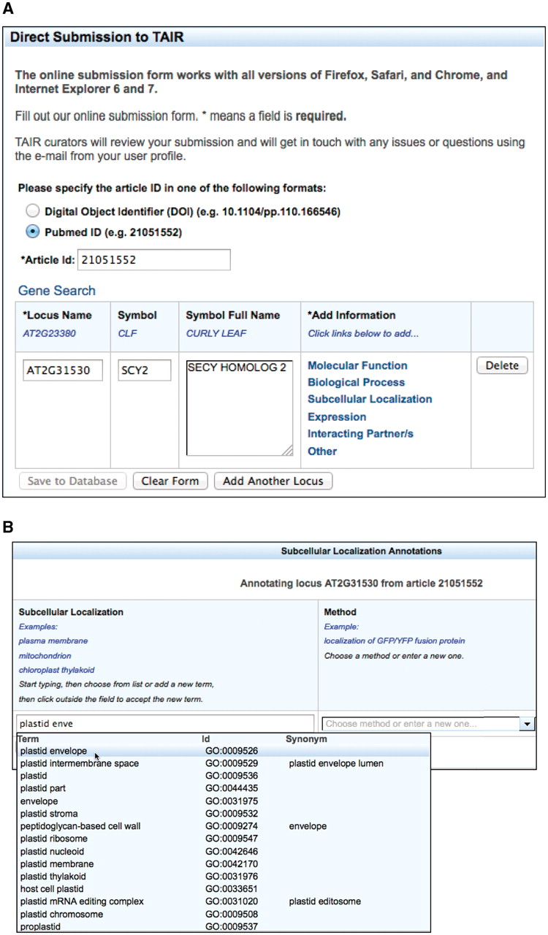
Figure 1. The TOAST interface. (A) Initial page that requests stable article identifiers and locus identifiers. Users ...
Notes:
Figure 1. The TOAST interface. (A) Initial page that requests stable article identifiers and locus identifiers. Users can then add annotations in six different areas, five of which are controlled vocabularies. (B) The subcellular localization data entry form. Submissions are aided by an auto-complete functionality which suggests terms that match the user's entry. Once selected, the appropriate stable id for the ontology term is also captured but not displayed to the submitter. Users can also enter terms not in the suggestion list. (C) Form with data ready for submission. At this stage the user may add additional loci or annotations or complete the submission process by saving to the curation database.
Unless provided in the caption above, the following copyright applies to the content of this slide: © The Author(s) 2012. Published by Oxford University Press.This is an Open Access article distributed under the terms of the Creative Commons Attribution Non-Commercial License (http://creativecommons.org/licenses/by-nc/3.0), which permits unrestricted non-commercial use, distribution, and reproduction in any medium, provided the original work is properly cited.

Slide 5
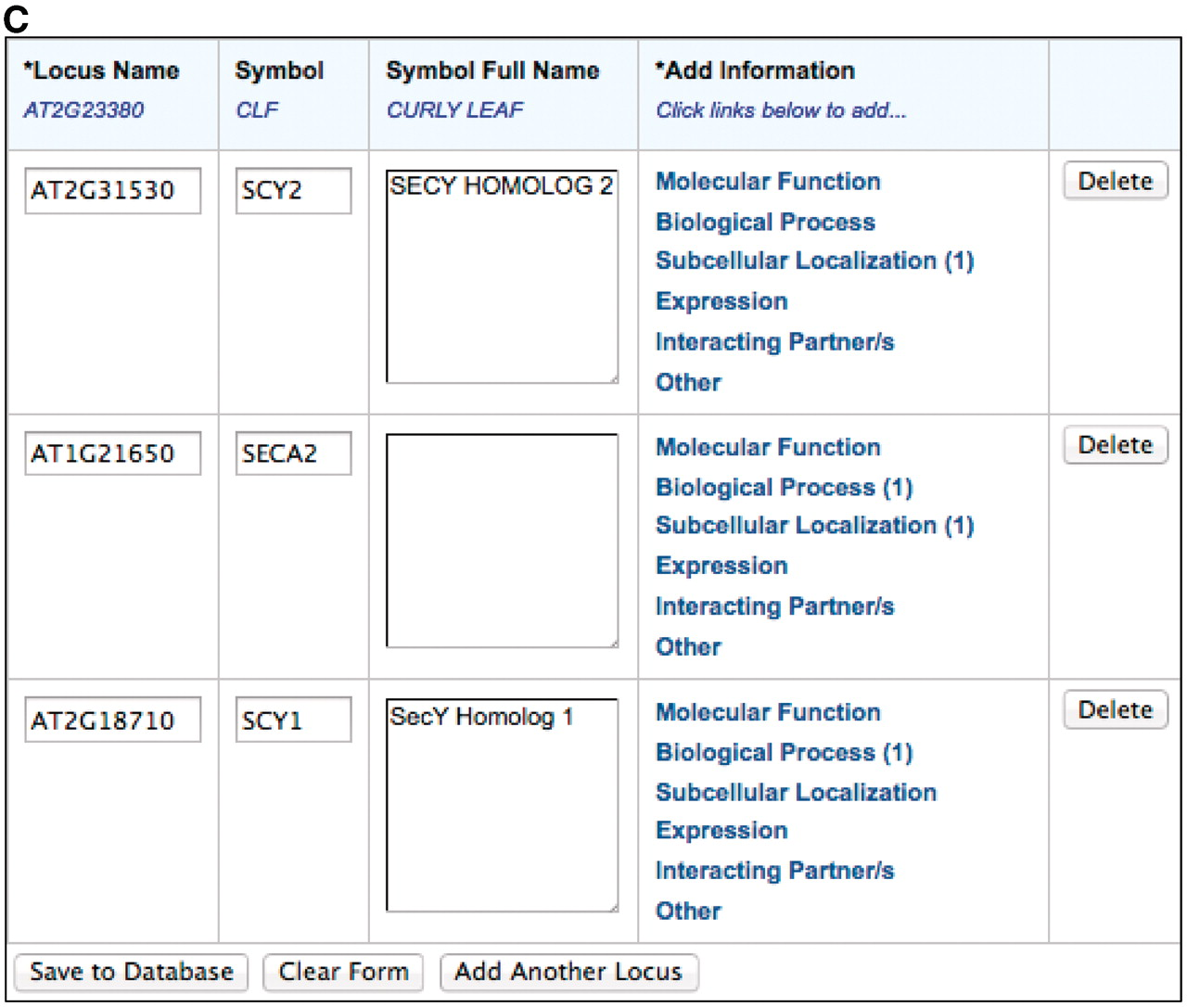
Figure 1. The TOAST interface. (A) Initial page that requests stable article identifiers and locus identifiers. Users ...
Notes:
Figure 1. The TOAST interface. (A) Initial page that requests stable article identifiers and locus identifiers. Users can then add annotations in six different areas, five of which are controlled vocabularies. (B) The subcellular localization data entry form. Submissions are aided by an auto-complete functionality which suggests terms that match the user's entry. Once selected, the appropriate stable id for the ontology term is also captured but not displayed to the submitter. Users can also enter terms not in the suggestion list. (C) Form with data ready for submission. At this stage the user may add additional loci or annotations or complete the submission process by saving to the curation database.
Unless provided in the caption above, the following copyright applies to the content of this slide: © The Author(s) 2012. Published by Oxford University Press.This is an Open Access article distributed under the terms of the Creative Commons Attribution Non-Commercial License (http://creativecommons.org/licenses/by-nc/3.0), which permits unrestricted non-commercial use, distribution, and reproduction in any medium, provided the original work is properly cited.

Slide 6
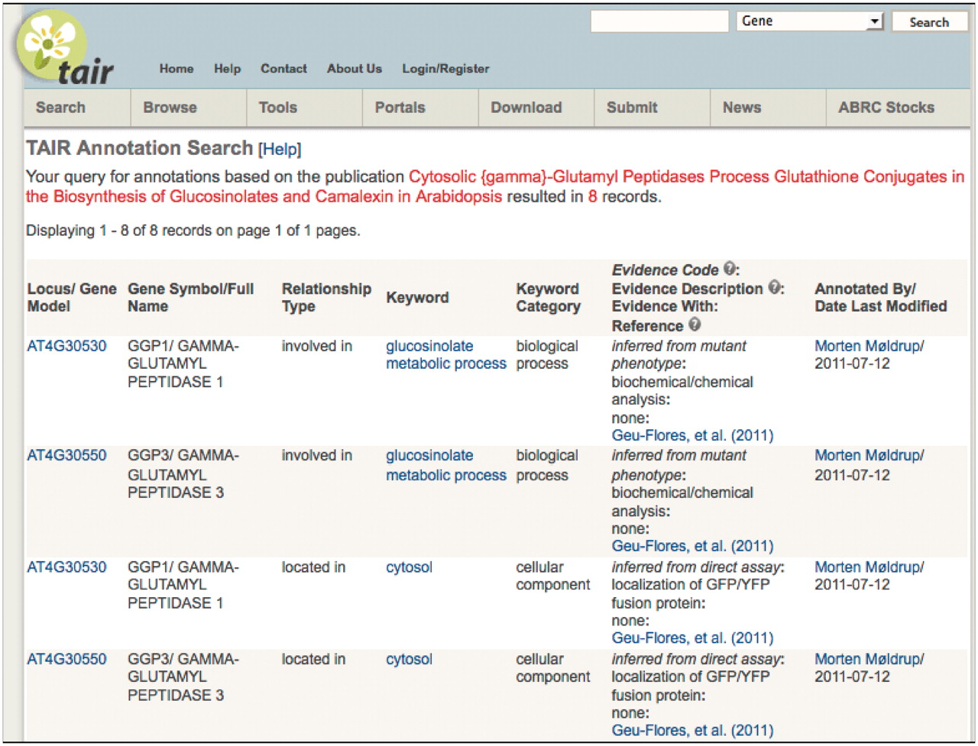
Figure 5. TAIR annotation detail page showing attribution to community member.
Notes:
Figure 5. TAIR annotation detail page showing attribution to community member.
Unless provided in the caption above, the following copyright applies to the content of this slide: © The Author(s) 2012. Published by Oxford University Press.This is an Open Access article distributed under the terms of the Creative Commons Attribution Non-Commercial License (http://creativecommons.org/licenses/by-nc/3.0), which permits unrestricted non-commercial use, distribution, and reproduction in any medium, provided the original work is properly cited.

