Slide 1
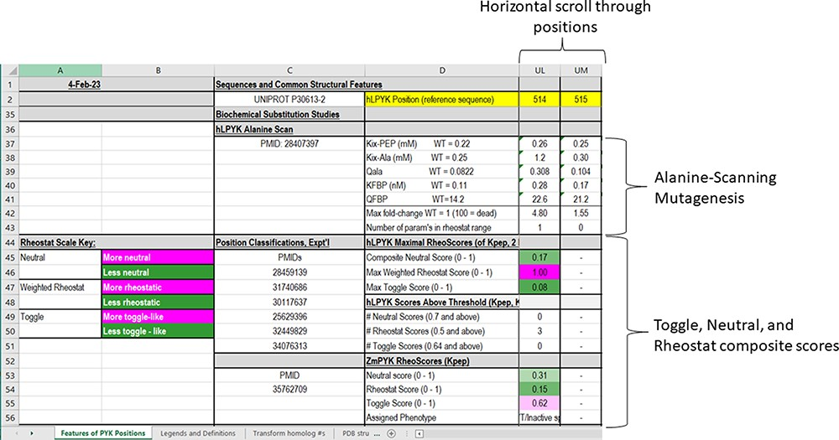
Figure 5. The fourth section of the ‘Features of PYK Positions’ worksheet in the PYK-SubstitutionOME workbook. Again, ...
Notes:
Figure 5. The fourth section of the ‘Features of PYK Positions’ worksheet in the PYK-SubstitutionOME workbook. Again, Rows 1 and 2 and Columns A–D are anchored to provide reference points; the K and Q values for wild-type hLPYK measured under the same experimental conditions (‘WT = [value]’) are included for reference. This section contains information from in vitro biochemical characterizations of purified [and partially purified (19)] PYK variants. Both information from a whole-protein, alanine-scanning mutagenesis study and RheoScale scores from semi-SM (i.e. toggle, neutral and rheostat scores) are entered here for each position. Each RheoScale score ranges from 0 to 1; the significant ranges are indicated in parentheses, and their corresponding color legends that aid visual interpretation are noted at left. Experimentally determined parameters for >1000 substituted hLPYK proteins are included in supporting worksheets.
Unless provided in the caption above, the following copyright applies to the content of this slide: © The Author(s) 2023. Published by Oxford University Press.This is an Open Access article distributed under the terms of the Creative Commons Attribution License (https://creativecommons.org/licenses/by/4.0/), which permits unrestricted reuse, distribution, and reproduction in any medium, provided the original work is properly cited.

