Slide 1
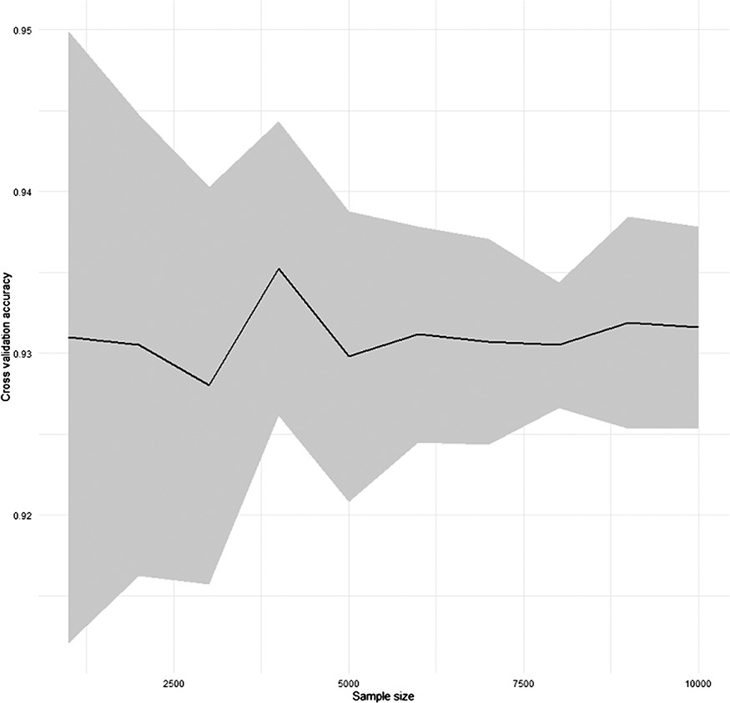
Figure 1. Result of the cross-validation for the performance of SC2sepsis automatic annotation function.
Notes:
Figure 1. Result of the cross-validation for the performance of SC2sepsis automatic annotation function.
Unless provided in the caption above, the following copyright applies to the content of this slide: © The Author(s) 2022. Published by Oxford University Press.This is an Open Access article distributed under the terms of the Creative Commons Attribution-NonCommercial License (https://creativecommons.org/licenses/by-nc/4.0/), which permits non-commercial re-use, distribution, and reproduction in any medium, provided the original work is properly cited. For commercial re-use, please contact journals.permissions@oup.com

Slide 2
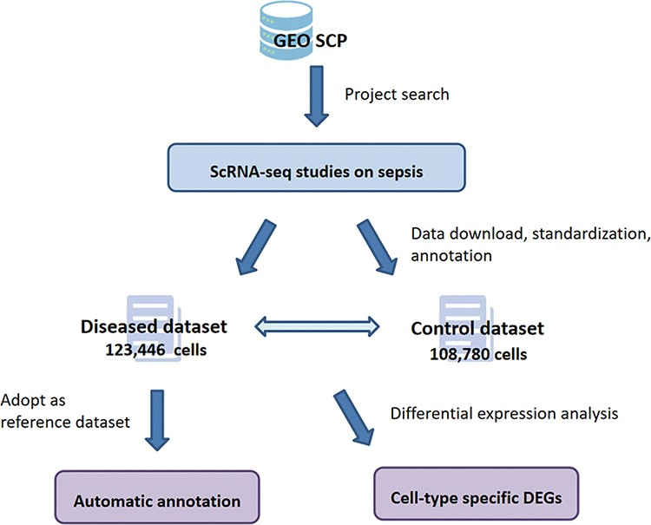
Figure 2. Overview of the workflow of SC2sepsis.
Notes:
Figure 2. Overview of the workflow of SC2sepsis.
Unless provided in the caption above, the following copyright applies to the content of this slide: © The Author(s) 2022. Published by Oxford University Press.This is an Open Access article distributed under the terms of the Creative Commons Attribution-NonCommercial License (https://creativecommons.org/licenses/by-nc/4.0/), which permits non-commercial re-use, distribution, and reproduction in any medium, provided the original work is properly cited. For commercial re-use, please contact journals.permissions@oup.com

Slide 3
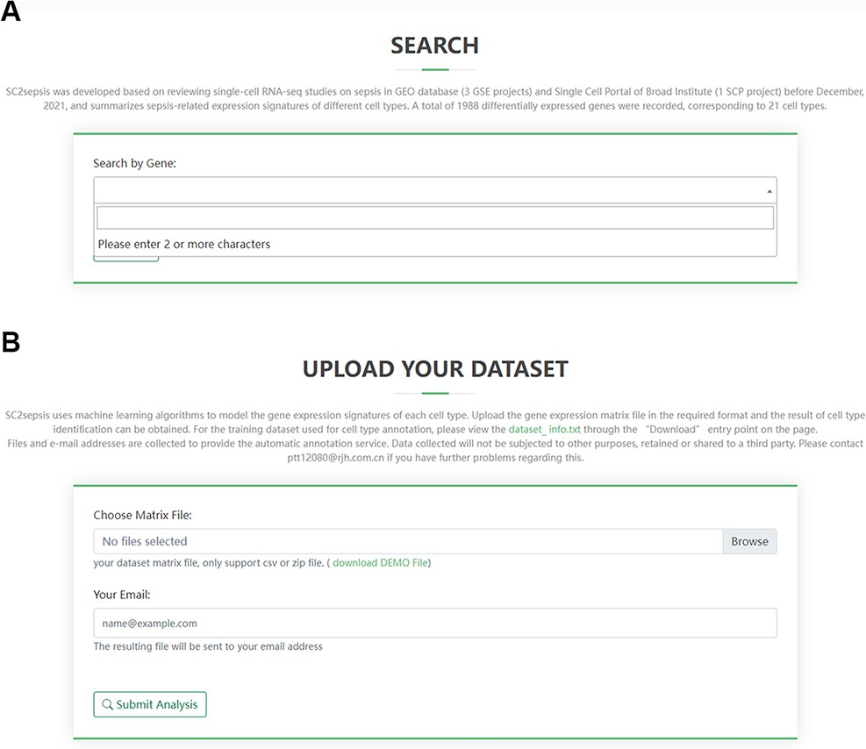
Figure 3. Overview of the search page for DEGs and the analysis page for users’ matrix data. (A) Search term input ...
Notes:
Figure 3. Overview of the search page for DEGs and the analysis page for users’ matrix data. (A) Search term input page. (B) Upload page for users’ matrix files.
Unless provided in the caption above, the following copyright applies to the content of this slide: © The Author(s) 2022. Published by Oxford University Press.This is an Open Access article distributed under the terms of the Creative Commons Attribution-NonCommercial License (https://creativecommons.org/licenses/by-nc/4.0/), which permits non-commercial re-use, distribution, and reproduction in any medium, provided the original work is properly cited. For commercial re-use, please contact journals.permissions@oup.com

Slide 4
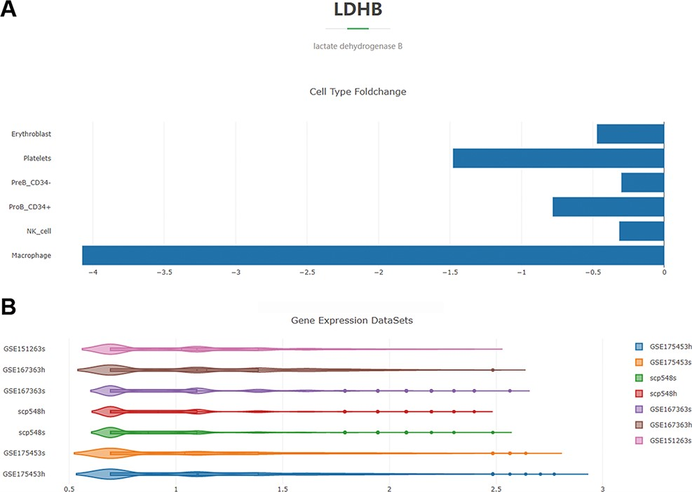
Figure 4. Overview of the DEG search result with the gene ‘LDHB’ as an example. (A) Histogram showing the log2 ...
Notes:
Figure 4. Overview of the DEG search result with the gene ‘LDHB’ as an example. (A) Histogram showing the log2 fold-change values of the cell-type-specific expression levels of LDHB in the septic versus healthy condition. (B) Violin plot of the expression-level distribution of LDHB across all the septic and healthy cells of the four projects.
Unless provided in the caption above, the following copyright applies to the content of this slide: © The Author(s) 2022. Published by Oxford University Press.This is an Open Access article distributed under the terms of the Creative Commons Attribution-NonCommercial License (https://creativecommons.org/licenses/by-nc/4.0/), which permits non-commercial re-use, distribution, and reproduction in any medium, provided the original work is properly cited. For commercial re-use, please contact journals.permissions@oup.com

