Slide 1
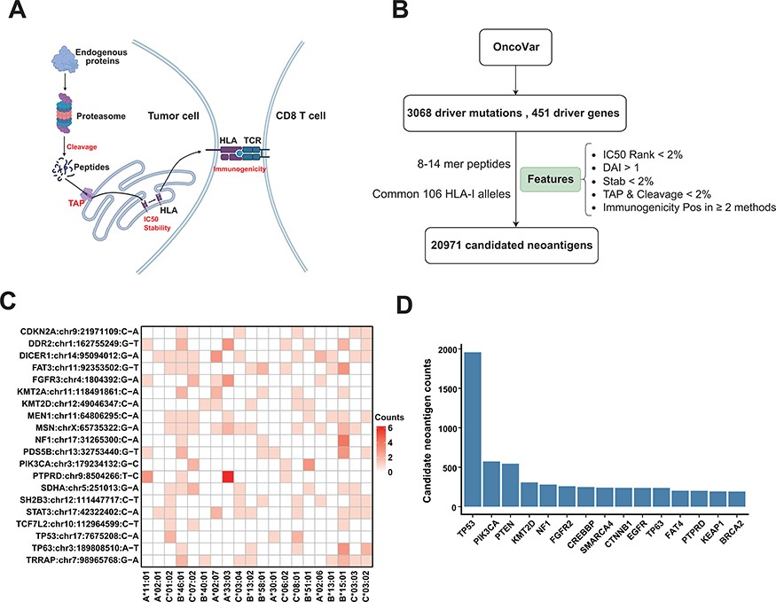
Figure 4. Candidate neoantigens of common cancer driver mutations. (A) The process of antigen presentation, including ...
Notes:
Figure 4. Candidate neoantigens of common cancer driver mutations. (A) The process of antigen presentation, including proteasome cleavage, transport into the endoplasmic reticulum by TAP, binding to HLA and then being presented to the cell surface to activate T cells. The processes of cleavage, translocating into endoplasmic reticulum by TAP, binding to HLA molecule and interacting with TCR are key steps in the antigen presentation process, so we use these features to filter neoantigens produced by common driver mutations as shown in (B) illustration of procedures for obtaining the list of potential neoantigens from common driver mutations by multiple features. (C) Common driver mutations that generate the top 20 amount of neoantigens and corresponding HLA allele (only show HLA alleles with top 20 population frequency). (D) The top 15 genes that can generate the largest number of potential neoantigens.
Unless provided in the caption above, the following copyright applies to the content of this slide: © The Author(s) 2023. Published by Oxford University Press.This is an Open Access article distributed under the terms of the Creative Commons Attribution License (https://creativecommons.org/licenses/by/4.0/), which permits unrestricted reuse, distribution, and reproduction in any medium, provided the original work is properly cited.

