Slide 1
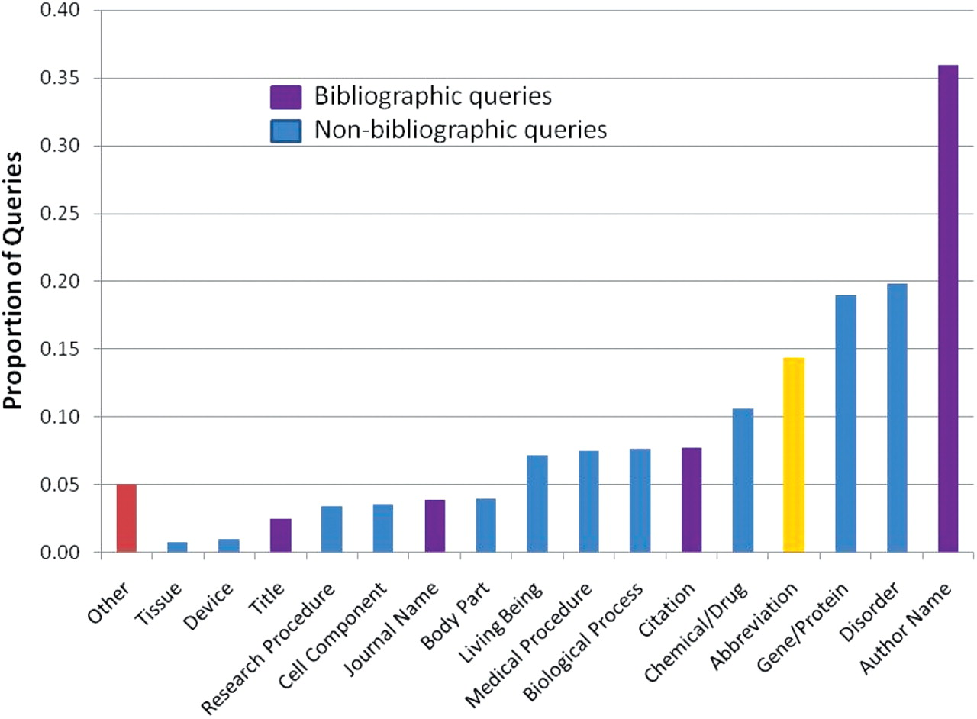
Figure 4. Annotated queries by category. Queries annotated with bibliographic categories (Author Name, Citation, ...
Notes:
Figure 4. Annotated queries by category. Queries annotated with bibliographic categories (Author Name, Citation, Journal Name and MEDLINE Title) are shown in purple, queries annotated with non-bibliographic categories (Gene/Protein, Disorder, Chemical/Drug, Biological Process, Medical Procedure, Living Being, Research Procedure, Cell Component, Body Part, Device or Tissue) are shown in blue, the percentage of queries containing an abbreviation is shown in yellow, and the queries that could not be fitted in the proposed set of categories are shown in red.
Unless provided in the caption above, the following copyright applies to the content of this slide: © The Author(s) 2009. Published by Oxford University Press.This is Open Access article distributed under the terms of the Creative Commons Attribution Non-Commercial License (http://creativecommons.org/licenses/by-nc/2.5/uk/) which permits unrestricted non-commercial use, distribution, and reproduction in any medium, provided the original work is properly cited.

