Slide 1
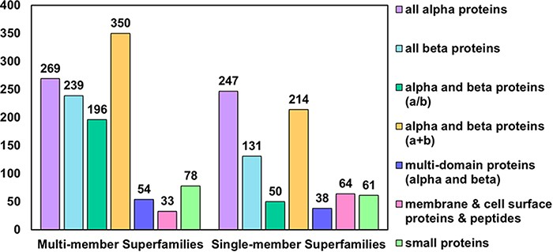
Figure 1. Distribution of MMS and SMS considered in PASS2.7 across the seven classes of SCOPe. The most represented ...
Notes:
Figure 1. Distribution of MMS and SMS considered in PASS2.7 across the seven classes of SCOPe. The most represented class as in the case of MMS is that of alpha and beta proteins (a+b) followed by all-alpha proteins, while in the case of SMS, the reverse holds.
Unless provided in the caption above, the following copyright applies to the content of this slide: © The Author(s) 2022. Published by Oxford University Press.This is an Open Access article distributed under the terms of the Creative Commons Attribution License (https://creativecommons.org/licenses/by/4.0/), which permits unrestricted reuse, distribution, and reproduction in any medium, provided the original work is properly cited.

