Slide 1
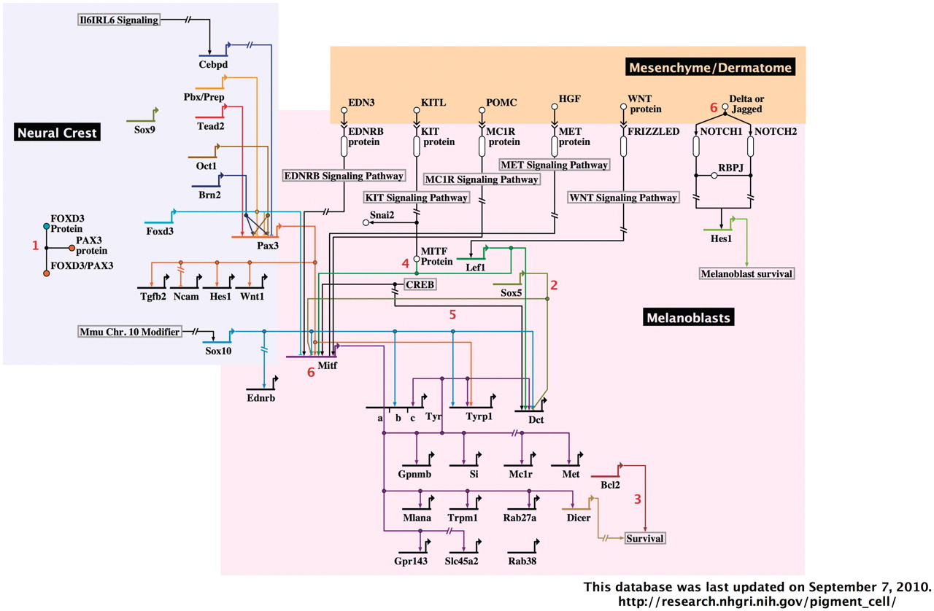
Figure 2. A representative image from the interactive, BioTapestry-generated Pigment Cell Gene Network. The portion of ...
Notes:
Figure 2. A representative image from the interactive, BioTapestry-generated Pigment Cell Gene Network. The portion of the network containing neural crest and melanoblasts with associated dermatome are shown. Red numbers represent interactive notes, which in the online network become visible by mouse-over. Regions included in the complete diagram are categorized by developmental stage/cell type, as follows: neural crest, melanoblasts and associated dermatome, follicular melanocyte stem cells, follicular/dermal melanocytes and associated keratinocytes and RPE.
Unless provided in the caption above, the following copyright applies to the content of this slide: Published by Oxford University Press 2010.This is Open Access article distributed under the terms of the Creative Commons Attribution Non-Commercial License (http://creativecommons.org/licenses/by-nc/2.5), which permits unrestricted non-commercial use, distribution, and reproduction in any medium, provided the original work is properly cited.

